Slide 1


Turning Film and Literary Tourism
into Immersive Experiences
Workshop 04
Learn how to promote and sell immersive film and literary tourism experiences by turning stories into compelling visitor journeys.
Explore how storytelling can bring places, characters, and narratives to life while helping you communicate your experience clearly across websites, social media, and tourism platforms to attract visitors and encourage bookings.
Promoting and Selling Immersive Film & Literary Experiences Through Storytelling
January 2026
By Feltech Ireland

Slide 2

Contents
Introduction (Page 3)
Challenges (Page 7)
Opportunities (Page 8)
Overview Workshop 4 (Page 9)
Turning Story Moments into Promotional Hooks (Page 12)
Case Study: Hobbiton Movie Set (New Zealand) (Page 15)
Using Characters and Perspectives to Promote Experiences (Page 16)
Case Study: Sherlock Holmes Museum (London) (Page 19)
Creating Shareable Story Moments (Page 20)
Case Study: Harry Potter Studio Tour (London) (Page 22)
Making the Experience Easy to Understand and Book (Page 23)
Case Study: Outlander Filming Location Tours (Scotland) (Page 25)

Slide 3
How This Workshop Builds on the Previous Sessions
This workshop builds on the previous sessions exploring immersive tourism, experience design, and financial planning.
While Workshop 1 introduced immersive tourism concepts, Workshop 2 explored story and audience alignment, and Workshop 3 focused on financial planning and responsible implementation, this workshop focuses on how immersive experiences can be successfully promoted and sold.
In this session we explore:
• using storytelling to communicate the value of immersive experiences
• turning story moments into compelling promotional messages
• designing visitor journeys that make experiences easy to discover and book
• using digital platforms and social media to reach new audiences
This workshop explores how to clearly communicate, promote, and sell immersive film and literary experiences in ways that feel authentic, practical, and aligned with your business goals.
It focuses on how storytelling can help introduce your experience to potential visitors, communicate its value, and encourage participation. You will explore practical ways to present your offer, select appropriate promotion channels, and design simple pricing, booking, and on-site visitor journeys that make the experience easy to understand and access.
The aim is to turn curiosity into participation — helping people discover your immersive experience, connect with the story behind it, and feel confident about how to take part, without adding unnecessary complexity or pressure.

Slide 4

Workshop 4
Promoting and Selling Immersive Film & Literary Experiences Through Storytelling.
Photo Credit: Image title

Slide 5
From Storytelling to Visitor Bookings
The purpose of this workshop is to explore how storytelling can be used not only to design immersive experiences, but also to promote, communicate, and sell them effectively
In film and literary tourism, the story itself is often the strongest marketing tool.
Visitors are rarely motivated by a location alone—they are motivated by the opportunity to step into the world of a story they already love or are curious to discover.
This workshop, therefore, focuses on how tourism businesses can translate narrative elements—characters, scenes, emotions, and plot moments—into compelling promotional messages and visitor journeys.
Participants will examine how storytelling can shape promotional materials, social media content, booking descriptions, and on-site experiences so that potential visitors immediately understand what makes the experience special and why it is worth participating in.
Rather than relying on traditional tourism advertising, this approach encourages businesses to use narrative-led promotion, where the story becomes the gateway that attracts visitors, builds emotional anticipation, and encourages participation.
Why is this important?
Promoting immersive film and literary experiences requires a different approach from promoting traditional tourism products. Visitors are not simply looking for attractions; they are seeking experiences that allow them to connect emotionally with stories, characters, and places they recognise from film or literature. Understanding how storytelling can drive discovery and decision-making is therefore essential.
Stories Drive Travel Motivation
Many visitors travel specifically because they want to experience locations connected to stories they love. Films, television series, and novels often create powerful emotional connections with audiences.

Slide 6
When these stories are linked to real places, those places become meaningful destinations. For example, fans travel to filming locations, author homes, landscapes described in novels, or towns that inspired fictional settings. Effective promotion highlights these connections and invites visitors to step into the narrative world.
Storytelling Creates Emotional Anticipation
Successful tourism promotion does more than provide information—it creates a sense of anticipation. When visitors encounter promotional content that references iconic scenes, characters, or story moments, they begin imagining themselves inside that experience.
This emotional anticipation is a powerful motivator in tourism decision-making. Instead of simply advertising a tour or attraction, storytelling allows businesses to frame their offer as a narrative journey visitors can become part of.
Immersive Experiences Need Clear Communication
Immersive experiences can sometimes be difficult to explain. Words such as “immersive,” “interactive,” or “experiential” may sound appealing but may not clearly convey what the visitor will actually do. Effective storytelling in promotion helps clarify the experience by describing moments, actions, and interactions that visitors will recognise and understand.
For example, rather than saying “interactive literary experience,” a promotional message might say:
"Step into the world of the novel and follow the footsteps of its characters through the streets where the story unfolds.“
This approach helps potential visitors visualise the experience before they arrive.
Storytelling Encourages Sharing and Word-of-Mouth
Immersive experiences naturally generate moments visitors want to share with others. Photos, videos, and social media posts become part of the promotional ecosystem. When storytelling is central to the experience, visitors are more likely to describe and share their journey, helping attract new audiences organically.

Slide 7
Key Challenges
Promoting immersive film and literary tourism experiences can present several challenges, particularly for small tourism businesses with limited resources or marketing capacity.
Challenges
Explaining Immersive Experiences Clearly
Immersive experiences are still relatively new in many tourism markets. Visitors may not immediately understand what an immersive experience involves or how it differs from a traditional tour or museum visit. Businesses must therefore communicate clearly what visitors will see, hear, or do, using storytelling examples rather than abstract descriptions.
Translating Stories into Promotional Messages
Another challenge is converting complex narratives into short, engaging promotional messages. Films and novels often contain rich and detailed stories, but promotional content must capture attention quickly. Businesses must identify the most compelling elements of the story—such as a key character, dramatic moment, or setting—and use those elements as entry points for visitors.
Competing for Attention in a Crowded Digital Environment
Tourism businesses today compete for attention across multiple digital platforms including social media, travel blogs, booking platforms, and tourism websites. Standing out requires compelling content that captures attention quickly. Story-based promotion can be highly effective, but it requires creativity and consistency.
Limited Marketing Resources
Many small tourism businesses do not have dedicated marketing teams or large advertising budgets. This can make it difficult to produce professional promotional materials or maintain a consistent online presence. However, storytelling-based promotion can often be achieved with simple tools, such as short videos, blog posts, or narrated images.
Converting Interest into Bookings
Even when visitors find an experience interesting, they may hesitate to book if the process is unclear or complicated. Ensuring that storytelling promotion leads smoothly into booking systems, clear pricing, and easy participation is an important step in turning curiosity into action.

Slide 8
Key Opportunities
Despite these challenges, storytelling provides powerful opportunities for tourism businesses seeking to promote immersive film and literary experiences.
The Story is Already the Attraction
Unlike many tourism products that must create a narrative from scratch, film and literary tourism already has a built-in storytelling foundation. Popular books, films, and television series have established characters, settings, and narratives that audiences recognise. Tourism experiences can build on this existing emotional connection, allowing visitors to continue their relationship with the story in a real-world setting.
Narrative-Based Promotion is Highly Engaging
Story-based marketing often performs better than traditional advertising because it engages audiences emotionally. Instead of simply presenting information, narrative promotion invites audiences into a story. For example, a short video showing a character walking through a filming location or a guide reading a passage from a novel at a real site can immediately capture attention.
Social Media Amplifies Storytelling
Social media platforms are particularly well suited to storytelling promotion. Short videos, behind-the-scenes content, character reenactments, and location-based storytelling can reach large audiences quickly. Visitors who participate in immersive experiences often share their own photos and videos online, helping extend the promotional reach of the experience.
Partnerships with Cultural and Tourism Organisations
Film and literary tourism experiences often connect with cultural institutions, festivals, museums, libraries, and tourism boards. These partnerships can expand promotional reach through shared marketing campaigns, cross-promotion, and themed tourism routes. For example, a literary trail might collaborate with local bookstores, theatres, or festivals celebrating the author’s work.
Creating Shareable Story Moments
Immersive experiences often contain visually memorable or emotionally powerful moments that visitors want to photograph or record. These moments can become powerful promotional tools. When visitors share their experiences online, they contribute to organic marketing that introduces the experience to new audiences.
8

Slide 9
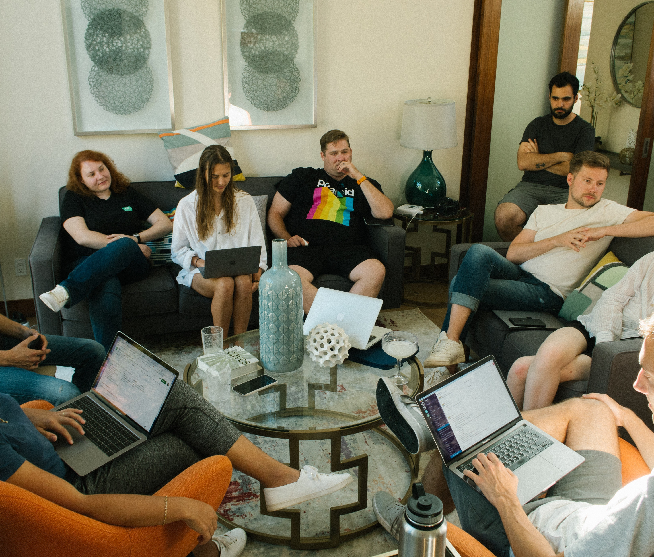
Time to Explore Immersive Opportunities
Workshop Discussion Section
Workshop Discussion Section
This section helps you think practically about how to communicate, promote, and sell your immersive film or literary experience through storytelling. It encourages you to consider how your story, location, or cultural connection can capture attention, spark curiosity, and inspire visitors to take part.
The aim is not to create complicated marketing strategies, but to ensure your experience is clearly communicated, emotionally engaging, and easy for visitors to discover and participate in.
Approach the questions conversationally — for personal reflection, team discussion, or group workshops. There are no right or wrong answers. The goal is to explore possibilities, uncover opportunities, and identify authentic ways to share your story so visitors recognise its value and feel inspired to step into the experience.

Slide 10
Overview to Discussion Workshop
Executive Summary:
Even the most creative immersive experience will fail if visitors cannot easily understand or book it.
This workshop explores how storytelling can be used to:
• attract attention
• communicate the experience clearly
• convert curiosity into bookings.
In Workshop 4 and Implementation Clinic 4, we focus on marketing and selling fully-developed immersive tourism experiences. Recognising that film and literary tours are built around stories, we emphasise using those story elements in promotion.
We define the visitor journey stages (Discovery → Interest → Evaluation → Booking) and a narrative-driven messaging framework (Hook–Promise–Proof–CTA) for each.
Workshop 4 covers concepts and discussion: leveraging story hooks, analysing examples (e.g. Airbnb ghost tours, Hemingway pub crawl), and developing key messages without repeating branding or audience work.
Purpose of Discussion:
In this interactive session, we explore how to turn the tour’s story into effective marketing.
(We do not redo positioning or concept design from Workshop 2; instead, we focus on communication.)
Because these tours are based on beloved narratives, we’ll emphasize highlighting story elements in promotion (e.g. referencing characters, quotes, plot settings) to attract fans.
We discuss the visitor’s decision stages and how to craft messages that guide them from first notice to booking.

Slide 11

The Visitor Discovery Journey
Quick reminder from Workshop and Clinic 2
1 Discovery
Visitors encounter the story online.
2 Curiosity
They learn about the location or narrative.
3 Engagement
They explore the immersive experience.
4 Booking
They decide to participate.
5 Sharing
They share the experience online.

Slide 12
1
Workshop Topic
Turning Story Moments into Promotional Hooks
Why This Matters
In film and literary tourism, the story is often the primary reason people travel. Visitors are drawn by the opportunity to experience places connected to beloved characters, scenes, or narratives. However, promotional materials sometimes focus too heavily on locations or logistics rather than the story itself. By highlighting key narrative moments—dramatic scenes, emotional turning points, or memorable character experiences—tourism businesses can create promotional messages that capture attention and help visitors immediately imagine themselves inside the story world.
Using story moments as promotional hooks helps turn passive interest into curiosity and encourages visitors to explore the experience further.
Definitions
Story Moment
A specific event, scene, or emotional turning point within a film or literary narrative that captures the essence of the story.
Promotional Hook
A short, compelling message or visual that sparks curiosity and encourages audiences to learn more about an experience.
Narrative Marketing
A promotional approach that uses storytelling elements—characters, conflict, setting, or journey—to communicate the value of an experience.
Examples
A literary walking tour could promote itself not simply as a city tour but as:
"Walk the streets where the detective followed his final clue.“
A film location experience might highlight a dramatic scene:
"Stand where the final battle scene was filmed and see the landscape that shaped the story.“
Instead of listing locations, the promotion connects the visitor directly to the narrative.

Slide 13
Workshop Topic
Turning Story Moments into Promotional Hooks
Discussion Questions
What moment from the story connected to your location would capture a visitor’s imagination?
Example context: Is there a famous scene, dramatic moment, or emotional turning point connected to your place?
How could that moment be described in one or two sentences to attract attention?
Example: Instead of “literary walking tour,” you might say:
"Follow the footsteps of the poet through the streets that inspired his most famous verses.“
Could this moment be shown visually in promotional material?
Examples include: a short video, a photograph of the location or a reenacted scene
Show & Tell Example
A tourism business connected to a historical novel creates a short promotional video showing an actor reading a dramatic passage from the book while standing in the real location where the story is set. This clip becomes the central promotional piece for social media and helps audiences immediately connect the place with the story.

Slide 14
Immersive & Digital Technology Considerations
Digital tools can help transform story moments into engaging promotional content that brings the narrative to life before visitors arrive.
For example, short-form video platforms such as Instagram Reels, TikTok, or YouTube Shorts allow tourism businesses to recreate or highlight dramatic scenes connected to their location.
A 20–30 second video showing a key moment from the story—such as a character walking through a real location or a narrator reading a passage from a novel—can immediately capture attention and communicate the emotional value of the experience.
Augmented reality (AR) can also support promotional storytelling. Using simple AR tools, a location can be overlaid with visual elements from the story. When potential visitors scan a QR code or image, they might see a character appear, a historical scene unfold, or a key narrative moment recreated digitally.
For SMEs with limited technical capacity, even simple tools such as Canva video storytelling templates, AI voice narration, or 360° photography can create compelling digital storytelling previews that act as promotional hooks.
Examples
30-second social media video showing the moment a famous film scene was shot.
A QR code on a brochure that launches a short audio reading from the novel.
A simple AR animation that briefly recreates a key moment from the story.

Slide 15
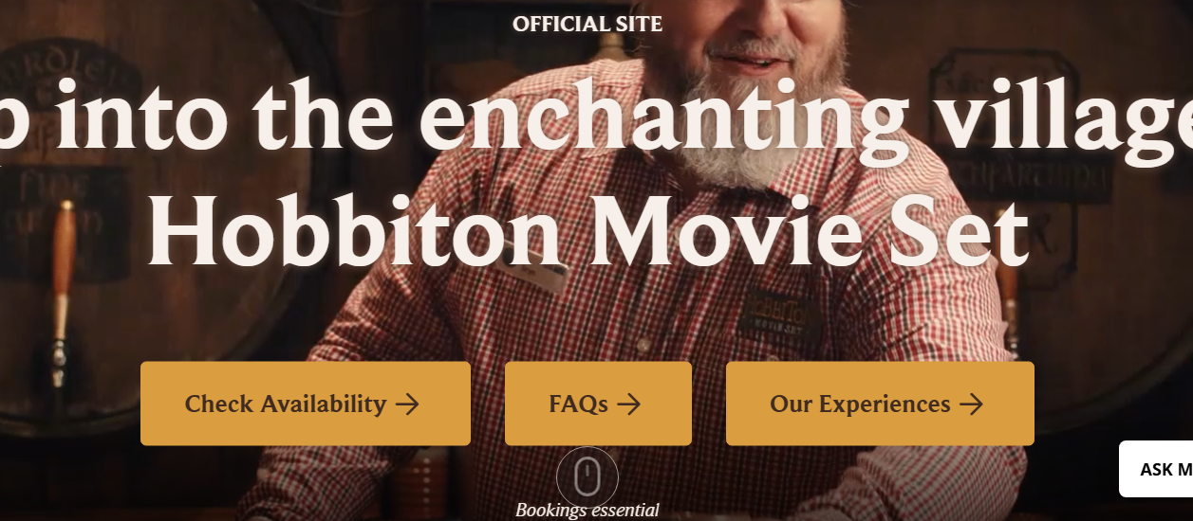
CASE STUDY
Turning Story Moments into Promotional Hooks
with Hobbiton Movie Set (New Zealand)
One of the most successful examples of using a story moment as a promotional hook comes from the filming location of The Lord of the Rings and The Hobbit.
Instead of promoting the location simply as a film set, Hobbiton markets itself through the story experience:
"Step into the Shire and explore the world of Hobbits.“
Visitors are invited to walk through the same landscapes where the story unfolds, see the Hobbit holes, and experience the setting that audiences recognise from the films. The promotional messaging focuses on entering the world of the story, not just visiting a location.
Why it works
Uses a clear narrative hook (the Shire)
Connects immediately with fans of the films
Allows visitors to imagine themselves inside the story world
https://www.hobbitontours.com/

Slide 16
2
Workshop Topic
Using Characters and Perspectives to Promote Experiences
Why this Matters
Stories are often remembered through characters. Visitors may feel connected to a hero, narrator, or author, and this emotional connection can become a powerful promotional tool. By presenting experiences from the perspective of a character or storyteller, tourism businesses can create marketing messages that feel more engaging and personal.
Character-based storytelling allows visitors to imagine themselves stepping into the role of the protagonist or walking alongside the author who created the story.
Definitions
Character Perspective: Promoting an experience by framing the story through the viewpoint of a character or narrator.
Narrative Voice: The tone or perspective used to tell a story, which shapes how audiences interpret and connect with the narrative.
Experiential Framing: Presenting an activity as an experience rather than a product or service.
Examples
Instead of saying: "Guided literary tour of the town.“
A character-based approach might say: "Follow the path the young heroine took as she escaped through the old town streets.“
Another example: "Join the detective’s investigation and uncover clues hidden across the city."

Slide 17
Workshop Topic
Using Characters and Perspectives to Promote Experiences
Discussion Questions
Is there a character, narrator, or storyteller connected to your location?
Example: An author, fictional hero, or historical figure.
How could the experience be described from their perspective?
Example: "Walk with the poet through the landscapes that shaped his imagination.“
Could visitors interact with the story through a character-based experience?
Examples include: a character guide, audio narration in a character voice or a short dramatic introduction.
Show & Tell Example
At a literary festival, actors perform short monologues from famous novels in the locations where the scenes take place. Visitors experience the story through the characters’ voices, creating a memorable promotional moment shared widely on social media.

Slide 18
Immersive & Digital Technology Considerations
Digital tools can help bring characters and storytellers into promotional content in engaging ways. Character voices can be introduced through audio narration, video storytelling, or interactive digital guides.
For example, a tourism business could create a short character introduction video, where an actor or narrator speaks directly to the audience from the perspective of the character or author connected to the story. This type of storytelling can be shared through social media, websites, or digital visitor guides.
AI-based voice narration tools can also help create character-driven audio experiences. A short character monologue could be triggered when visitors scan a QR code or access a mobile-friendly web page.
More immersive experiences could use location-based storytelling apps that allow visitors to hear the story through the character’s voice as they walk through real locations connected to the narrative.
Examples
Audio narration spoken from the perspective of a character.
Short social media videos introducing a character or narrator.
Location-based storytelling apps where characters guide visitors through a story trail.

Slide 19
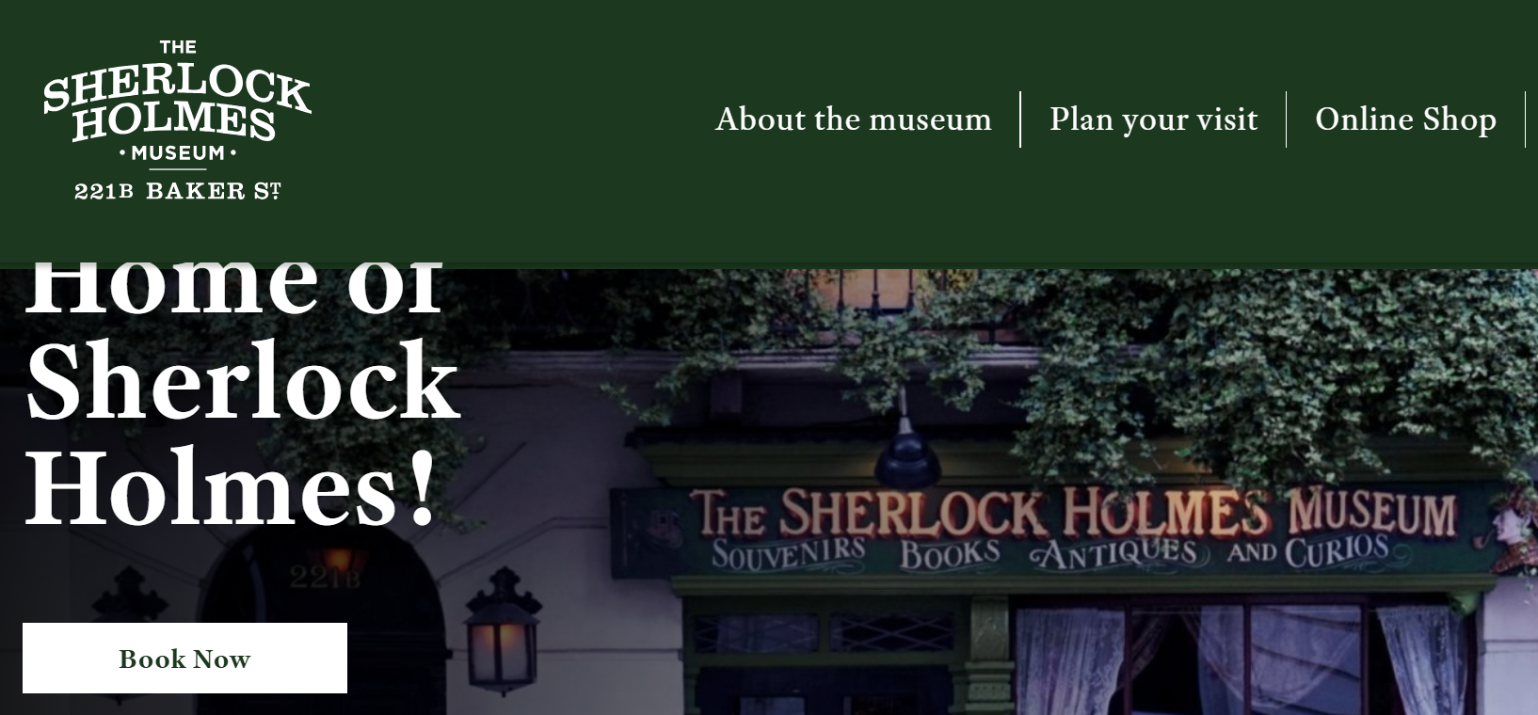
CASE STUDY
Using Characters and Perspectives to Promote Experiences
with Sherlock Holmes Museum (London)
The Sherlock Holmes Museum at 221B Baker Street promotes its experience through the perspective of the famous fictional detective.
Visitors are not simply entering a museum; they are stepping into Holmes’ world.
The museum recreates the rooms described in the novels and introduces visitors to the story through characters such as Holmes and Dr Watson.
This character-based storytelling helps visitors feel as if they have entered the narrative.
https://www.sherlock-holmes.co.uk/

Slide 20
3
Workshop Topic
Creating Shareable Story Moments
Why This Matters
In the digital age, visitors often become promoters of tourism experiences through social media. If an experience includes visually striking or emotionally powerful moments, visitors are more likely to share photos, videos, or personal reflections online. These shared moments can significantly increase visibility and attract new audiences.
Designing experiences with shareable story moments in mind can turn visitors into ambassadors for the experience.
Definitions
Shareable Moment: A visually or emotionally memorable part of an experience that visitors are likely to photograph or share online.
User-Generated Content: Content created by visitors themselves, such as photos, videos, or reviews.
Social Amplification: The process where shared content spreads to wider audiences through social media networks.
Examples of shareable moments include:
standing in a famous film location
recreating a scene from a movie
posing with props related to a literary character
interacting with immersive digital elements.
Discussion Questions
What moment in your experience might visitors want to photograph or share online?
Could the experience include a visual storytelling moment?
Examples: a viewpoint, a recreated scene, a character encounter.

Slide 21
Workshop Topic
Creating Shareable Story Moments
How could visitors be encouraged to share their experience?
Example:
A sign saying:
"Share your story moment here."
Show & Tell Example
A film location experience installs a simple sign marking the exact camera position used in a famous scene. Visitors stand in the same spot to recreate the moment, photograph it, and share the experience online.
Immersive & Digital Technology Considerations
Immersive technologies can help create visually memorable moments that visitors want to share online. Social media platforms thrive on visually engaging content, so designing experiences with photogenic or interactive storytelling moments can significantly increase visibility.
Augmented reality filters or effects can allow visitors to temporarily “step into” the story by appearing in costume, standing beside a character, or recreating a scene. These filters can be shared instantly through social media platforms, helping extend the reach of the experience.
Interactive digital installations or projection mapping can also transform physical locations into storytelling environments that visitors want to capture and share.
Even simple technologies—such as a QR code linking to a short video reenactment—can create shareable experiences.
Examples
Instagram AR filter allowing visitors to appear in a film scene.
A projection of a famous literary quote onto a building at night.
A QR code that launches a short animated scene connected to the story.

Slide 22
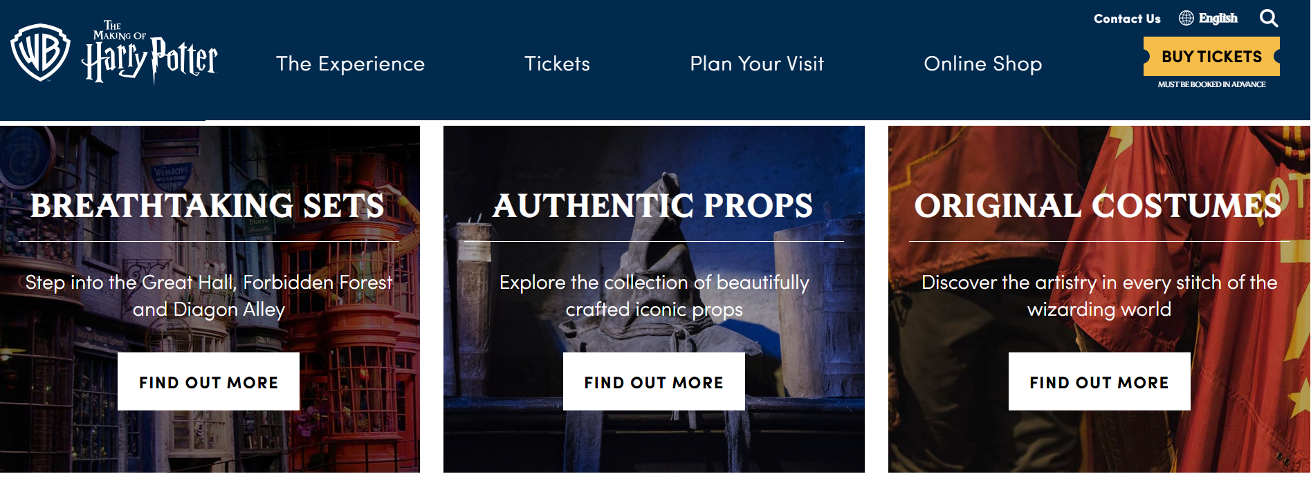
CASE STUDY
Creating Shareable Story Moments
with Harry Potter Studio Tour (London)
The Warner Bros Studio Tour creates many visually memorable moments that visitors naturally share online.
Visitors can:
• ride a broomstick using green screen technology
• see the Hogwarts Express
• walk through the Great Hall
These moments are designed to be photographed and shared.
As a result, thousands of visitors post images on social media, which acts as powerful promotion for the attraction.
https://www.wbstudiotour.co.uk/

Slide 23
4
Workshop Topic
Making the Experience
Easy to Understand and Book
Why This Matters
Even the most creative immersive experience can struggle if visitors do not clearly understand what is being offered. Promotional messages must quickly explain the value of the experience and make it easy for visitors to book or participate.
Clear communication helps visitors decide quickly whether the experience is right for them.
Definitions
Visitor Journey: The steps a visitor takes from discovering an experience to booking and participating.
Conversion: When a potential visitor becomes a paying participant.
Call to Action: A clear instruction encouraging visitors to take the next step, such as booking or visiting.
Examples
Examples of clear promotional messages include:
"Join a 60-minute immersive walking experience exploring the film locations behind the story.“
"Book your place and step into the world of the novel."
Discussion Questions
How clearly does your promotional material explain the experience visitors will have?
What key information do visitors need to know?
Examples: duration, price, location, booking method.
Is the booking process simple and easy to follow?

Slide 24
Workshop Topic
Making the Experience
Easy to Understand and Book
Show & Tell Example
A literary trail creates a clear booking page with a short video introduction, visitor photos, and a simple booking button. The improved clarity increases bookings significantly.
Immersive & Digital Technology Considerations
Digital tools play an important role in ensuring visitors can easily understand and book immersive experiences. Clear communication and simple booking systems help convert interest into participation.
A well-designed website or booking page can include storytelling elements such as short introductory videos, interactive maps, or immersive previews that show visitors what the experience will feel like.
Interactive digital maps can help visitors explore the locations connected to the story before they book. These maps might highlight filming locations, literary landmarks, or key narrative moments.
Digital ticketing platforms and mobile booking systems also make it easier for visitors to reserve places quickly.
Examples
• An interactive map showing locations connected to the story.
• A short introductory video explaining the immersive experience.
• Online booking systems integrated directly into the website.

Slide 25
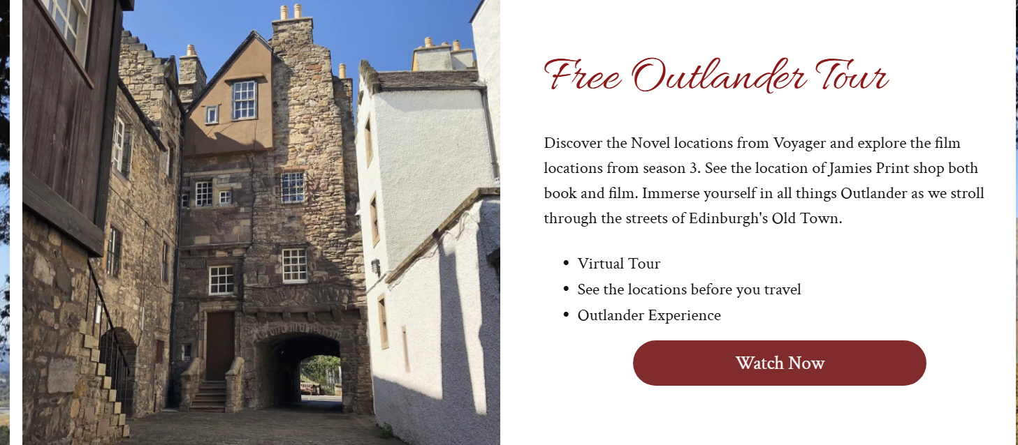
CASE STUDY
Making the Experience Easy to Understand and Book
Outlander Filming Location Tours (Scotland)
Many tours in Scotland promote locations from the TV series Outlander.
Tour descriptions clearly explain:
• which locations will be visited
• how they connect to the series
• how long the experience lasts
Visitors immediately understand what the tour offers and how it connects to the story.
This clarity helps convert interest into bookings.
https://www.outlandertour.co.uk/

Slide 26
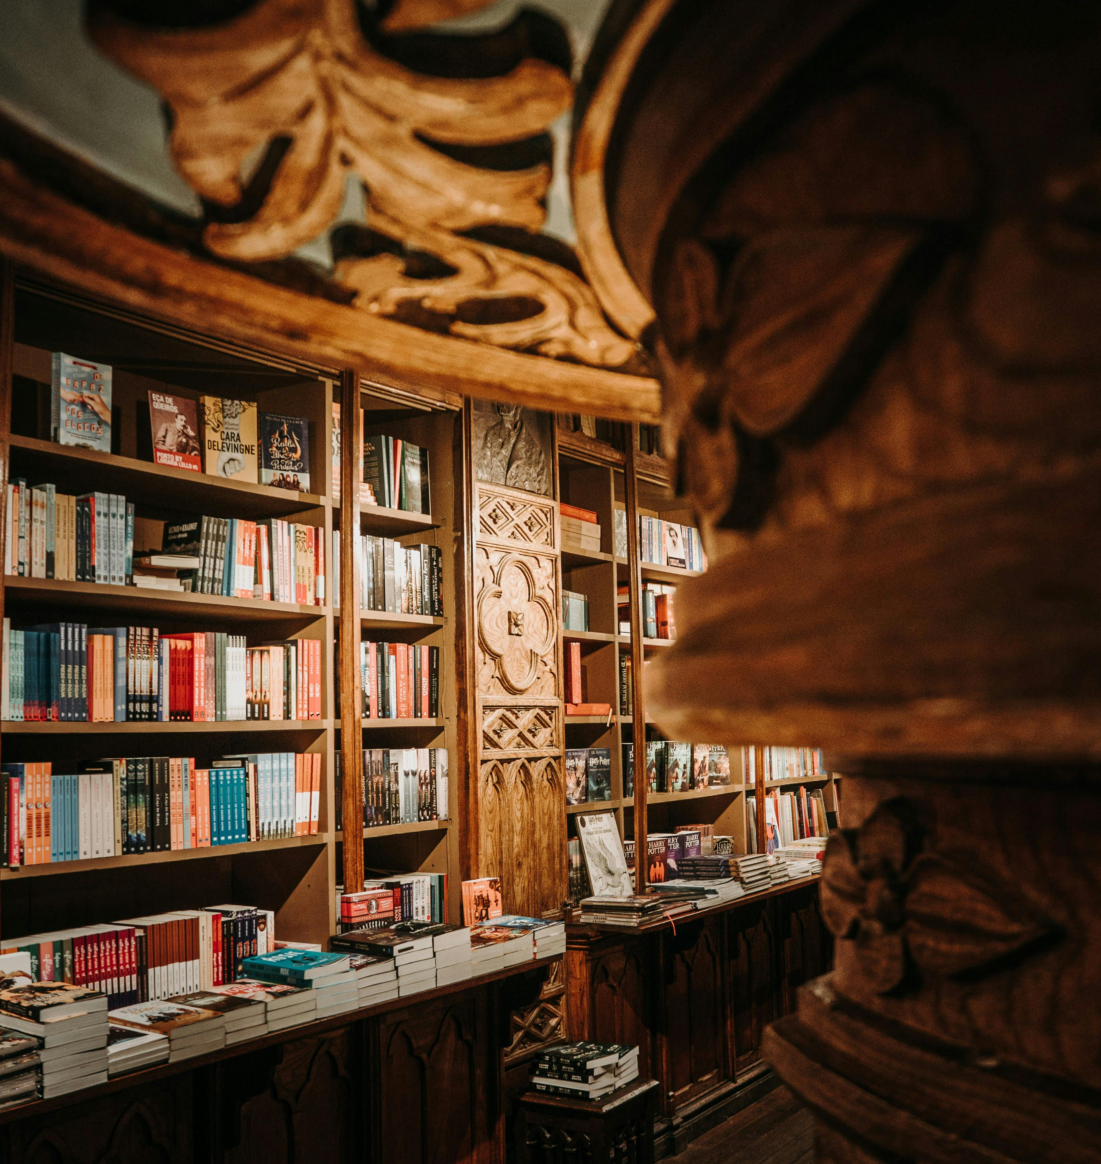
www.uplifttourism.eu

