Slide 1



Turning Film and Literary Tourism
into Immersive Experiences
Implementation Clinic 04
Promoting and Selling Immersive Film & Literary Experiences Through Storytelling
Learn how to promote and sell immersive film and literary tourism experiences by turning stories into compelling visitor journeys.
Explore how storytelling can bring places, characters, and narratives to life while helping you communicate your experience clearly across websites, social media, and tourism platforms to attract visitors and encourage bookings.
January 2026
By Feltech Ireland

Slide 2

Contents
Overview Implementation Clinic 4 (Page 3)
Transform Story Moments into Promotional Messages (Page 5)
Case Study: Downton Abbey Filming Locations – Highclere Castle (Page 8)
Create Character-Led Story Promotion (Page 9)
Case Study: Shakespeare’s Birthplace – Stratford-upon-Avon (Page 11)
Creating Shareable Story Moments (Page 12)
Case Study: Game of Thrones Studio Tour (Northern Ireland) (Page 14)
Design the Visitor Discovery and Booking Journey (Page 15)
Case Study: Literary Dublin Walking Tours, Ireland (Page 18)
Approaches and Solutions (Page 50)
Action Plan (Page 53)
Further Reading & Resources (Page 55)

Slide 3

Bringing European Film & Literature to Life
Implementation Clinic Section
Implementation Clinic Section
This section helps you explore how storytelling, promotion, and practical visitor journeys can support the successful promotion and selling of your immersive film or literary experience.
Use the questions and prompts as conversation starters — for personal reflection, team discussions, or group workshops. There are no right or wrong answers. The purpose is to explore how your story can be communicated clearly, how visitors might discover and understand your experience, and how simple booking and participation pathways can make it easy for people to take part in ways that feel authentic to your place and business.

Slide 4
Promoting & Selling Immersive Film & Literary Experiences Through Storytelling
This implementation clinic focuses on turning storytelling ideas into practical promotion and sales actions that tourism businesses can apply immediately.
While Workshop 4 explored how storytelling can attract attention and communicate the value of immersive experiences, this clinic focuses on how to implement those ideas in real tourism contexts. The goal is to move beyond creative ideas and develop simple, effective methods for communicating your experience, attracting visitors, and converting interest into bookings.
Film and literary tourism experiences have a unique advantage compared with many other tourism offers: the story already exists. Visitors are not just interested in seeing a place — they want to experience the world of a story, understand where it was created, or step into locations they recognise from books, films, or television.
This clinic helps you translate those story connections into clear promotional messages, shareable visitor moments, and accessible booking journeys.
You will work through exercises that help you:
transform story moments into promotional messages
create character-led storytelling content
design visually shareable visitor experiences
improve discovery and booking pathways
use digital and immersive technologies to support storytelling
The aim is not to create complex marketing campaigns, but to develop practical and affordable approaches that allow visitors to discover your immersive experience, recognise its value, and confidently participate.

Slide 5
1
Implementation Clinic
Transform Story Moments into Promotional Messages
Purpose
To identify the most compelling story moments connected to your location and translate them into clear, engaging promotional messages.
Many tourism businesses describe their experiences using practical terms such as “tour”, “exhibition”, or “visit”. While these descriptions are informative, they often fail to capture the emotional appeal that draws visitors to film and literary tourism.
Visitors are usually motivated by story moments — memorable scenes, dramatic events, or meaningful connections between a place and a narrative.
Your goal in this exercise is to identify the moment that sparks curiosity and build your promotion around it.
STEP 1 – Identify Key Story Moments
List moments connected to your location that might capture visitors’ imagination.
Examples may include:
• a famous scene filmed at the location
• a moment described in a novel
• the place where an author lived or wrote
• a turning point in the story’s narrative
Ask yourself: What moment would visitors most want to stand within?
For example:
In Scotland, the Glenfinnan Viaduct attracts visitors because it appears in the Harry Potter films as the route taken by the Hogwarts Express. The promotional message focuses on this moment rather than simply describing the railway bridge.
https://westcoastrailways.co.uk/jacobite/steam-train-trip

Slide 6
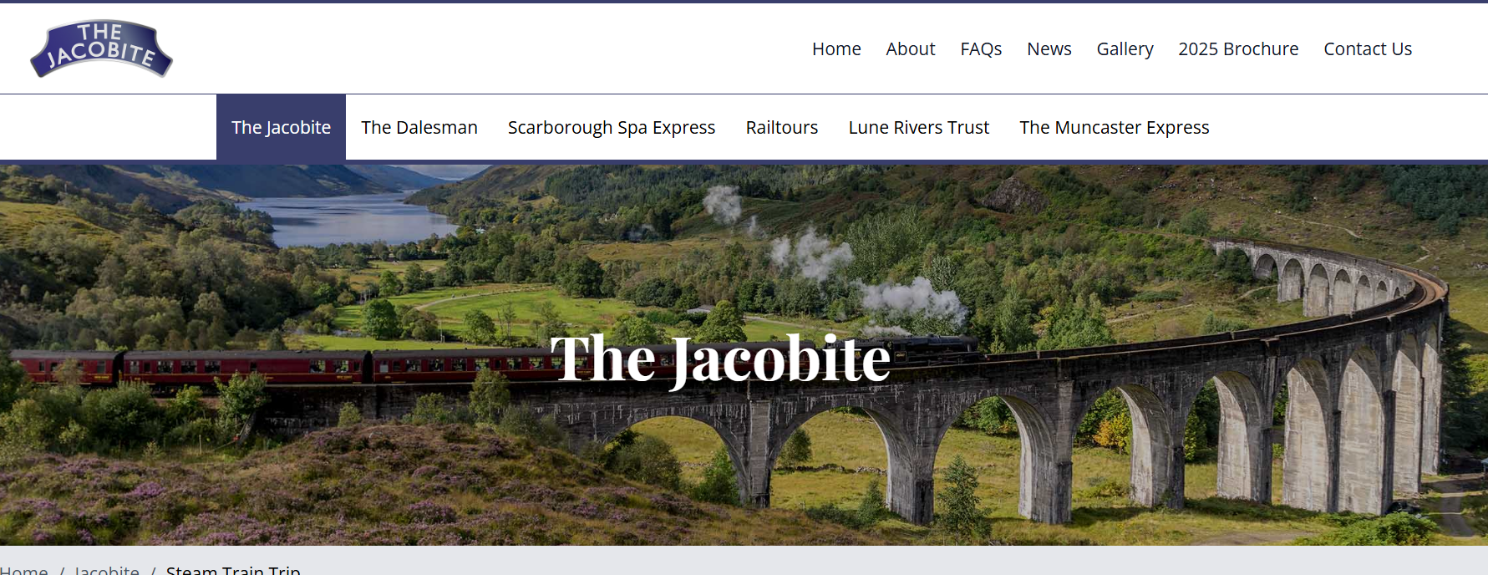
Implementation Clinic
Transform Story Moments into Promotional Messages
STEP 2 – Translate the Story Moment into a Promotional Hook
Once you identify the key moment, translate it into a short message that captures attention.
For example:
Instead of: “Guided walking tour of historic film locations.”
Try: “Stand where the final scene of the film unfolded and see the landscape that shaped the story.”
Or: “Walk the streets that inspired the novel’s most dramatic chapter.”
Short narrative hooks like this work well in:
• website headlines
• tourism brochures
• social media posts
• booking platform descriptions

Slide 7
Implementation Clinic
Turning Story Moments into Promotional Hooks
STEP 3 – Test the Message
Share the promotional message with colleagues, partners, or visitors and ask:
• Does it make you curious?
• Can you imagine the experience?
• Would you want to know more?
If the message feels too abstract, try making it more visual or story-led.
Digital & Immersive Technology Ideas
Digital tools can help turn story moments into engaging promotional content.
Examples include:
Short story teaser videos using smartphone footage or simple editing tools
360° photos or videos that allow visitors to preview the location
QR codes linking to short narrated story clips
augmented reality previews showing how a scene looked during filming
Free or low-cost tools include:
Canva video editor
https://www.canva.com/video-editor/
Google Street View Studio (for 360° content)
https://streetviewstudio.maps.google.com/

Slide 8
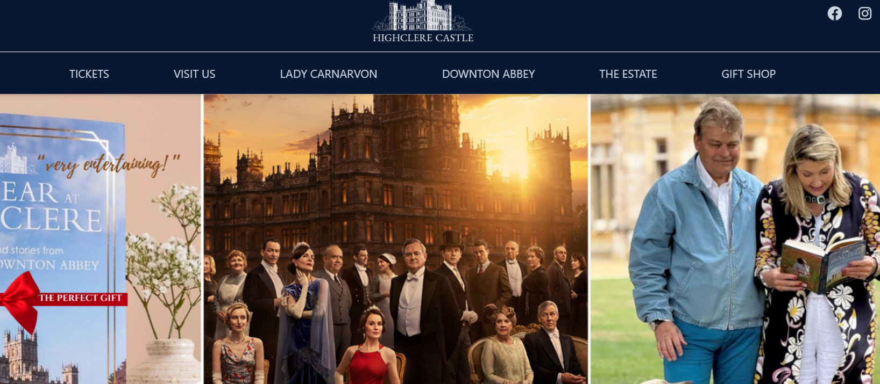
CASE STUDY
Transform Story Moments into Promotional Messages
Downton Abbey Filming Locations – Highclere Castle
Highclere Castle became internationally famous as the filming location for the television series Downton Abbey. Rather than promoting the castle purely as a historic building, the destination uses the series’ story to attract visitors.
Visitors are invited to explore the rooms seen in the show and imagine the lives of the fictional Crawley family.
Key promotional hook
"Visit the real Downton Abbey.“
This simple narrative connection allows visitors to move from watching the story on screen to experiencing it in real life.
Impact
The popularity of the series significantly increased tourism to the estate and surrounding area.
https://www.highclerecastle.co.uk/

Slide 9
2
Implementation Clinic
Create Character-Led Story Promotion
Purpose
Stories are often remembered through characters rather than locations.
Visitors connect emotionally with the people, voices, and personalities that shape the story. By introducing experiences through characters or narrators, tourism businesses can create promotional content that feels more personal and engaging.
STEP 1 – Identify a Character or Story Voice
Consider whether your experience could be introduced through:
• the author of the story
• a fictional character
• a narrator or storyteller
• a historical figure connected to the place
For example:
The Sherlock Holmes Museum in London promotes the experience as a visit to Holmes’ fictional home rather than simply a museum.
Visitors are invited to explore “221B Baker Street”, the famous detective’s residence.
https://www.sherlock-holmes.co.uk/
STEP 2 – Create a Character Introduction
Write a short introduction from the perspective of the character or narrator.
Example: “Welcome to the streets where my investigation began. Every corner hides a clue.”
Or: “This landscape inspired the writer’s most famous tale.”
This character voice could appear in:
• website introductions
• audio guides
• short promotional videos
• social media storytelling posts

Slide 10
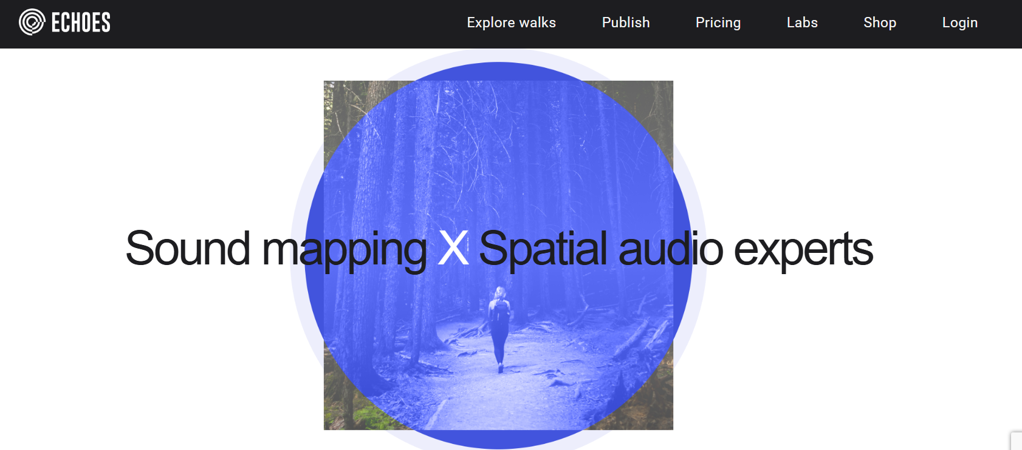
Implementation Clinic
Create Character-Led Story Promotion
STEP 3 – Use Digital Storytelling
Digital tools make it easier than ever to introduce character perspectives.
Examples include:
• short narrated videos
• podcast-style audio clips
• location-based storytelling apps
• QR-triggered audio storytelling
Platforms that support this include:
STQRY – digital storytelling trails https://stqry.com/
Echoes – GPS triggered storytelling walks https://echoes.xyz/. A platform for interactive, location-based audio experiences — often called “soundwalks.” It lets creators design tours where audio, stories, music, or narration automatically play when you reach certain locations.
These tools allow visitors to hear a story unfold as they walk through locations.

Slide 11
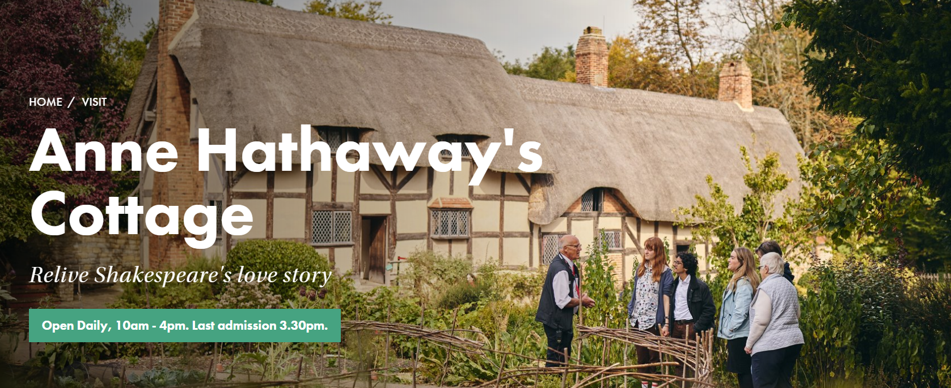
CASE STUDY
Create Character-Led Story Promotion
Shakespeare’s Birthplace – Stratford-upon-Avon
The Shakespeare Birthplace Trust uses storytelling and character interpretation to bring Shakespeare’s world to life. Actors perform scenes from the plays within the historic spaces, and visitors experience the story through the voices of the characters themselves.
Promotional messaging often focuses on meeting the world of Shakespeare, rather than simply visiting historical buildings. You can also visit the museum online through various lecture series, quizzes, games, creative challenges, home learning and more.
Why it works
• Characters bring the narrative to life
• Performances create memorable experiences
• Visitors feel part of the story rather than observers
https://www.shakespeare.org.uk/

Slide 12
3
Implementation Clinic
Creating Shareable Story Moments
Purpose
Visitors increasingly share travel experiences online. Designing moments that are visually striking or emotionally engaging can help transform visitors into active promoters of the experience.
A “shareable story moment” is an interaction that encourages visitors to photograph, film, or post about the experience.
STEP 1 – Identify Visual Story Locations
Look for locations where the story and the physical place intersect.
Examples:
• a viewpoint described in a novel
• a famous filming location
• an author’s writing space
For example: At King’s Cross Station in London, visitors recreate the moment from Harry Potter by posing at Platform 9¾. https://www.kingscross.co.uk/harry-potter
This simple installation has become one of the most photographed locations in London.
STEP 2 – Create Visitor Interaction
Add a simple interactive element.
Examples include:
• story quotes displayed on signs
• scene recreation prompts
• props linked to characters
• simple role-play moments
These small elements help visitors feel part of the story.
STEP 3 – Encourage Sharing
Encourage visitors to share their experience online.
Examples:
• a suggested hashtag
• a sign saying “Recreate the scene here”
• QR codes linking to story content

Slide 13
Implementation Clinic
Creating Shareable Story Moments
STEP 3 – Encourage Sharing
Encourage visitors to share their experience online.
Examples:
• a suggested hashtag
• a sign saying “Recreate the scene here”
• QR codes linking to story content
Digital & Immersive Technology Ideas
Immersive technologies can enhance shareable moments.
Examples include:
• AR filters allowing visitors to appear in a scene
• projection mapping recreating moments from a film
• digital storytelling murals triggered by smartphone scans
Tools that can support this include:
Adobe Aero (AR storytelling)
https://www.adobe.com/products/aero.html
Spark AR (Instagram AR filters)
https://sparkar.facebook.com/

Slide 14
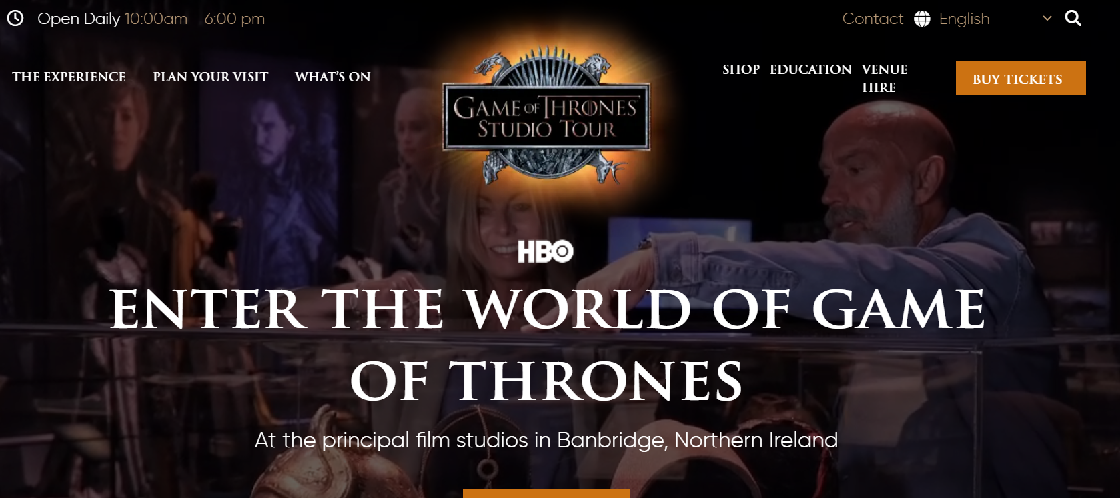
CASE STUDY
Creating Shareable Story Moments
Game of Thrones Studio Tour (Northern Ireland)
The Game of Thrones Studio Tour invites visitors to experience sets, costumes, and interactive displays connected to the series.
Several installations encourage visitors to take photos and recreate iconic scenes, such as sitting on the Iron Throne.
These shareable experiences encourage visitors to post their photos online, helping extend the reach of the attraction.
https://gameofthronesstudiotour.com/

Slide 15
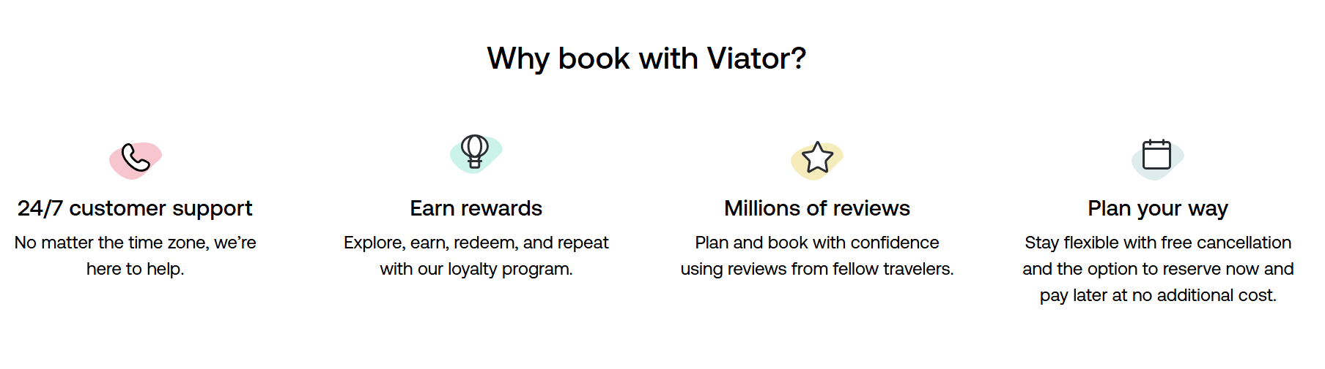
4
Implementation Clinic
Design the Visitor Discovery
and Booking Journey
Purpose
Even the most creative experience will struggle if visitors cannot easily understand what is being offered or how to participate.
A clear discovery and booking journey helps turn interest into confirmed visits.
STEP 1 – Map Visitor Discovery Points
Identify where visitors are most likely to first encounter your experience.
Examples include:
• tourism websites
• travel blogs
• social media
• visitor centres
• travel booking platforms
For example: Many film tourism tours appear on booking platforms such as:
Viator https://www.viator.com/
GetYourGuide https://www.getyourguide.com/
These platforms help visitors discover experiences they did not initially search for.

Slide 16
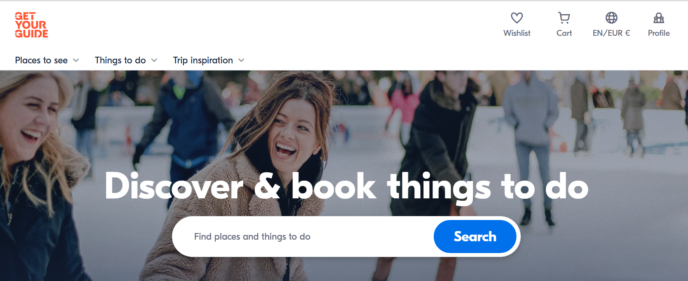
Implementation Clinic
Design the Visitor Discovery
and Booking Journey
STEP 2 – Clarify the Experience Description
Ensure the description quickly answers key visitor questions.
Visitors typically want to know:
• What will I experience?
• How long does it last?
• Where does it take place?
• How much does it cost?
Example: “Join a 60-minute immersive walking experience exploring the real locations behind the novel.”
Clear descriptions reduce uncertainty and increase bookings.

Slide 17
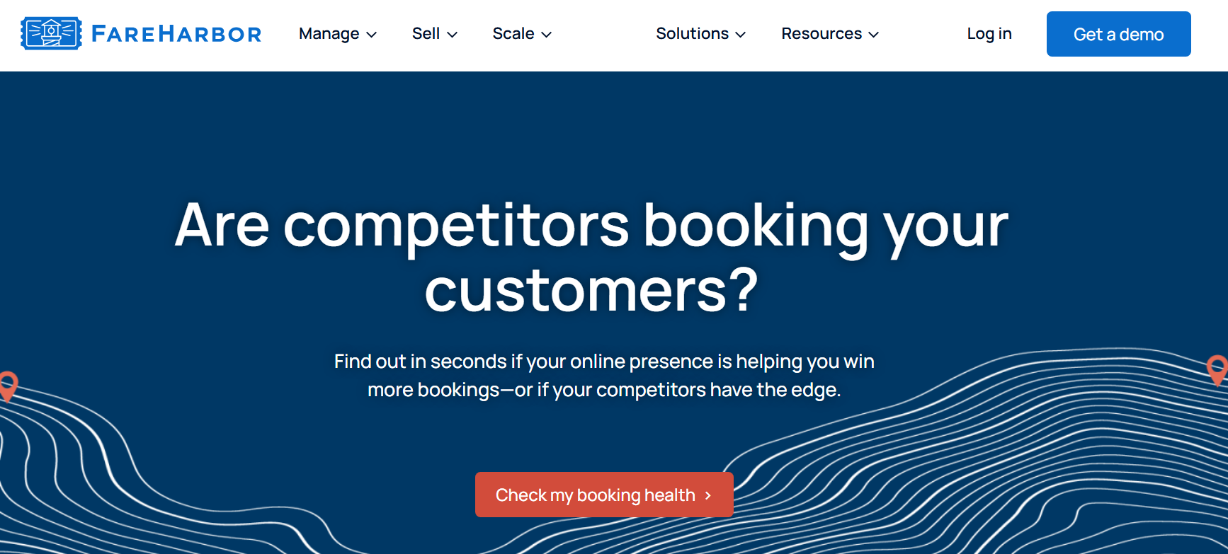
Implementation Clinic
Design the Visitor Discovery
and Booking Journey
STEP 3 – Simplify the Booking Process
Visitors should be able to book within a few steps. Examples include:
• direct online booking
• QR code ticket purchase
• integrated payment systems
Useful tools include:
FareHarbor booking system https://fareharbor.com/
TrekkSoft booking platform https://www.trekksoft.com/
Digital & Immersive Preview Ideas
Digital previews can help visitors understand the experience before booking.
Examples:
• short introduction videos
• virtual walkthroughs
• interactive maps showing story locations
These previews reduce uncertainty and help visitors imagine the experience.

Slide 18
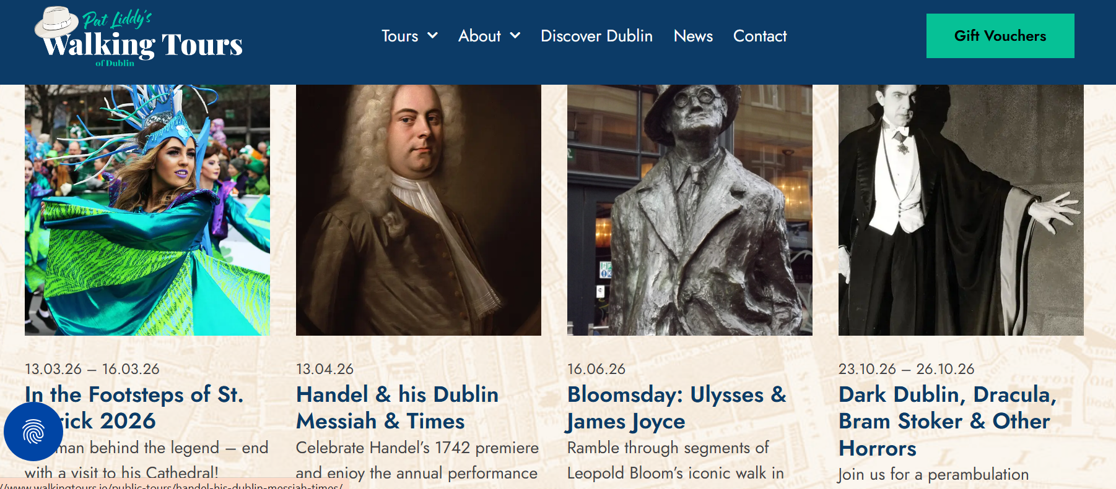
CASE STUDY
Design the Visitor Discovery and Booking Journey
Literary Dublin Walking Tours, Ireland
Literary walking tours in Dublin connect visitors to famous writers such as James Joyce, Oscar Wilde, and Samuel Beckett.
Tour websites often include:
• short story descriptions
• maps of key locations
• clear booking options
Visitors can quickly understand what they will experience and reserve their place.
https://www.visitdublin.com/guides/literary-dublin

Slide 19
Approaches & Solutions
Promoting and Selling Immersive Film & Literary Experiences
Tourism businesses often assume immersive experiences require large marketing campaigns or complex digital strategies.
In reality, the most successful immersive experiences are promoted through clear storytelling, simple messaging, and authentic connections to place.
The following approaches can help tourism businesses effectively communicate their immersive experiences and attract visitors.
Focus on the Story, Not the Technology
Visitors are rarely motivated by the technology used in an experience. Instead, they are attracted by the story behind the place.Rather than promoting the technical features of an experience (for example AR or VR), focus on the narrative moment that visitors can experience.Example approaches include:
• highlighting a memorable scene from a film or book
• inviting visitors to stand where a story unfolded
• sharing the inspiration behind a writer’s work
• connecting landscapes to characters or events
By framing the experience around story rather than technology, tourism businesses can create stronger emotional connections with visitors.
Create Clear and Compelling Experience Messages
Visitors should be able to quickly understand:
• what the experience is
• why it is unique
• what they will see or do
Instead of describing an experience in technical or operational terms, focus on short narrative hooks.

Slide 20
Instead of describing an experience in technical or operational terms, focus on short narrative hooks.
For example:
Instead of “Self-guided film location tour”
Try
“Walk through the landscapes that inspired the story and discover where the famous scenes were filmed.”
Clear storytelling messages work particularly well in:
• tourism websites
• brochures
• social media posts
• booking platforms
Use Visual and Shareable Story Moments
Immersive tourism experiences often generate highly visual moments that visitors enjoy sharing.
Examples include:
• standing at a famous filming location
• comparing past and present scenes
• interacting with story elements
• exploring landscapes connected to literature
Designing experiences with shareable moments encourages visitors to promote the experience themselves through social media.
These organic visitor posts can significantly increase awareness and interest.

Slide 21
Make the Experience Easy to Discover and Book
Even the most creative immersive experience can struggle if visitors cannot easily understand how to participate.
Tourism businesses should ensure that:
• the experience description is clear and engaging
• booking options are simple and visible
• information is easy to find online
• visitors know what to expect before arriving
Simple booking systems, clear pricing, and well-designed visitor information help convert curiosity into participation.
Use Partnerships to Expand Promotion
Many immersive tourism experiences benefit from collaboration.
Possible partners include:
• local tourism organisations
• film offices or cultural institutions
• museums and heritage sites
• writers’ associations
• tourism boards and visitor centres
Partnerships can help extend the reach of promotional efforts and attract new audiences interested in film and literary tourism.

Slide 22
Develop Your Action Plan
The following steps can help tourism businesses begin promoting their immersive experiences.
without smartphones. If a VR experience isn’t wheelchair accessible (due to space or hardware), consider having a 2D video version. This inclusive approach keeps the experience positive for all.
Phase 1 (Year 0-1: Exploration & Pilot)
Tourism businesses begin by identifying the stories connected to their location and exploring how immersive elements could enhance visitor engagement. This stage focuses on testing ideas on a small scale before committing significant resources. Businesses may start by organising a pilot immersive activity, such as a short guided storytelling walk, a small pop-up event, or a limited immersive experience connected to a film or literary story. Simple technologies such as QR codes linking to audio stories, short video clips, or behind-the-scenes content can be introduced. Partnerships are explored with local tourism organisations, museums, cultural groups, or writers’ associations. Promotion may initially focus on local audiences, social media channels, and community events. The pilot stage helps test visitor interest and identify practical improvements such as signage, storytelling quality, visitor flow, and duration of the experience.
Phase 2 (Year 1-2: Launch & Early Growth)
Using insights from the pilot phase, the experience is refined and officially launched as a regular tourism offering. Businesses may extend the route, improve storytelling elements, and introduce clearer visitor information. Marketing activities expand to include tourism websites, visitor centres, and regional tourism campaigns. A simple booking system is introduced, and the experience may be packaged with other tourism services such as accommodation or guided tours. Visitor feedback is actively collected to understand satisfaction levels and improve the experience. At this stage, businesses may also begin tracking key metrics such as visitor numbers, booking rates, and online engagement. By the end of this phase, the immersive experience becomes a recognised part of the destination’s tourism offer.

Slide 23
Phase 3 (Year 2-3: Experience Development)
Once the experience gains traction, businesses can begin enhancing the immersive elements to deepen visitor engagement. This may involve introducing additional storytelling stops, multimedia content, or simple digital tools such as augmented reality overlays or interactive maps. Collaborations with film offices, heritage organisations, or cultural institutions may help enrich the narrative and expand promotional reach. At the same time, businesses can improve visitor interpretation through better signage, visual storytelling elements, or guided experiences. Marketing efforts expand further through partnerships with tourism boards, travel bloggers, and online travel platforms. The experience begins attracting visitors from outside the immediate region.
without smartphones. If a VR experience isn’t wheelchair accessible (due to space or hardware), consider having a 2D video version. This inclusive approach keeps the experience positive for all.
Phase 4 (Year 3-4: Expansion & Partnerships)
With growing recognition and visitor demand, the immersive experience can be expanded through new partnerships and additional experiences. Tourism businesses may collaborate with technology providers, universities, or creative studios to develop enhanced immersive elements such as augmented reality scenes, digital storytelling apps, or projection experiences. New visitor experiences may also be introduced, including themed events, seasonal storytelling tours, or immersive festivals celebrating film and literature connected to the destination. At this stage, the destination may gain media attention, tourism board support, and inclusion in regional or national tourism campaigns, increasing visitor awareness.

Slide 24
Phase 5 (Year 4–5: Destination Positioning & Long-Term Sustainability)
By the fifth year, immersive film and literary experiences can become a distinctive feature of the destination’s tourism identity. The focus shifts towards long-term sustainability and visitor experience quality. Businesses continue refining storytelling, updating digital content, and maintaining immersive installations. Tourism organisations may position the experience as part of a broader cultural tourism offer, integrating it with heritage attractions, festivals, and creative tourism initiatives. Long-term partnerships with tourism boards, cultural organisations, and international tourism platforms can help promote the destination globally. At this stage, immersive experiences can contribute to stronger destination branding, increased visitor engagement, and sustainable tourism development.
without smartphones. If a VR experience isn’t wheelchair accessible (due to space or hardware), consider having a 2D video version. This inclusive approach keeps the experience positive for all.

Slide 25

www.uplifttourism.eu

