Slide 1



Turning Film and Literary Tourism
into Immersive Experiences
Implementation Clinic 03
Budgeting, Costs, Financial Planning & Responsible Practice
Learn how to plan and deliver immersive experiences affordably and sustainably, using tools and techniques that match your budget and capacity.
Together, we explore practical cost-saving strategies, financial plannin, responsible implementation approaches to deliver powerful visitor experiences — even on a small budget.
January 2026
By Feltech Ireland

Slide 2

What’s Covered
Section 1 Discussion (Page 4)
Budgeting, Costs, Financial Planning
Build a Realistic Budget
Learn about Cost Components, One-Time Versus Ongoing Costs and Return on Investment (Page 5)
Identify Cost Drivers (Page 10)
Adapt & Repurpose Instead of Build (Page 20)
Affordable & Scalable Approaches (Page 25)
Financial Approaches and Solutions (Page 30)
Section 2 Discussion (Page 38)
Legal Copyright and Ethics
Intellectual Property & Copyright (Page 39)
Due Diligence and Permissions (Page 43)
Implement Safeguards and Documentation (Page 44)
Monitor, Maintain, and Adapt (Page 46)
Case Study: Sherlock Holmes (Page 48)
Approaches and Solutions (Page 50)
Action Plan (Page 53)
Further Reading & Resources (Page 55)

Slide 3

Bringing European Film & Literature to Life
Implementation Clinic Section
This section helps you explore how immersive experiences can strengthen your positioning, clarify your brand, and better connect with your target audiences.
Use the questions and prompts as conversation starters — for personal reflection, team discussions, or group workshops. There are no right or wrong answers. The purpose is to examine how immersive ideas could support your brand story, resonate with the audiences you want to attract, and feel authentic to your place and values.

Slide 4
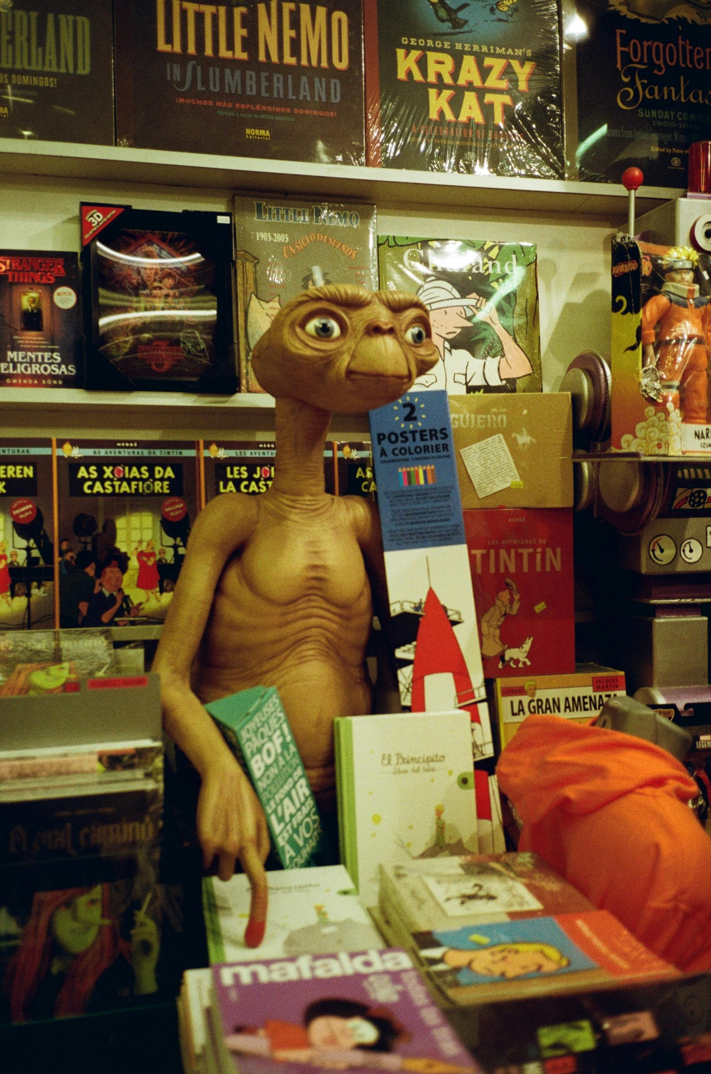
Section 1
Budgeting, Costs, Financial Planning
Photo Credit: Image title

Slide 5
1
Implementation:
Build a Realistic Budget
Cost Structure Stress Test
Move from “listing costs” to understanding financial pressure points.
Build a Real Cost Model
Identify all cost categories. Classify each as:
  Fixed
  Variable
  One-time
  Recurring
  Scale driver
  Complexity driver
Estimate:
  Minimum viable pilot cost
  Full-scale rollout cost
Next slide shows a completed Advanced Cost Structure Template using realistic immersive tourism figures.

Slide 6
Advanced Cost Structure – Immersive Pilot Example
Cost Item | Type (Fixed / Variable) | One-Time / Ongoing | What Increases This Cost? | Pilot Estimate | Scale Estimate (Multi-Site)
AR Experience Development | Fixed | One-time | Scope complexity, number of scenes, level of animation | €4,000 | €12,000
Scriptwriting & Story Design | Fixed | One-time | Number of locations, research depth | €1,500 | €4,500
Voiceover Recording | Variable | One-time | Languages required, professional talent level | €1,000 | €3,000
Graphic Design & Branding | Fixed | One-time | Custom illustration, 3D assets | €800 | €2,500
AR Platform Subscription | Fixed | Ongoing (Annual) | User numbers, storage, feature upgrades | €1,200/year | €2,500/year
Hosting & Cloud Storage | Variable | Ongoing (Annual) | Traffic, content size | €300/year | €800/year
Tablets (3 units pilot) | Variable | One-time | Number of visitor devices required | €900 | €3,000
WiFi / Connectivity | Fixed | Ongoing (Monthly) | Bandwidth, visitor volume | €480/year | €1,200/year

Slide 7
Advanced Cost Structure – Immersive Pilot Example
Cost Item | Type (Fixed / Variable) | One-Time / Ongoing | What Increases This Cost? | Pilot Estimate | Scale Estimate (Multi-Site)
Testing & Integration | Fixed | One-time | Technical complexity, external consultants | €800 | €2,000
Staff Training | Variable | One-time | Staff numbers, session length | €600 | €1,500
Insurance Update | Fixed | Annual | Equipment value, public liability cover | €500 | €800
Maintenance & Updates | Variable | Annual | Bug fixes, content refresh, OS updates | €1,000/year | €3,000/year
Financial Summary Pilot (Year 1)
Estimated One-Time Costs: €13,400
Estimated Annual Ongoing Costs: €3,480
Approximate Year 1 Total: €16,880
Scale Scenario (Multi-Site Expansion)
Estimated One-Time Costs: €38,500
Estimated Annual Ongoing Costs: €8,300
This table shows realistic immersive cost categories
Differentiates pilot vs scale
Separates one-time vs recurring
Identifies what actually drives cost increases

Slide 8
Implementation:
Build a Realistic Budget
ROI Scenario Planning
Testing Financial Viability Under Different Performance Conditions
Strategic Purpose
Immersive projects rarely fail because the idea is poor.
They fail because projected revenue assumptions are overly optimistic.
This exercise helps you to:
Identify break-even thresholds
Test financial resilience under conservative conditions
Quantify acceptable downside risk
Separate “strategic value” from “financial return”
Establish Baseline Operating Data
Before modelling uplift, participants must define the Baseline Metric and the Current Position to ground the model in reality.
Baseline Metric | Current Position
Annual Visitors | 8,000
Average Ticket Price | €12
Current Annual Revenue | €96,000
Annual Ongoing Immersive Cost | €3,480
Year 1 Total Cost (including development) | €16,880

Slide 9
ROI Scenario Planning
Scenario Table – Year 1
Scenario | Extra Visitors | Ticket Increase | Revenue from New Visitors | Revenue from Price Increase | Total Additional Revenue | Year 1 Cost | Net Position
Conservative | +200 | €0 | €2,400 | €0 | €2,400 | €16,880 | –€14,480
Realistic | +400 | €1 | €4,800 | €8,000 | €12,800 | €16,880 | –€4,080
Optimistic | +800 | €2 | €9,600 | €16,000 | €25,600 | €16,880 | +€8,720
Interpretation
Conservative case results in significant Year 1 loss.
Realistic case narrows loss but does not break even.
Optimistic case generates surplus.
This leads to mature financial questions:
Is the organisation prepared to absorb a Year 1 loss?
Is this investment justified over a 3–5 year horizon?
Does the model depend heavily on price increase sensitivity?

Slide 10
2
Implementation
Identifying Costs Drivers
Assessing Your Cost Drivers
A cost driver is a specific decision, feature, or design choice that directly increases the total cost of your project.
It is not just “something expensive.”
It is the factor that causes costs to rise when you increase scale, complexity, quality, or technical sophistication. In other words, A cost driver is the lever that pushes your budget up or down. When you change the lever — the budget changes.
Why This Matters
Many tourism SMEs think, “We’ll just add one more feature.”
But each added layer often multiplies cost, not just adds to it.
Cost drivers are usually connected to complexity, customisation, scale, technical sophistication and human input. If you don’t identify them early, your project becomes financially unstable.
The goal is not to build the most advanced immersive experience. The goal is to build the most sustainable one with a structured financial model.
Define the idea clearly
Identify cost drivers
Look at CapEx (Capital Expenditure, one-off expenses, e.g., iPads) vs OpEx (Operational Expenditure – regular expenses, e.g., wages, hosting, advertising)
Calculate break-even
Build phased plan
Discuss maintenance & risk

Slide 11
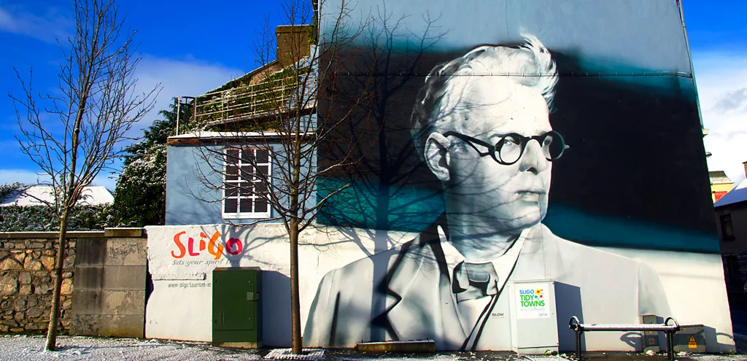
Irish Example:
Small Literary AR Trail – Sligo (Yeats-Inspired Walking Experience)
County Sligo, often referred to as "Yeats Country," was the spiritual home, muse, and final resting place of Nobel Prize-winning poet William Butler Yeats (1865–1939).
While born in Dublin, Yeats spent much of his childhood in Sligo with his maternal grandparents, and the landscape, folklore, and scenery of the region deeply influenced his poetry throughout his life.
https://www.yeatssociety.com/yeats-in-sligo/
STEP 1: Define the Concept Clearly (Before Any Budgeting)
With this concept clearly defined, it becomes possible to identify cost drivers and build a realistic budget.
Many SMEs start pricing before defining scope. That leads to vague budgets and underestimation. Clarity reduces financial surprises.
The Idea: A self-guided AR walking trail in Sligo town where visitors scan QR codes at key Yeats-related locations and experience:
Audio narration of poetry
Archival imagery overlays
Light AR animations inspired by landscape
Optional guided group version using tablets

Slide 12
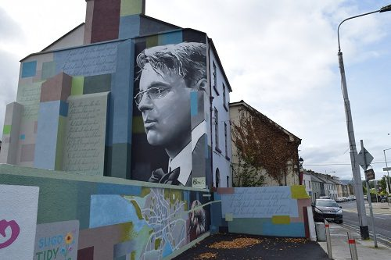
Define the Idea Clearly:
If you cannot describe your immersive experience in operational detail, you cannot cost it accurately.
Experience Name: Yeats Walk – An Augmented Literary Journey Through Sligo
Audience: Cultural tourists aged 35+, literary enthusiasts, small group visitors.
Format: Self-guided walking route using QR-based web AR.
Locations: 3 key Yeats-related sites in town centre.
Content at Each Stop:
2-minute professional narration.
Archival imagery overlay.
Subtle animated poetic visual element.
Revenue Model: €3 add-on to existing heritage ticket.
Phase 2 Potential: Expand to 6 stops + multilingual option.
Now this can be budgeted.
Image credit: https://intheknowtraveler.com/spell-bound-yeats-country-ireland/

Slide 13
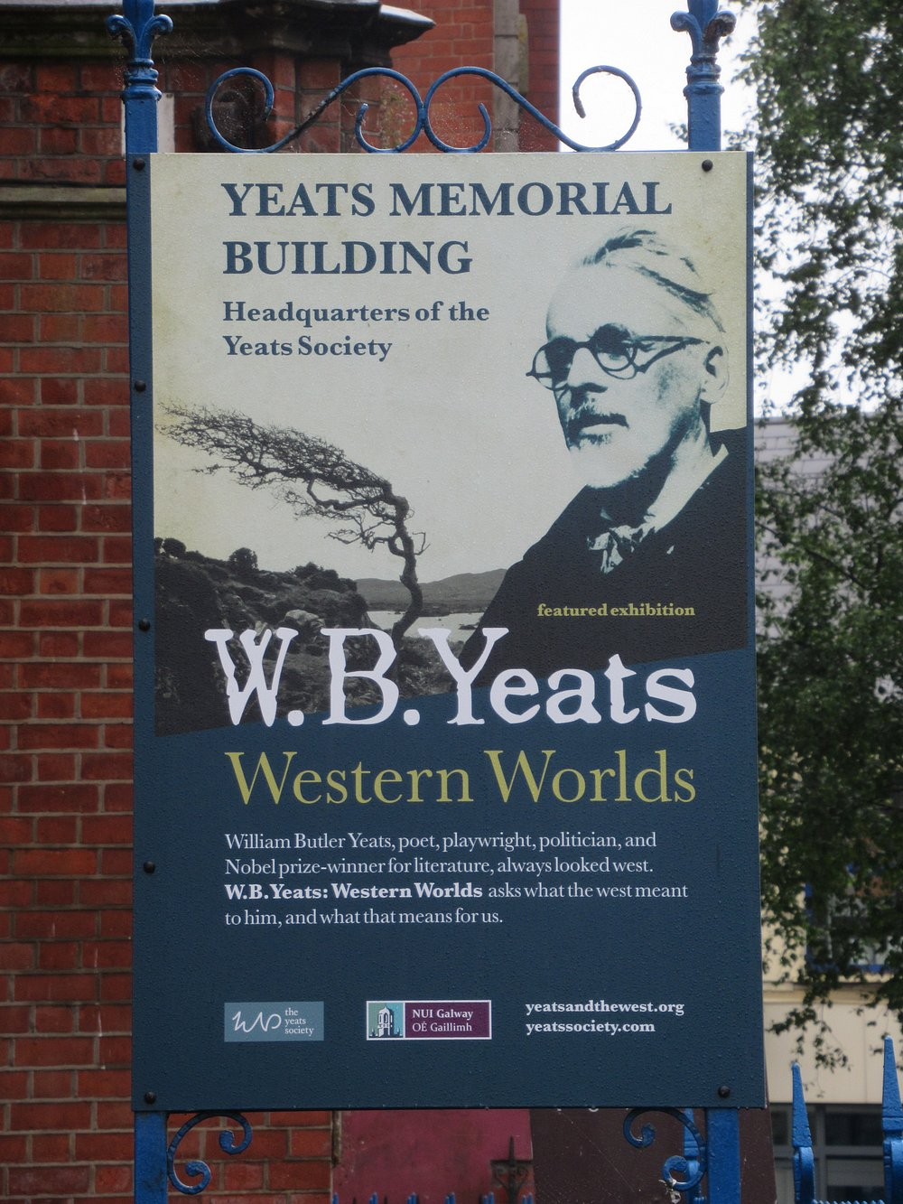
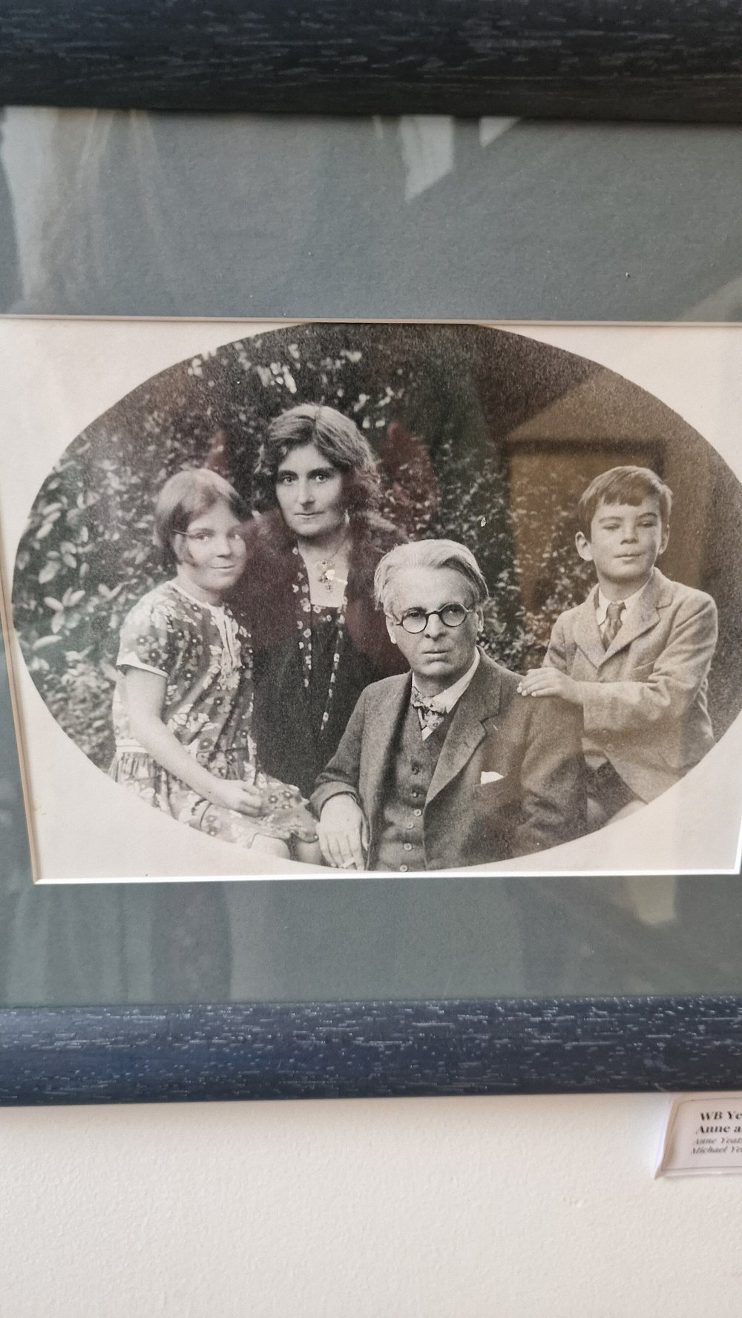
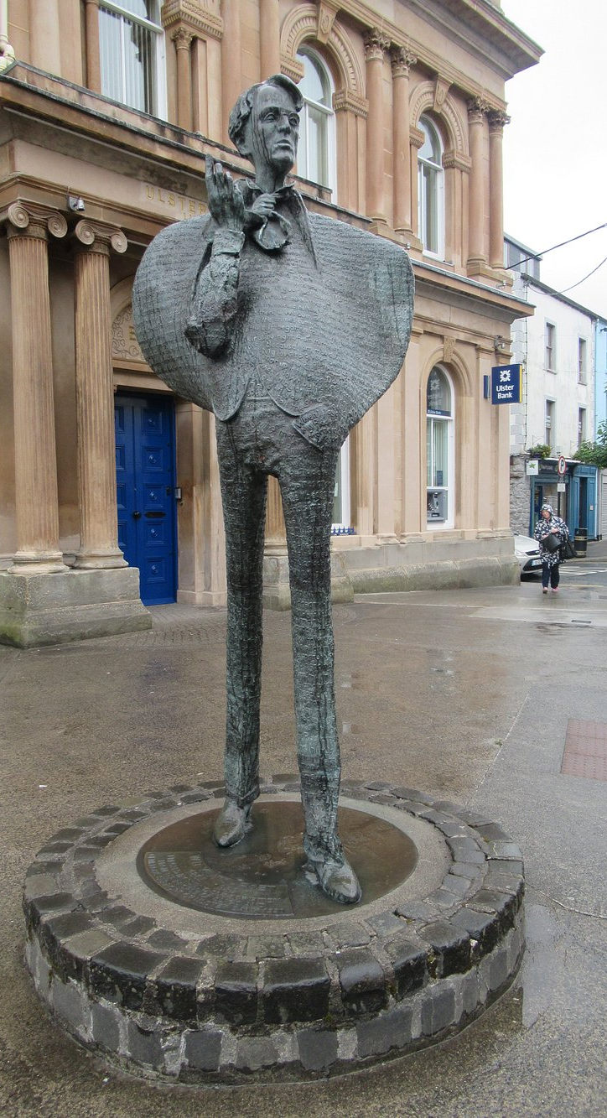
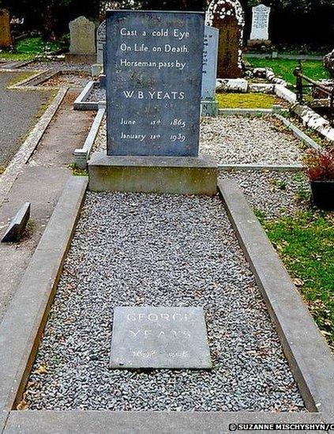

Slide 14
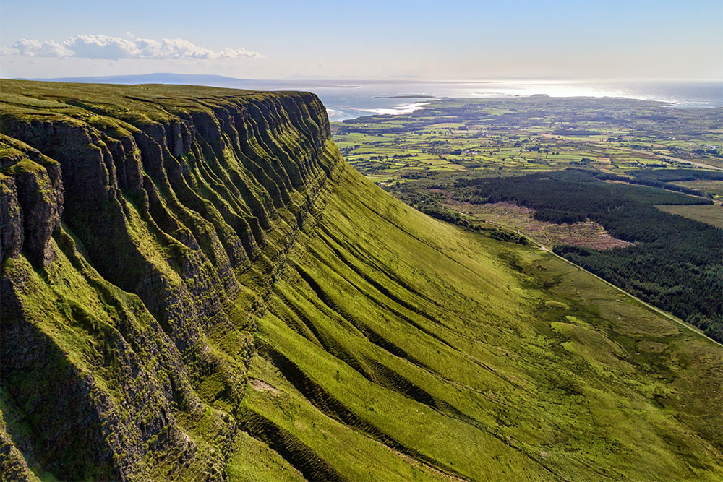
STEP 2: Identify the Core Experience vs Enhancements
Before identifying cost drivers, separate:
Core Version (Phase 1) - 3 locations, QR codes, hosted audio narration, basic image overlay, smartphone-based (no app download required)
Enhanced Version (Future Phase) - 8–10 locations, custom AR interface, 3D landscape reconstructions, multilingual voiceover, data analytics dashboard, tablets for guided tours.
This separation immediately reveals cost drivers.
STEP 3: Identify Cost Drivers in This Project
Now let’s properly apply the definition. A cost driver is any decision that increases complexity, scale, or technical sophistication — and therefore increases cost. The table in the next section is adapted to the WB Yeats Concept.

Slide 15
Cost Driver Category | Examples of Costs | Type of Cost Driver
Number of Locations | Each additional stop increases: content creation, filming, voice recordings, design work, insurance, testing, signage and maintenance | This is a scale driver or multiplier.
Type of Technology | Option A: QR code + hosted web-based AR platform Low development cost. Option B: Fully custom app High development + ongoing maintenance cost. | This is a customisation driver.
Level of Animation / Production Quality | Simple historic photo fade-in overlay = low cost 3D reconstruction of 19th-century Sligo town = high cost Complex animation requires 3D modelling, specialist software, rendering time, technical testing Costs multiply quickly. | This is a complexity driver.

Slide 16
Cost Driver Category | Examples of Costs | Type of Cost Driver
Multilingual Content | Adding French, German, Spanish means: Each additional language multiplies script translation, voice recording, cultural editing, quality control and subtitle syncing. Each language replicates production costs. | This is a duplication driver.
Staffing Model | Self-guided trail: Minimal staffing. Guided immersive group experience: Staff training Wage costs (€18–€22/hour) Scheduling Insurance considerations | This is a labour driver.

Slide 17
STEP 4: Build the Budget Structure
Now we move into real implementation.
Example Budget – Phase 1 (Lean Pilot Version)
Budget Category | Itemised Costs | Cost Impact
Development & Content | Scriptwriting (3 locations) – €1,000 Voiceover recording – €1,000 Basic animation & overlays – €2,000 Graphic design & branding – €500 | Subtotal: €4,500
Technology | AR platform subscription – €200/month Hosting – €20/month Testing & integration – €800 | Year 1 Technology Total €3,000
Hardware (Optional Guided Version) | 4 iPads (€500 each) – €2,000 Portable WiFi – €40/month | Subtotal: €2,480
Compliance & Insurance | Insurance update – €500 GDPR signage & privacy setup – €300 | Subtotal: €800
Phase 1 Total Estimate:
Approximately €10,000–€12,000
Add 15% contingency €1,500
True working budget €11,500–€13,500

Slide 18
STEP 5: Financial Planning – Break-Even
If:
Project cost = €12,000
Ticket uplift = €3 per visitor
Break-even visitors required: 12,000 ÷ 3 = 4,000 visitors
Now ask:
Is this realistic in Sligo annually? If not, adjust:
Pricing
Scope
Phasing
This is where financial realism enters.
STEP 6: Phased Implementation Plan
Instead of launching a fully expanded trail:
Phase 1 (6 Months) | Phase 2 (After Validation) | Phase 3 Only after proven ROI
3 locations Single language QR code delivery Measure engagement Collect visitor feedback | If: Engagement strong Visitors dwell longer Café spend increases Media interest grows Then: Add 2 more locations Improve visuals Explore funding for expansion | Custom app Multilingual content International marketing

Slide 19
STEP 7: Operational Planning (Often Forgotten)
After launch, Who:
Updates content?
Fixes broken QR codes?
Renews subscription?
Replaces damaged tablets?
Annual maintenance budget:
10–20% of initial cost.
If initial cost €12,000:
Annual maintenance €1,500–€2,000
Without this, the experience deteriorates.
STEP 8: Risk Management
Potential Risks:
Platform closes
Technology glitches
Low visitor uptake
Weather affecting signage
Copyright complaints
Mitigation:
Choose stable platform
Keep printed backup content
Avoid copying Yeats text without checking rights
Start small
STEP 9: Revenue Opportunities Beyond Tickets
The AR trail could:
Increase café sales
Encourage overnight stays
Support grant applications
Attract literary festivals
Generate sponsorship from local businesses
Financial impact is not always direct ticket sales.

Slide 20
3
Implementation
Adapt & Repurpose Instead of Build (Example)
Irish Example:
Bantry, West Cork Town Immersive Film Tour
Bantry Old Town Tour (Pilot €3k, Scale €15k+): A local guide filmed a 3-minute 360° video of the town dock and historic pub scene (€3k for filming and editing).
It’s hosted on a private YouTube link and accessed via a QR code on a simple sign.
Visitors use their phones to watch. If engagement is good, the group plans to develop a native app tour (estimated €15k) with multiple locations, audio guides, and AR hotspots.
Bantry Heritage Pub AR (Pilot €2k, Scale €8k): A Bantry pub repurposed its archived photos by creating smartphone AR overlays.
Patrons point their phone camera at old framed photos on the wall to see historical scenes come alive (using a low-cost AR app platform).
Initial set-up (piloting 3 photos) cost €2k (designer/AR subscription). If visitors love it, they will add more scenes and possibly tablet stations in the pub (€8k total).

Slide 21
Implementation
Adapt & Repurpose Instead of Build (Example)
Bantry, West Cork Town Immersive Film Tour
Durrus School Ghost Story (Pilot €1.5k, Scale €7k): Local students and teachers created an original audio drama about a local legend and set it at specific points around the village.
They use simple recording gear and free editing (cost €1.5k including student labor).
Audio clips are triggered by QR codes on a printed map.
If feedback is positive, the village will fund professionally voiced narration and add illustrations for an €7k interactive trail booklet & app.
Step-by-Step Actions
Inventory Assets: List existing videos, photographs, recordings, or exhibit materials.
Explore Free Tools: Research off-the-shelf platforms (e.g. YouTube, Google Street View, free AR apps) that match your needs.
Prototype Quickly: Create a proof-of-concept using these tools. For example, shoot a short 360° clip on a borrowed camera and test on phones.
Gather Feedback Early: Show the prototype to a small audience (staff, local volunteers) to check usability and interest.
Refine Content: Improve the story/dialogue using local input, without changing the underlying low-cost tech.
Decide Next Steps: Based on results, plan whether to scale up (more locations, higher-end tech) or pivot.

Slide 22
Implementation
Adapt & Repurpose Instead of Build (Example)
Bantry, West Cork Town Immersive Film Tour
Success Metrics
Engagement: Number of QR scans or video plays; average watch time.
Budget Efficiency: Actual pilot cost vs. initial estimate.
Qualitative Feedback: Visitor comments on story and tech (e.g. surveys, comments).
Ease of Use: Percentage of users who can access content smoothly (no crashes or confusion).
Social Reach: Shares, likes, or reposts of teaser clips on social media.

Slide 23
4
Implementation
Affordable & Scalable
Approaches
Phased implementation
You don’t have to do everything at once. Start with a low-cost pilot to test one or two features before a big rollout.
As one expert note advises, “Start small – pilot a single AR demo or kiosk – then expand once you’ve measured engagement and confirmed value”.
In practice, that means perhaps renting or borrowing equipment initially, or using a pop-up installation. Gradual adoption mitigates risk and helps refine spending.
Irish Example:
A small centre in West Cork wants to create a fully immersive film scene simulation from a famous film.
Instead of building a €25,000 VR experience…
PHASE 1 – Low-Cost Pilot (€3,000–€5,000)
✔ 360° panoramic scenery and authentic buildings filmed locally. Local actors and community dressed up with props recreating one or more scenes
✔ Hosted on YouTube (private link)
✔ Viewed via visitor smartphones
✔ QR code signage installed
✔ Short 3-minute immersive story
Goal: Test engagement.

Slide 24
4
Implementation
Affordable & Scalable
Approaches
Phase 1 – Low-Cost Pilot (€3,000–€5,000)
Goal
The purpose of a pilot phase is not to build the final immersive experience, but to test whether visitors are interested in the concept and whether the storytelling resonates with them.
Many tourism organisations assume they must launch a polished, technology-heavy experience immediately. In reality, starting with a small pilot allows you to test audience engagement, identify practical challenges, and understand how visitors interact with the story before investing significant resources.
In this West Cork example, the centre wants to create an immersive experience inspired by a well-known film scene shot in the region. Instead of investing immediately in a €25,000 VR installation or custom application, they begin with a simpler storytelling prototype that can be delivered through visitors’ smartphones.
This approach reduces financial risk and allows the organisation to refine the concept based on real visitor feedback.
Step 1 – Identify a Key Scene
The first step is to choose a moment from the film that has a strong connection to the local landscape and that visitors will immediately recognise or emotionally connect with.

Slide 25
For example, the centre might select a dramatic scene filmed on a coastal cliff, in a village square, or near a historic building. The aim is to identify a moment where the physical location itself plays an important role in the story.
Selecting a single scene helps to keep the pilot manageable. It ensures that the team focuses on creating one compelling storytelling moment rather than trying to recreate an entire film narrative.
At this stage, the team should also consider:
whether the location is easy for visitors to access
whether it is safe for visitors to stand and view the experience
whether there is space to install a small sign or marker explaining the scene
Choosing the right scene is critical because the landscape itself becomes part of the immersive storytelling.
Step 2 – Film a Short Recreation
Once the scene has been selected, the centre can recreate a short storytelling moment inspired by the film. This does not require expensive equipment or professional production. In many cases, a small creative team can produce effective content using local resources.
The filming process might involve:
using the real landscape where the original scene was filmed
involving local theatre actors or community volunteers
recreating simple props or costumes related to the scene
The goal is not to reproduce the film perfectly. Instead, the aim is to capture the atmosphere and narrative so visitors can imagine how the film scene unfolded in that location.
The final video should be short, ideally between two and three minutes. This length is long enough to tell a meaningful story but short enough to keep visitors engaged while standing outdoors.

Slide 26
Short immersive storytelling is often more effective than long, complex productions because it fits naturally into the flow of a walking tour.
Step 3 – Host the Content Online
After filming and editing the video, the centre needs a simple way for visitors to access the content.
One of the most affordable options is to host the video on an existing platform such as YouTube or Vimeo using a private or unlisted link. This avoids the cost of developing a custom mobile application.
Visitors can then access the video by scanning a QR code with their smartphone. When they scan the code, the video opens directly in their browser and plays automatically.
Using existing platforms significantly reduces technical complexity. It also ensures that the experience works on most smartphones without requiring visitors to download an additional app.
Step 4 – Install Simple Signage
To guide visitors to the experience, the centre installs a small sign at the filming location. This sign explains the connection between the place and the film scene and invites visitors to scan the QR code.
The signage should be clear, durable, and visually appealing. It may include:
a short description of the scene
a still image from the film or the recreated version
the QR code linking to the video
Positioning the sign carefully is important so visitors can look at the landscape while watching the scene. This creates the sense that the story is unfolding directly in front of them.

Slide 27
Even simple signage can create a powerful storytelling moment when visitors connect the physical environment with the narrative they are watching.
Step 5 – Visitor Experience
When visitors arrive at the location, they scan the QR code using their phone and watch the short immersive video. As they watch, they can look up at the real landscape and imagine the events of the film taking place in that exact spot.
This combination of storytelling and place creates the immersive effect. The visitor is not simply watching a video; they are experiencing the story within the real environment where it happened.
Importantly, this experience requires no specialised technology. Visitors use their own phones, which removes the need for expensive equipment and makes the experience accessible to a wide audience.
Make Sure to Consider the Ethics
When you recreate a “famous film scene,” ethics are not just legal — they’re cultural, commercial, and community-based.
Instead of - “Recreate a famous scene”
Shift to - “Create a locally interpreted immersive story inspired by the cinematic heritage of West Cork.”
That small shift makes a massive ethical difference.
More on ethics and legalities in the next page. Then we move onto Phase 2 and Phase 3.
_______________________________________________

Slide 28
Intellectual Property & Copyright Ethics
If the film is still protected by copyright (which almost all modern films are)
Key ethical questions:
Are you recreating specific dialogue, script, music, costumes, or set design?
Are you using the film’s name, branding, logo, or characters?
Are you suggesting official affiliation?
Ethical risk: Even if filmed locally, the creative expression (script, characters, visual styling) belongs to the rights holder.
Ethical approach:
Do not replicate exact scenes or dialogue.
Avoid trademarked names or logos.
Frame it as:
“Inspired by films shot in West Cork”
rather than
“Step into [Film Name]”
If exact recreation is intended → permission/licensing is ethically required.

Slide 29
Moral Rights of Creators
Even if legally permissible, ethical storytelling asks:
Are you respecting the artistic intent of the filmmakers?
Are you trivialising or commercialising something in a way that distorts its meaning?
For example:
Turning a serious historical film into a novelty selfie attraction.
Removing social or political context from a story.
Ethical tourism should enhance meaning — not dilute it.
Community Representation Ethics
Since local actors and community members are involved:
Ethical considerations:
Are participants paid or fairly compensated?
Are vulnerable groups being used symbolically?
Is the story aligned with local identity?
Does the project benefit the community financially?
Visitor Transparency
Ethical immersive tourism avoids misleading visitors.
You should clearly state:
This is a community interpretation
It is not an official film production
It is an independent immersive experience inspired by local filming history
Transparency builds trust.
Data & Digital Ethics
GDPR applies in Ireland and the EU. If hosted on YouTube and accessed via QR codes, consider:
Are you collecting visitor data?
Is consent required?
Is tracking disclosed?
Are minors protected?

Slide 30
Cultural Sustainability
A deeper ethical question, does this support long-term place identity? Or does it reduce the location to a single cinematic moment?
Ethical immersive tourism should:
Layer storytelling - Connect film to heritage - Avoid “Disneyfication”
Commercial Ethics
If charging entry - Are you profiting from another company’s IP?
An ethical alternative - Partner with:
  Local tourism office
  Film commission
  Rights holder
Or create a “Behind the Scenes of West Cork Film Locations” experience instead.
For UPLIFT, this is actually a powerful teaching moment:
Low-tech does not mean low-ethics.
Ethical Checklist for Phase 1 Pilot
Before launching:
✔ No copyrighted dialogue used
✔ No trademarked logos
✔ No direct scene replication
✔ Clear visitor disclosure
✔ Community consent
✔ GDPR compliant
✔ Cultural integrity preserved
Big Picture
The ethics are about:
Respecting creators
Respecting community
Respecting visitors
Respecting intellectual property
Avoiding cultural extraction

Slide 31
Phase 2 – Evaluating the Pilot
Once the pilot experience has been launched, the organisation needs to assess how visitors respond to it.
Evaluation helps determine whether the idea is worth expanding into a larger immersive project.
Several indicators can be used to understand visitor engagement.
The number of QR code scans can reveal how many people interact with the experience. Visitor feedback, collected through informal conversations or short surveys, can show whether the story was engaging or memorable.
Social media activity may also indicate interest. Visitors often share photos or comments about unique experiences, which can help spread awareness of the project.
Observing visitor behaviour can also provide valuable insights. For example, staff might notice whether visitors spend several minutes at the location or whether they quickly move on.
These forms of feedback help the organisation understand what worked well and what could be improved before expanding the project.

Slide 32
Phase 3 – Scaling the Experience
If the pilot generates strong interest and positive feedback, the organisation can begin to expand the experience gradually.
Rather than launching a full-scale immersive project immediately, the centre can build on the successful elements of the pilot.
For example, they might add additional scenes from the film at other locations around the region, creating a multi-stop storytelling trail.
Guided tours could also be introduced, where a storyteller or guide leads visitors between locations while explaining the history of the film and the landscape.
More advanced technology might also be introduced over time. Augmented reality overlays could show elements of the original film scene superimposed onto the landscape. Sound design or ambient audio could enhance the atmosphere.
Because the pilot has already demonstrated visitor interest, these investments carry less financial risk.

Slide 33
Key Lesson for Participants
One of the most important lessons from this example is that immersive tourism experiences do not need to begin with complex or expensive technology.
Many successful projects start with simple storytelling concepts that connect visitors emotionally to a place.
By testing ideas through small pilots, organisations can learn what visitors respond to and refine the experience before committing larger budgets.
This approach allows creative ideas to grow sustainably rather than relying on large initial investments.
Reflection Question
To conclude this section, participants can be asked to reflect on their own organisation or destination.
A useful question is:
What is one immersive experience idea you could test as a small pilot using the resources you already have?
Encouraging participants to think about achievable pilot projects helps shift the conversation from abstract ideas to practical action.

Slide 34
Financial Approaches & Solutions
Phased Investment – Regional AR Trail
A region wanted to create an AR-enhanced literary trail across multiple towns. Instead of funding all at once (which would be huge), they phased it:
Year 1, they built AR content for 2 key sites with a €10k budget (got a tourism grant to cover half).
They used that success to attract a sponsor for Year 2 to add 5 more sites.
By Year 3, seeing increased tourist numbers, the regional government allocated regular funding to complete the trail and maintain it.
Each phase had its own budget and ROI analysis, making it digestible and showing proof at each step.
For an SME, similarly, you could phase: maybe start with one chapter of an immersive story, then later add more chapters as finances allow.
This case shows how breaking into phases can turn a €30k dream into manageable chunks with support along the way.
Crowdfunding a VR Experience
A small museum had an idea for a VR exhibit but no budget. They launched a crowdfunding campaign (Kickstarter) telling their community “Help us bring this story to life in VR!”
They offered rewards like exclusive early access, name credits, etc. They raised several thousand euros which, combined with a bit of their own savings, funded a basic VR setup.

Slide 35
Financial Approaches & Solutions
The community buy-in not only provided money but also a ready audience. Post-launch, those backers became ambassadors who brought friends/family to see “the thing they funded.”
This example highlights alternative financing – if your story resonates, people might literally invest in it. It also turns financing into marketing (two birds, one stone).
Cost-saving through Partnerships
An outdoor historic site wanted an audio immersion (soundscape) installation along a trail. Instead of hiring an expensive sound engineer outright, they partnered with a local university’s music tech department.
The students created the soundscapes as part of their coursework, supervised by their professor (who ensured quality). The site paid only a small honorarium and equipment costs – maybe 1/10th of what a commercial project would cost.
This partnership saved money and gave students experience. For other tech, similar partnerships can work (e.g. a local coding bootcamp might develop your app prototype). It underscores that thinking outside the usual vendor-client box can dramatically cut costs.
Sponsorship Win-Win
A literary festival created an AR app where visitors could see characters pop up around the venue. They secured a sponsorship from a tech company that was eager to reach artsy audiences.
The sponsor covered the app development costs (€5k) in exchange for a “Powered by [Company]” on the app and marketing materials.

Slide 36
Financial Approaches & Solutions
The SME essentially got their product funded, and the company got goodwill and exposure. Attendees didn’t mind the subtle branding, as it was tastefully done.
This shows that if your immersive idea has a cool factor or aligns with a company’s interests, you might find willing sponsors – be it a local bank, a telecom provider, or even a hardware shop (imagine “This audio tour is brought to you by XYZ Electronics – they love innovation in our community”).
It’s about pitching mutual benefit.
Resources & Further Reading:
Cost Estimation Guides: There are blog posts like “How much does it cost to build an AR app?” or “VR development cost breakdown 2025”. These can give rough figures and factors affecting cost (devices, complexity, content). While your mileage may vary, they provide ballpark ranges to inform your budget assumptions.
Grant Databases: For Europe, check the EU’s funding portal or resources like Europa Tourism Funding Guide. Nationally, organizations like Tourism boards or cultural funds often have grant listings or advisors. Also, look at creative technology grants (sometimes under culture or arts rather than tourism explicitly). Knowing what’s available can shape your finance plan – e.g. if a grant covers 70% of costs up to X amount, you plan your project around that.
ROI Case Studies: Search for reports or articles where museums or attractions discuss outcomes of tech investments. For example, American Alliance of Museums or Themed Entertainment Association sometimes publish pieces like “Digital Media ROI in Museums”. They might say “X exhibit cost Y but led to Z% attendance increase”. These help you make your case with analogous data. Even if not exact, it adds credibility to say, “When Museum A introduced AR, they saw a 15% rise in dwell time and 10% more shop sales; we anticipate similar returns.”

Slide 37
Financial Approaches & Solutions
Budget Templates: Basic project budget templates (in Excel or Google Sheets) can be found on sites like TemplateLab or through project management resources. Grab one and customise for your purpose – it ensures you don’t forget categories and can tally easily. If numbers intimidate, a template with formulas built-in might help reduce errors.
Business Plan Assistance: If you need to pitch this to a bank or investor, a short section in a business plan will be required. Organisations like local small business development centres often have free mentoring on writing business plans and budgets. They can review your financial projections and give feedback.
Also, sometimes banks have community programs or corporate social responsibility funds for local innovations – talking to your bank manager about your plan might yield unexpected support or at least advice on financing options (like a low-interest loan or line of credit specifically for tech upgrades).
Don’t overlook traditional financing if the ROI looks strong; small loans might be easily serviceable if the investment boosts revenue as expected.

Slide 38

Section 2
Legal, Copyright, and Ethics
Photo Credit: Image title

Slide 39
1
Implementation Clinic: Intellectual Property & Copyright
Example:
A small Irish tour operator creates an AR walking tour inspired by a famous modern fantasy film series. They:
Overlay character images in AR.
Use recognisable costume designs.
Include short film dialogue clips.
Use the film logo in promotional posters.
They justify it as “educational tourism.”
What’s Wrong?
Character likenesses = protected.
Dialogue clips = protected.
Logo = trademark infringement.
Educational intent does not override copyright.
Even if no lawsuit occurs, they are exposed legally and reputationally.
Practical Implementation – What a Compliant Version Looks Like
Step 1: Content Audit (Real Example)
Element | Status | Action
Character AR overlay | Protected | Remove & redesign
Dialogue clip | Protected | Replace with narration
Logo in poster | Trademarked | Remove
Historic filming location | Factual | Allowed

Slide 40
Implementation Clinic: Intellectual Property & Copyright
Step 2: Redesign Strategy
Instead of using film characters, the operator:
Creates original fantasy-inspired illustrations.
Focuses on real filming locations (factual information is not protected).
Links visitors to the official trailer on YouTube instead of hosting clips directly.
Avoids any logo use.
Step 3: Documentation
Keeps written confirmation of trailer embedding permissions via platform policy.
Saves screenshots of public domain verification (if applicable).
Stores all original artwork source files.
Step 4: Marketing Adjustment
Instead of: “Official Magical Film Tour Experience”
They use: “Inspired by the cinematic landscapes of Ireland’s fantasy filming heritage.”
No implied official endorsement.

Slide 41
Implementation Clinic: Intellectual Property & Copyright
Step 2: Redesign Strategy
Instead of using film characters, the operator:
Creates original fantasy-inspired illustrations.
Focuses on real filming locations (factual information is not protected).
Links visitors to the official trailer on YouTube instead of hosting clips directly.
Avoids any logo use.
Step 3: Documentation
Keeps written confirmation of trailer embedding permissions via platform policy.
Saves screenshots of public domain verification (if applicable).
Stores all original artwork source files.
Step 4: Marketing Adjustment
Instead of: “Official Magical Film Tour Experience”
They use: “Inspired by the cinematic landscapes of Ireland’s fantasy filming heritage.”
No implied official endorsement.

Slide 42
Implementation Clinic: Do a Copyright Check
Take one element – say you want to use snippets of a novel’s text on your interpretive panels. Find out if it’s copyrighted.
A quick rule: in many countries, works enter public domain 70 years after the author’s death. So, if the author died before 1950, likely it’s public domain (but double-check for your country).
If it’s still under copyright, consider contacting the publisher or estate for permission (they might allow small excerpts for educational/tourism use, possibly with a fee or credit).
If that’s not feasible, plan to use very short quotes (some “fair use” is possible) or paraphrase. Document your findings – even just noting “Okay to use X (public domain); Avoid Y (trademark).”
Take the next element and complete the process. This will serve as your cheat-sheet so you and any staff know the do’s and don’ts.

Slide 43
2
Implementation Clinic: Due Diligence and Permissions
Early on, list all external content you intend to use and seek permissions or alternatives now. If a certain movie studio’s content is crucial, reach out to them early (or decide to replace it with something license-free if that’s more practical). Contact authors or publishers if you need to quote or use images – surprisingly, some may grant free or low-cost permission for educational tourism use, but you need to ask and likely get it in writing.
Simultaneously, incorporate legal consultation into your budget if needed: perhaps allocate a small amount to have a lawyer review your plan (maybe through a local business legal clinic or a one-time consult).
For privacy, draft a simple privacy policy if your project collects user data – plenty of templates exist; short-term is the time to sort out what data you really need so you can minimize data collection (easier to avoid headaches by not collecting unnecessary personal info). If building an app or website, make sure to include that privacy notice and maybe a Terms of Use.
On ethics, engage stakeholders now – for example, if your project involves local folklore, talk to community elders or cultural offices to ensure they’re on board and to get guidance. It’s much better to collaborate upfront than face criticism later.
If the experience is on public land or a heritage site, check if any permits are needed for digital installations (some places treat AR like signage or filming). Short-term is about checking all these boxes before you invest too heavily: essentially, get the green light in legal/ethical terms so you don’t hit a roadblock later.

Slide 44
3
Implementation Implement Safeguards and Documentation
As the project is being built, weave in the legal/ethical measures.
For example, if the solution was to use license-free content, ensure the team actually does that (and keep proof of licenses for any stock music/images used – save those license files). If you got permissions, keep those emails/contracts organized.
Build any safety warnings or disclaimers into the experience: e.g. start AR app with “Please remain aware of your surroundings” (Pokémon Go style), or VR exhibit sign “Not recommended for under 13 without supervision,” etc.
Also train staff on these points – medium-term is when you develop staff guidelines: e.g. what to do if someone opts out of being photographed in an AR experience, or how to assist someone who has privacy questions.
If you collect data, set up how you’ll store it securely (maybe you decide to use a reputable platform that handles user accounts securely rather than DIY). If applicable, conduct a mini privacy impact assessment – basically go through what data you have and ensure it’s protected and necessary; adjust features if not.
On the ethics side, test the experience from different perspectives: invite someone from the local community or an outsider to beta test, specifically to catch anything that might be insensitive or problematic. Medium-term is the time to tweak content for tone, appropriateness, inclusivity (better now than after launch).
Also, think about accessibility: ethically and sometimes legally (like under disability laws) you should accommodate as much as possible.

Slide 45
Implementation Clinic: Implement Safeguards and Documentation
For instance, provide captions or transcripts for audio, ensure color contrasts in app are good for color-blind users, consider an alternate experience if someone can’t use VR (maybe a video of what’s in the headset so they’re not excluded). Implement these if feasible, or at least note them and perhaps plan to address in future updates if time is short.
Document everything – keep a file of content sources and rights, data handling procedures – so if any question arises, you can quickly show you did your homework.

Slide 46
4
Implementation Monitor, Maintain, and Adapt
After launch, legal and ethical responsibility continues.
Monitor for any issues: for example, if visitors start contributing content (comments, uploads), have a moderation plan so nothing abusive or infringing stays.
Keep an ear out for any community feedback – if someone voices a concern that something in the experience is offensive or inaccurate, address it proactively (maybe tweak the content or provide context).
Periodically review your permissions/licenses – some might be time-limited. If an agreement was “you can use X content for one year,” mark that date and either renew or remove it before it lapses.
Also stay updated: laws can change (like data protection regulations evolving) – it’s worth checking annually if anything new affects you (for instance, if you eventually get visitors from California, suddenly CCPA law might matter too).
For privacy, ensure you uphold what you promised: e.g. if you said you’d delete user photos after 30 days, do it (automate it if possible).
Long-term, also consider insurance: check if your general liability insurance covers things like someone claiming they got injured using your VR or if a rights holder did come after you (there’s IP infringement insurance, but it’s niche; probably not needed if you’re careful, but at least know your coverage).
Keep up the ethical engagement: maybe do an annual workshop with staff about ethical storytelling, refresh them on cultural sensitivity – especially important if staff changes or new content is added.

Slide 47
Implementation Clinic: Monitor, Maintain, and Adapt
If you expand or update the experience, repeat the vetting process for new material.
The idea is to treat legal/ethical as an ongoing checklist, not one-and-done. Many organisations integrate this into standard operating procedures (e.g. every time we create new content, we fill a rights clearance form; every time we do an app update, we check compliance). By doing so, you create a culture of responsibility that ultimately protects and enhances your brand.
Plus, by being diligent you can advertise aspects like “officially licensed” or “created in partnership with local X community,” which actually boost the product’s appeal.

Slide 48
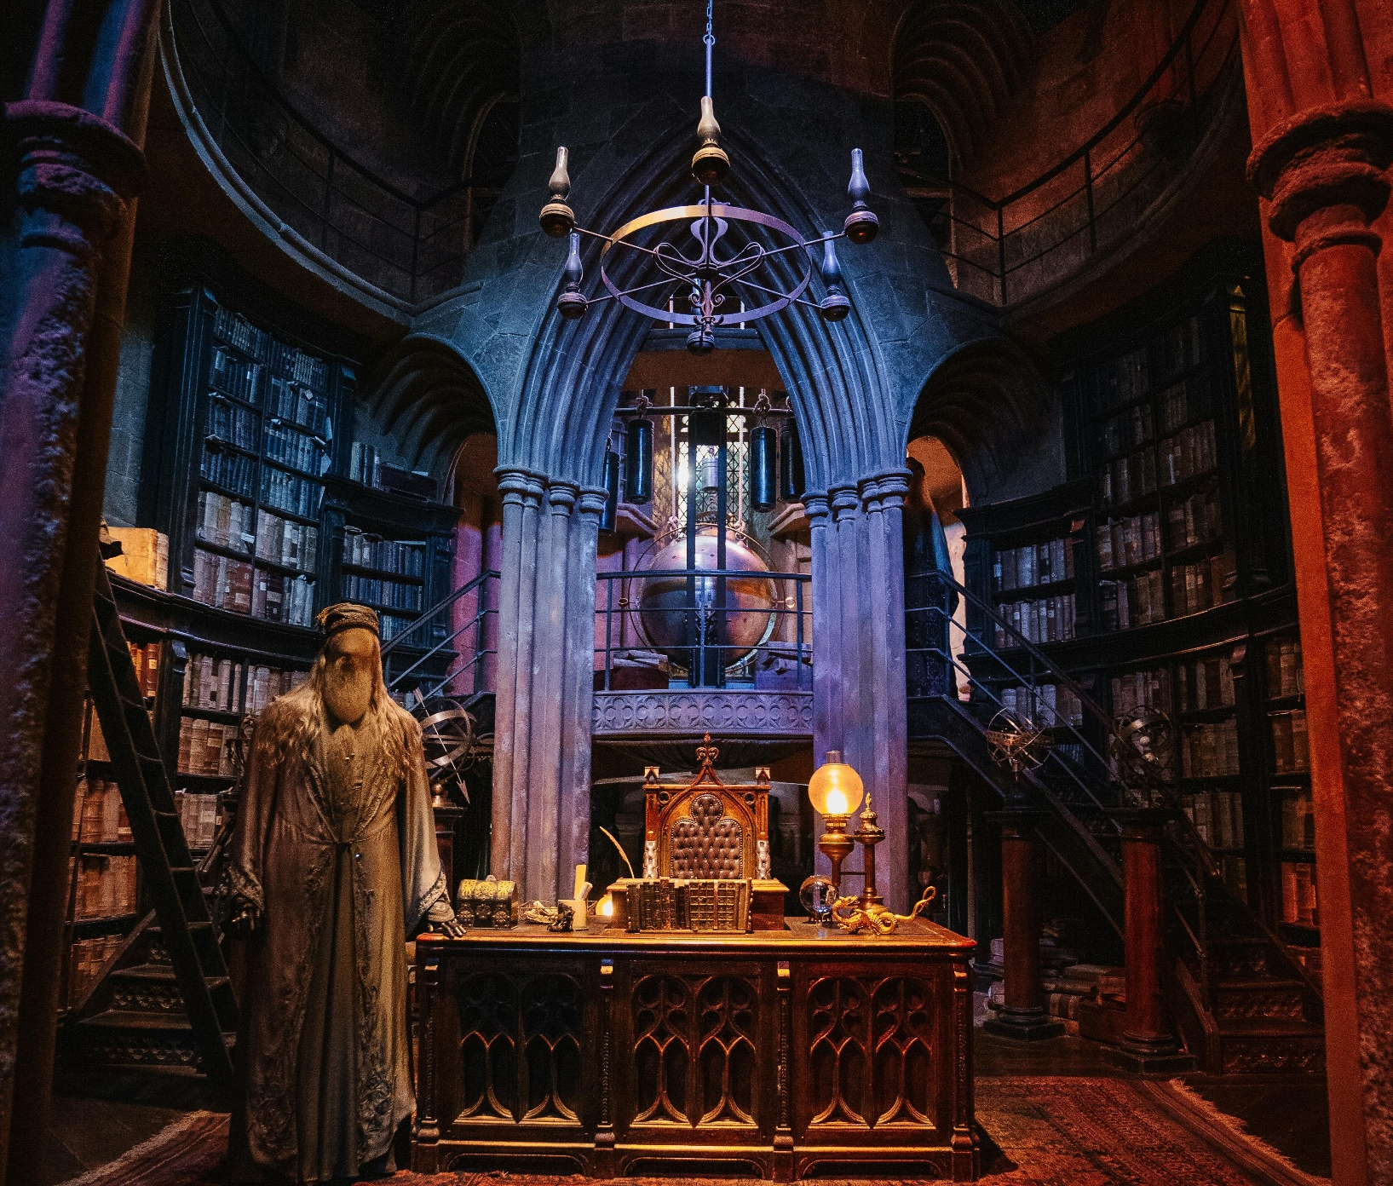
CASE STUDY
Sherlock Holmes Museum
Licensed Literary Apps
Public Domain Positioning
The Sherlock Holmes Museum in London (as a hypothetical example) might want an AR app where Holmes appears.
Sherlock Holmes stories are mostly public domain, but the character and some stories had lingering copyrights until recently.
They ensured everything they used was from the public domain stories, and for the deerstalker image (which is a classic trademark-ish icon from movies), they avoided using specific film imagery.
Instead, they created their own 3D model of Holmes that was generic enough. They proudly state the app uses “the original Arthur Conan Doyle stories” (which signals it’s legit usage). This case shows working within public domain to avoid issues, and being transparent about source material.
Conversely, consider unlicensed tours: there have been “Harry Potter tours” in cities which Warner Bros. have sometimes warned if they use trademarked names heavily. These tours got around it by marketing as “Wizard Walks” and focusing on the inspiration and public facts rather than direct quotes or images. They instruct guides to speak about “the author of a famous boy-wizard series” rather than say the name too often, and definitely not use the movie logo anywhere. It’s a delicate dance but demonstrates how to avoid legal trouble by adjusting presentation.

Slide 49
CASE STUDY
Sherlock Holmes Museum
Privacy in AR Games
The makers of Pokémon Go learned quickly about ethics – when the game launched, some PokéStops were in inappropriate places (like memorials or private yards). They had to respond by allowing removal requests and creating policies about sensitive locations.
For a tourism SME’s AR, similarly if your experience inadvertently points people’s cameras at private homes or crowds, you need to think ahead.
One real example: an AR history app overlayed old photos on current streets, but one photo included identifiable people from the 1920s – which was fine legally (they’re likely deceased and no privacy rights after so long), but the app creators still chose to blur a face after a descendant said they felt it was not right to use great-grandpa’s image without asking. Ethically, they did the polite thing, even though legally maybe not required. It earned community respect.

Slide 50
Ethical & Legal Approaches & Solutions
When in Doubt, Ask (or Avoid)
For intellectual property, if you’re unsure about using something, either seek permission or choose an alternative.
Reaching out to rights holders might seem intimidating, but sometimes they’re supportive (especially if you’re essentially promoting their content by bringing fans). For example, contacting an author’s estate or publisher to say “We’d like to create a tour about this book, including some quotes” might result in a reasonable license or even a free blessing if it’s non-profit/educational. Keep the communication professional and highlight how it benefits their IP (more readers, etc.).
However, if the IP owner is known to be strict (some studios fiercely protect their brands), it might be wiser to design your content in a way that doesn’t require direct use of protected material. Remember, you can always talk about factual events and public domain aspects. For instance, you can say “This scene was filmed here” (fact) and describe it in your own words, without using the film’s footage or trademarked names in promotional material.
Also, consider limiting use of any licensed material to on-site only (if you have permission for that) and not posting it online, as online is where enforcement is tighter.
Embrace Public Domain & Local Content:
Building your experience around public domain stories or historical facts gives you a lot more freedom. Many literary tourism efforts focus on classic authors precisely for this reason (no copyright headaches with Shakespeare or Jane Austen!).
If your subject isn’t public domain, think of adding elements that are uniquely yours or locally sourced – like original stories from local folklore, or your own fictional narrative that ties into the theme. That way, you’re creating new IP that you own.

Slide 51
Ethical & Legal Approaches & Solutions
For example, a castle that can’t use Game of Thrones names could still market a “Dragon’s Tale Quest” that invokes the spirit of the show but is actually based on a local legend of a dragon, combined with the castle’s real history. This creative pivot not only sidesteps legal issues but can enrich the experience with authentic culture.
Secure Necessary Permits & Insurance:
Ensure you have any needed permits for tours or events. Check if guiding requires a license in your area (some cities require tour guides to be registered). If you use drones for filming or VR, adhere to regulations.
It’s also wise to get liability insurance for your activities – accidents can happen in tourism, and insurance protects you and gives peace of mind to partners.
If you’re using tech with user-generated data, have a privacy policy and maybe a liability waiver for participants if doing something physically involving.
Respect and Include Locals
Make the well-being of the local community a design criterion, not an afterthought.
For example, if one spot on your tour is a quiet residential street that just so happens to have a famous film house, maybe schedule your visits at respectful hours (not early morning or late night). Inform residents of when tours run, so they aren’t caught off guard.
Perhaps include a positive angle for them – like your tour stops by a local family-run cafe (bringing business) or you share some of the tour proceeds with a community fund for upkeep of an area. By doing this, you turn potential critics into stakeholders.

Slide 52
Some film tourism destinations have had to implement crowd control or ban tours due to resident complaints; it’s far better to pre-empt that by designing responsibly.
Ethically, always ensure your immersive experience does no harm – culturally, environmentally, or socially. This might mean adjusting routes to avoid erosion on a popular trail, or explicitly educating tourists to be respectful.
Data Ethics and Safety
If your experience uses an app or any data collection (like taking visitor emails for AR logins or photos for a “share your experience” wall), be transparent about it.
Have an opt-in for any data use, comply with GDPR by, for example, not collecting more info than necessary and allowing users to delete their data. This builds trust.
Also, implement safety measures for tech: for AR games, maybe have built-in alerts like “Stop and look around you now” if they’ve been looking down too long, or use geofencing so certain hazardous areas are not included. Little things like offering water and breaks during a VR session show you care about visitor well-being.
Train Your Staff/Guides
Ensure anyone working on the experience understands these legal and ethical guidelines. Provide them with the dos and don’ts (maybe from your earlier copyright checklist and visitor guidelines).
Role-play scenarios – like how to handle if a tourist attempts to wander somewhere off-limits (“I’m sorry, that area is private, we’re not allowed beyond this point”), or if someone asks a sensitive question (guide knows how to respond accurately yet sensitively).
A well-trained guide can diffuse potential issues on the spot – for example, if a visitor is being disrespectful (climbing on a fragile monument for a selfie), the guide should politely intervene.

Slide 53
Develop Your Action Plan
Imagine a case study of a small town that wanted to create a Film Festival and Tour around a movie trilogy filmed there. The organizers (initially just a couple) followed a strategic roadmap:
without smartphones. If a VR experience isn’t wheelchair accessible (due to space or hardware), consider having a 2D video version. This inclusive approach keeps the experience positive for all.
Phase 1 (Year 0-1: Setup & Pilot)
They spent months planning, getting buy-in from the town council and local businesses. They set a modest goal: a weekend “immersive film festival” event to test interest, including guided location tours, screenings, and simple cosplay. They secured a small grant and sponsorship from a local hotel. They marketed primarily to fans via online forums. The event happened, attendance was decent (say 200 fans came), feedback was positive especially for the tours but some issues noted (lack of clear signage, too short tours). They treated it as a pilot.
Phase 2 (Year 1-2: Official Launch & Regular Operation)
Using the pilot feedback, they refined the tour (made it longer, trained more guides, put up signage). They officially launched a weekly schedule of tours throughout summer. At the same time, they launched a website for year-round fan engagement, and packaged tour tickets with hotel stays to entice out-of-towners. They tracked bookings and saw growth month over month. They also continued the annual festival but now better organized, doubling attendance by year 2 (thanks to word of mouth and improved programming). They began tracking metrics: tour attendance, festival tickets, merch sales, visitor satisfaction via a quick survey (which was high, around 4.5/5 average).
Phase 3 (Year 3-5: Expansion & Partnerships)
With proven success, they approached national tourism bodies for support, got featured in a “Visit our movie locations” campaign, boosting visibility. They scaled up: added an AR app to the tours by partnering with a tech startup (who saw value in showcasing AR in tourism and offered a discount). They also created a small exhibition center in town (with props from filming, photo ops) as a free teaser to upsell tours.

Slide 54
Develop Your Action Plan
Phase 3 (Year 3-5: Expansion & Partnerships)
By year 5, the immersive tours and festival had put the town on the map, drawing thousands annually. Financially, the program became self-sustaining and even profitable, allowing hiring of a small staff. The initial couple transitioned to oversight roles and trained others to run daily operations. They wrote a report on their journey, sharing strategies with other rural towns at a tourism conference – highlighting how short-term pragmatic steps plus long-term vision led to cultural and economic revival via immersive tourism experience that can inspire others. Key strategic moves: They kept stakeholders engaged (town council loved the business it brought, residents were kept happy with crowd management and seeing their town celebrated). They remained agile (when one year a film-related controversy arose, they quickly adjusted their marketing to focus on the positive aspects, showing adaptability in PR). They reinvested wisely (each successful year’s profit partly went into new features like the AR app or better infrastructure). They had clear metrics – e.g., aiming for 20% annual growth in visitors and achieving it, which they touted to get more funding. They also had contingency plans (they had insurance and a rainy-day fund; when one year a storm cancelled many tours, they bounced back the next with extra events to recover revenue). This example underscores how stepping through phases, evaluating, and iterating leads to steady growth. It also shows strategic partnerships – tech partner, tourism board – can amplify impact beyond what they could do alone.
without smartphones. If a VR experience isn’t wheelchair accessible (due to space or hardware), consider having a 2D video version. This inclusive approach keeps the experience positive for all.
For your project, the details differ, but the approach of plan -> pilot -> launch -> evaluate -> expand holds. By anticipating challenges and being proactive, you turn what could be an overwhelming endeavour into a series of manageable projects. And importantly, by looking at 6-month, 2-year, 5-year horizons, you ensure that daily tasks connect to a bigger purpose, and you’re always steering towards that vision of a thriving, innovative immersive tourism experience that can inspire others.

Slide 55
Resources & Further Reading:
WIPO Handbook for Tourism IP: The World Intellectual Property Organization (WIPO) sometimes publishes guides on IP in creative industries. While maybe not specific to tourism, they have case studies and simple explanations of copyright, trademark in things like cultural products. Could be a reference if you want to dive deeper or need to explain to colleagues.
Creative Commons & Public Domain Resources: Websites like Creative Commons (for finding content you can use under certain licenses) and Project Gutenberg or Europeana (for public domain texts/images) are goldmines. Using CC-licensed or PD materials (like old illustrations, sounds, etc.) can save you legal hassle and cost. Make sure to follow the license terms (e.g. give credit if required). Familiarize with the different CC licenses – e.g. CC-BY means you must credit the creator, CC0 means no attribution needed, etc. This will help you populate your experience with safe content.
GDPR Basics for Small Businesses: If you’re in the EU or serving EU customers, GDPR is key for data. The EU has simple checklists (e.g. on their official site or publications like “GDPR for Small Business” PDFs) that explain what you need to do if you collect personal data: mainly get consent, secure it, allow people to access/delete their data, etc. It might sound heavy but for small-scale (like an email list or an app login) it’s manageable with built-in tools or templates.
Local Regulations Check: Consider reaching out to your local tourism office or city hall about your project. They might point out if any permits or guidelines exist (some cities have ordinances for AR if it involves projection or placing physical markers, etc.). Also, heritage sites often have rules (like no bright lights at night, no commercial activities without permission – does an AR experience count?). Getting a quick okay or guidance from authorities can save trouble. Sometimes they even become supporters once they know what you’re doing.

Slide 56
Resources & Further Reading:
Ethical Tourism Frameworks: Look at codes like UNWTO’s Ethical Tourism principles or organizations like ITE (Immersive Technology in Entertainment) Code of Ethics, if available. While broad, they reinforce thinking about cultural respect, sustainability, inclusivity. Even if not legally binding, aligning with these can elevate your project’s credibility.
For instance, being able to say “Our experience follows the principles of sustainable and ethical tourism” is a plus. Some of these frameworks might have specific tips for digital/immersive experiences as the field grows, so keep an eye out for updates and articles on “ethics of AR/VR” in tourism contexts. Being engaged in that conversation can make you a leader in your community for responsible innovation.

Slide 57

www.uplifttourism.eu

