Slide 1
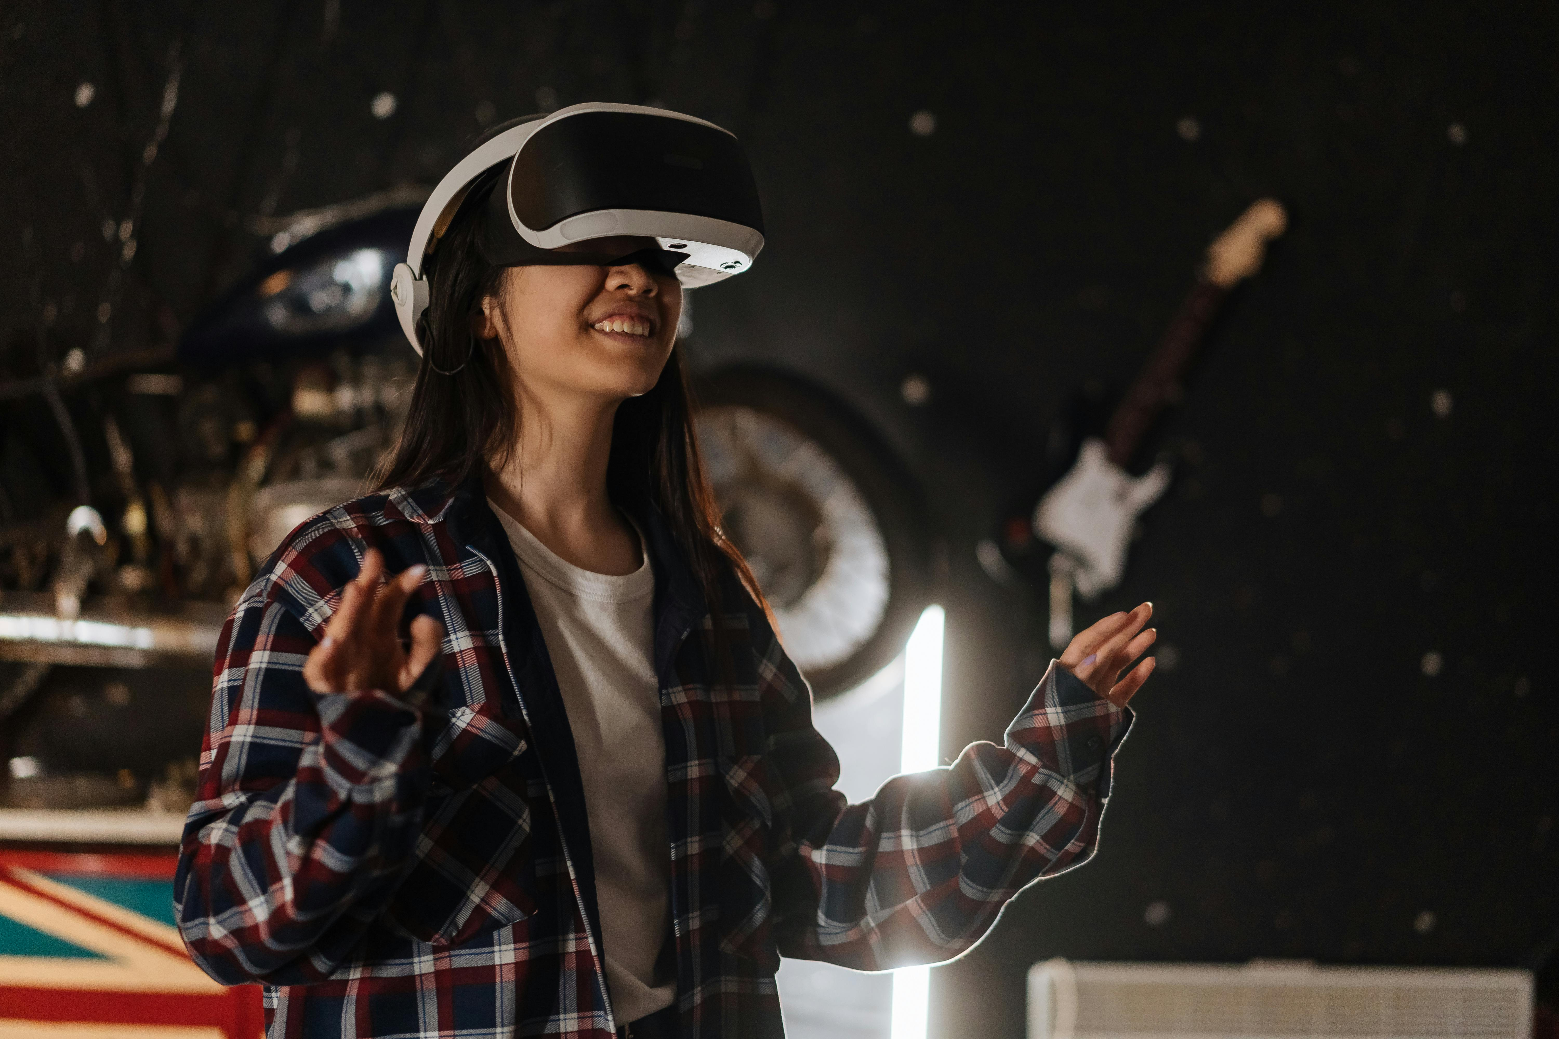

Turning Film and Literary Tourism
into Immersive Experiences
Workshop 03
Learn how to plan and deliver immersive experiences affordably and sustainably, using tools and techniques that match your budget and capacity.
Together, we explore practical cost-saving strategies, financial plannin, responsible implementation approaches to deliver powerful visitor experiences — even on a small budget.
Budgeting, Costs, Financial Planning & Responsible Practice
January 2026
By Feltech Ireland

Slide 2

Contents
Introduction Workshop 3 (Page 3)
Key Challenges (Page 7)
Key Opportunities (Page 8)
Case Study: Little Prine Exhibition, France (Page 10)
Key Terms Explained (Page 12)
Workshop 3 Introduction (Page 20)
Workshop Discussion Section 1 (Page 22)
Build a Realistic Budget (Page 24)
Learn about Cost Components, One-Time Versus Ongoing Costs and Return on Investment
Identify Cost Drivers (Page 28)
Adapt & Repurpose Instead of Build (Page 32)
Affordable & Scalable Approaches (Page 34)
Workshop Discussion Section 2 (Page 39)
Intellectual Property & Copyright (Page 42)
Includes data protection, domain usage, ethics, trademarks, content usage, public safety, and accessibility.
Common Challenges and Myths Explored (Page 44)
Guided Workshop Discussion Questions (Page 49)

Slide 3
How This Workshop Builds on the Previous Sessions
This workshop builds on the previous sessions exploring immersive tourism and experience design.
While Workshop 1 introduced the concept of immersive tourism and
Workshop 2 explored how immersive ideas should align with your brand and audience, this workshop focuses on the practical realities of implementing those ideas.
In this session we explore:
• understanding the real costs involved in immersive experiences
• identifying key cost drivers and financial risks
• planning affordable pilot projects and phased investment
• exploring funding opportunities and partnerships
• ensuring responsible and sustainable implementation
This workshop helps you understand the real costs involved in developing immersive experiences and how to plan for them in a practical, manageable, and responsible way.
It explores affordable and scalable approaches, showing how immersive ideas can be tested and introduced through low-cost pilots, phased budgeting, and gradual investment as confidence and demand grow.
The workshop also introduces key legal, copyright, and ethical considerations, including permissions, content ownership, data protection, and cultural sensitivity — helping you avoid common risks and make informed decisions from the outset.
The goal is to help tourism businesses plan immersive experiences that are financially realistic, sustainable, and aligned with long-term business goals.

Slide 4
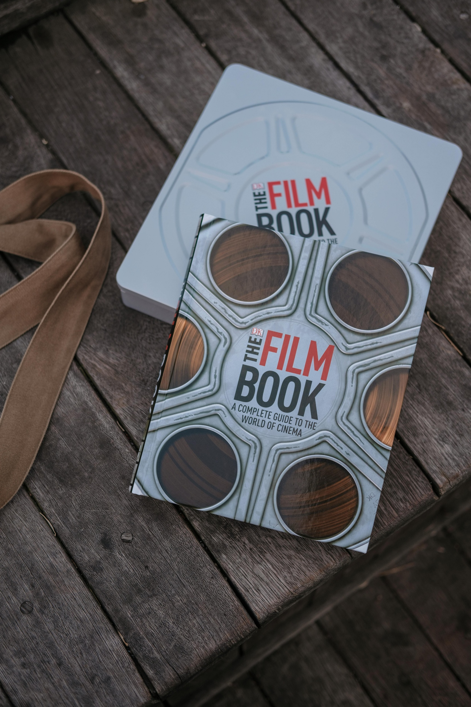
Workshop 3
Budgeting, Costs, Financial Planning & Responsible Practice.
Immersive experiences can range from very low- cost storytelling elements to complex digital installations.
The key challenge for most SMEs is understanding:
• what elements cost money
• how to plan investment gradually
• how to test ideas before scaling.
Photo Credit: Image title

Slide 5
Financial Reality of Immersive Experiences
In this workshop, we shift from “What can we do?” to “What can we realistically deliver — and sustain?”.
One of the scariest questions about immersive tech is “What will it cost us?” – not just in money, but time and resources. This theme tackles budgeting and finance in a very approachable way. We’ll break down the costs associated with various immersive options (from low-tech sensory additions to high-tech VR setups) and talk about how to budget smartly for them.
Importantly, we’ll dispel the myth that everything immersive is prohibitively expensive – there are often low-cost or incremental approaches. We’ll also discuss potential funding sources: grants, sponsorships, partnerships, or phased investments, so that small businesses aren’t bearing the full burden at once.
The goal is to empower you to make informed financial decisions: what can you afford now, what’s the potential return on investment (ROI), and how to plan for ongoing costs (maintenance, updates). By the end, you should feel more confident building a business case for your immersive project that speaks to the dollars and cents, not just the cool factor.
Immersive projects can be exciting — but they require careful planning. Content creation, devices, software development and ongoing maintenance all cost money. We’ll show you how to break down those costs into manageable parts, starting with affordable, scalable pilots. For example, begin with a short QR-code audio tour or printed story map to gauge interest before investing in an app or VR experience
We also address legal and ethical issues up front: obtaining rights (literary excerpts, film clips), ensuring accessibility, and protecting visitor data. Ignoring these can create hidden costs or liabilities.
Most importantly, every spend must align with your brand and visitor goals. Don’t build tech for its own sake: only invest when it clearly deepens the story or improves the visitor experience in a way that fits your theme. For instance, rather than a costly custom app, a well-crafted audio narrative might achieve your goals just as effectively. We’ll teach you to match your budget to outcomes — ensuring you invest wisely.
Why is this important?

Slide 6
Key Challenges
Let’s talk money in plain terms. Immersive technology expenses can range from very little to quite a lot, depending on what you do.
On the modest end, maybe you’re printing a few banners for a photo-op corner with some backing audio – those are small one-time costs. On the high end, custom VR software or hiring developers can run thousands of euros. But don’t panic – you rarely need to jump to the high end immediately. This workshop is designed to suit most businesses and budgets, even non-finance folks, grasp the basics of budgeting for an immersive project.
Challenges
“Immersive tech is too expensive for us, period.” – The myth is that all AR/VR requires unaffordable budgets. Yes, some projects carry hefty price tags, but many SMEs have done immersive on a shoestring. The challenge is prioritizing spending for impact. We’ll show examples of budget-friendly approaches (like using visitors’ own smartphones rather than buying devices, leveraging free platforms, starting with a pilot before scaling).
Additionally, tech costs have been dropping as tools get more common – what cost €50k five years ago might be doable for a few thousand or less today. So, don’t write it off before exploring options. As one insight from the UPLIFT research noted, access to funding and digital programs is growing, and SMEs can avail of those.
“We must budget everything upfront (and we don’t have the money).” – Actually, you can phase your investment. A challenge is convincing stakeholders who want a full cost breakdown up front. The myth is you need a big lump sum now. Instead, you can plan small expenditures over time: e.g. initial trial (€500 on a demo), then seek a grant or allocate more next year for expansion. Also, you might incorporate costs into existing budgets (like using part of your marketing budget for an AR trial since it doubles as marketing). We’ll discuss how to draft a phased budget that shows immediate affordability and longer-term needs, making it more palatable.
“There’s no funding help – we’re on our own.” – Many assume if you’re a small private business, you can’t get grants or external funds. This is a myth; in reality there are increasing opportunities for digital innovation funding in tourism. The challenge is finding and applying for them. From EU funds to local business innovation grants, or even sponsorship by a brand that wants to be associated with innovation, money is out there. We’ll highlight a few avenues and emphasise building that into your finance plan.

Slide 7
Key Challenges
Challenges continued…
For example, maybe you budget that 50% of the project will come from a grant you’ll apply for. Contingency planning (what if you don’t get it?) is also part of good budgeting.
“We can figure out costs as we go – let’s just start and see.” – Enthusiasm is great, but not having at least a rough budget can lead to overspending or projects stalling due to lack of funds.
A challenge is the unknowns: you might not know how much a developer charges. We bust the myth by encouraging getting ballpark quotes or doing research upfront. Even an informal inquiry can give you numbers to plug in. It’s better to have an estimate and add a contingency than to be hit with surprises. So, we’ll practice making a simple budget forecast – no precise penny-counting, just enough to guide decisions.
Key Opportunities
Opportunities
The good news is that immersive experiences don’t have to begin with a big budget. Most successful concepts start with a clear idea, careful planning, and small, well-judged steps. When you approach immersion through structured budgeting and responsible practice, you reduce risk and increase confidence. You can test ideas, learn what works for your visitors, and build gradually rather than committing to major investment too early.
As discussed, Immersive experiences are often perceived as expensive, but many successful projects start with simple storytelling and small pilots. In reality, one of the greatest opportunities for SMEs lies in starting small and scaling strategically. Immersion does not have to begin with complex AR or VR installations. It can start with thoughtful storytelling, sensory details, simple projection, QR-triggered audio content, or structured audience participation. These lower-cost entry points allow businesses to test ideas for a modest investment, learn what resonates with visitors, and build confidence before committing to larger developments. This phased approach reduces financial risk while creating space for innovation.
7

Slide 8
Key Opportunities
Opportunities continued…
Financial planning also creates the opportunity to spread investment over time rather than treating immersion as a one-off capital expense. A business might begin with low-tech narrative design in year one, introduce light digital layers in years two or three, and gradually incorporate more advanced elements only when there is clear demand and capacity. Thinking in a one- to five-year horizon allows immersive development to grow alongside revenue, skills, and operational readiness. This staged model turns immersive thinking into a manageable business strategy rather than an overwhelming leap.
There are also significant revenue opportunities. Well-designed immersive experiences can justify premium pricing, tiered packages, or exclusive small-group sessions. They can open up new income streams such as digital add-ons, downloadable content, themed merchandise, educational workshops, or corporate bookings. Immersion encourages visitors to engage more deeply, which often increases dwell time, secondary spending, and repeat visitation. Rather than relying purely on higher visitor numbers, businesses can improve yield per visitor through richer experience design.
From a funding perspective, immersive and digital initiatives align strongly with innovation, cultural heritage, and tourism development priorities. Many regional, national, and European programmes support digital transformation, cultural storytelling, sustainability, and skills development. Positioning immersive development within these broader agendas can unlock financial support and reduce the burden on internal budgets. Partnerships with universities, creative practitioners, or technology providers can further reduce costs while strengthening quality and credibility.
Operationally, immersive design can improve efficiency when planned well. Digital interpretation layers can reduce reliance on constant live guiding, provide multilingual access, and extend the experience beyond physical opening hours. Self-guided immersive routes or hybrid digital-physical models can help manage visitor flow more effectively. When financial planning is aligned with operational realities, immersive elements become tools for scalability rather than additional strain on staff and resources.

Slide 9
Key Opportunities
Opportunities continued…
Responsible practice also presents clear business opportunities. Ethical storytelling, proper permissions, copyright compliance, and respectful cultural representation build trust and protect reputation. In an era where authenticity and transparency matter deeply to visitors, responsible design strengthens brand credibility. Sustainable choices in technology, energy use, and sourcing can reduce long-term operational costs while aligning with environmental expectations. Similarly, clear data protection practices increase visitor confidence in digital interactions.
Ultimately, careful budgeting and responsible planning transform immersive experiences from creative experiments into structured investments. They allow businesses to innovate without overextending, to test before scaling, and to align creative ambition with financial sustainability. When approached strategically, immersion is not simply an expense — it is an opportunity to strengthen competitiveness, diversify revenue, and position the business for long-term growth.

Slide 10
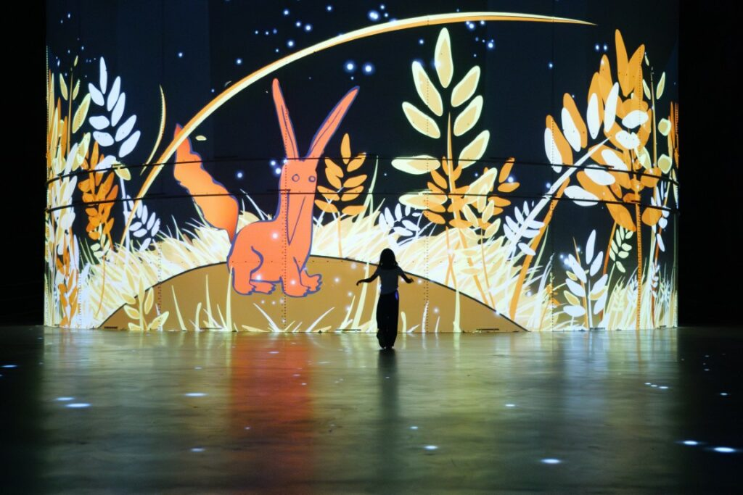
The Little Prince exhibition:
Atelier des Lumières
World Tour Showcase
Location
Paris - France
Category
Exhibition
Website
The Little Prince exhibition in Paris - Atelier des Lumières
Social Media
The Little Prince exhibition
From Page to Pixels : Exploring the World of the Little Prince
The Little Prince exhibition at the Atelier des Lumières in Paris is a stunning tribute to Antoine de Saint-Exupéry and his beloved novella Le Petit Prince, one of the most translated and cherished books in the world. This immersive experience brings the story to life using large-scale projections, music, and animation that brings visitors in the poetic universe of the young prince. Held within the industrial beauty of the Atelier, the exhibition invites guests of all ages to journey across planets, stars, and desert landscapes, just as the prince does in the book.
Antoine de Saint-Exupéry was born in Lyon, France, in 1900, and his life as a pilot deeply inspired his writing. He wrote The Little Prince during his exile in New York during World War II, blending his philosophical reflections on love, loss, and the absurdity of adulthood into a timeless tale. The exhibition pays tribute to this legacy, combining places from the text with vibrant imagery that echoes the book’s original watercolors.
The immersive setting allows visitors to walk through constellations, meet the prince’s whimsical companions—the Fox, the Rose, the Lamplighter—and reflect on the story’s universal messages. Narration, both in French and English, echoes through the space, and quotes from the novella appear like stardust across the walls.
In 2025, the exhibition continues to enchant audiences, offering a deeply emotional and visually rich way to rediscover The Little Prince. Whether you're a lifelong fan or discovering the story for the first time, every step through the gallery becomes part of a personal journey through wonder, imagination, and the heart of one of literature’s most beloved characters.
Click to find out more. Download UPLIFT’s Best Practice Case Studies.
10

Slide 11

Immersive Literary and City Experiences:
The Curious Case of the Wandering Self
What makes The Little Prince exhibition truly remarkable is how it reimagines literature for the modern world. By transforming a beloved book into a multisensory journey, it bridges the gap between generations, learning styles, and even languages.
For some, this is their first encounter with Saint-Exupéry’s world—not through paper, but through light, sound, and space. For others, it’s a reawakening of childhood memories, made vivid through movement and music. The exhibition doesn’t replace reading—it amplifies it, making the story feel immediate, personal, and alive.
In this immersive format, literature becomes democratic and emotional—accessible to children, to those unfamiliar with the language, or to visitors who connect more through visual or auditory experience. It invites everyone, regardless of background, to feel the story, to walk through it, and to find their own meaning in its universal themes.
This is more than an exhibition—it’s a cultural translation, making timeless stories speak in the language of today.
A Fusion of Art, Technology and Emotion
At the heart of the Atelier des Lumières is cutting-edge digital technology that transforms walls, floors, and ceilings into living canvases. Using 140 video projectors and a state-of-the-art spatialized sound system, the exhibition surrounds visitors with moving images, color, and music on a monumental scale.
This immersive format invites audiences to step inside the story—not just to look, but to feel. In The Little Prince, watercolor sketches drift across vast walls, planets orbit underfoot, and words echo in light and sound. It’s a deeply emotional experience that dissolves the line between observer and artwork.
Here, technology doesn’t distract—it amplifies emotion, magnifies wonder, and gives literature a new language: light.
The Little Prince exhibition in Paris
"What makes the desert beautiful is that somewhere it hides a well.“
– Antoine de Saint-Exupéry, The Little Prince
11

Slide 12
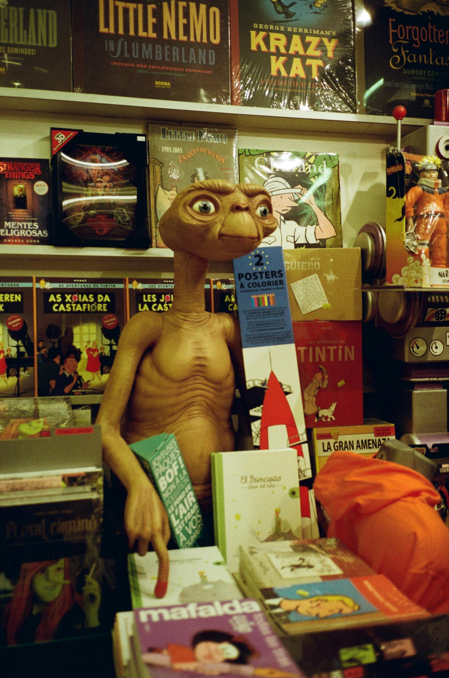
Terms Explained
Budgeting, Costs, Financial Planning & Responsible Practice.
Photo Credit: Image title

Slide 13
Financial & Responsible Terms Explained
One-time vs. Ongoing Costs: One-time (capital) costs are paid only once during setup, e.g. buying AR headsets or building initial content. Ongoing (operational) costs repeat regularly, e.g. software licenses, staff pay, equipment maintenance. Separating these helps plan cash flow and realistic pricing.
High Upfront Costs: Large initial investments required before an immersive experience launches — often quoted by tech vendors for AR/VR development, custom apps, hardware, or installation.
High quotes (€20k–€100k+) can stall innovation because small tourism businesses get thrown off by the expense of immersive costs and think I is practically “not for them.” Also, many tech vendors quote large sums. By starting small (e.g. a €3k–€5k pilot) you keep risk low and test engagement first. Fáilte Ireland cites examples of capital grants up to €200k, but also encourages phased pilots.
Underestimated Hidden Costs: Costs that are not obvious in the initial quote but arise during delivery and maintenance.
Common hidden costs are editing and post-production, hosting fees (website, app servers), software subscriptions, equipment insurance, staff training, ongoing updates, technical support and your own time.
Digital must enhance the story — not become the story.
Try to reuse existing tools (smartphone AR, YouTube, QR codes) to avoid custom development. (“Digital must enhance the story,” advises Fáilte Ireland.)
Copyright & Permissions: Legal rights protecting creative works (film, scripts, music, images, characters). Recreating a famous film scene without permission can infringe copyright.

Slide 14
Financial & Responsible Terms Explained
One-time vs. Ongoing Costs: One-time (capital) costs are paid only once during setup, e.g. buying AR headsets or building initial content. Ongoing (operational) costs repeat regularly, e.g. software licenses, staff pay, equipment maintenance. Separating these helps plan cash flow and realistic pricing.
High Upfront Costs: Large initial investments required before an immersive experience launches — often quoted by tech vendors for AR/VR development, custom apps, hardware, or installation.
High quotes (€20k–€100k+) can stall innovation because small tourism businesses get thrown off by the expense of immersive costs and think I is practically “not for them.” Also, many tech vendors quote large sums. By starting small (e.g. a €3k–€5k pilot) you keep risk low and test engagement first. Fáilte Ireland cites examples of capital grants up to €200k, but also encourages phased pilots.
Underestimated Hidden Costs: Costs that are not obvious in the initial quote but arise during delivery and maintenance.
Common hidden costs are editing and post-production, hosting fees (website, app servers), software subscriptions, equipment insurance, staff training, ongoing updates, technical support and your own time.
Digital must enhance the story — not become the story.
Try to reuse existing tools (smartphone AR, YouTube, QR codes) to avoid custom development. (“Digital must enhance the story,” advises Fáilte Ireland.)
Copyright & Permissions: Legal rights protecting creative works (film, scripts, music, images, characters). Recreating a famous film scene without permission can infringe copyright.

Slide 15
Financial & Responsible Terms Explained
Irish law grants creators “paternity” and “integrity” moral rights – meaning the original filmmakers have a right to be credited and not have their work distorted. The safe approach is to be inspired by a location or theme, not a verbatim copy.
Moral Rights (Irish Law)
Paternity Right – the creator must be credited.
Integrity Right – their work cannot be distorted or misrepresented.
These rights apply even if you are not making money.
Related Term – Intellectual Property (IP): All legal rights related to creative content.
Data Protection & Consent: Legal responsibility for handling personal data (emails, photos, video, names).
Under GDPR (General Data Protection Regulation):
If you collect or store personal data, you must:
Explain why you are collecting it
Store it securely
Allow people to withdraw consent
If you collect any personal data (e.g. sign-ups) or film visitors, GDPR applies. At small events it’s easiest to get written or implied consent. Use clear signage: e.g. “Exhibit includes filming – participation implies consent.” (This follows DPC guidance to be transparent about photography at events.)
Funding Creativity: Using small-scale funding creatively to test ideas before major investment. Ireland offers small grants and funding, example:
Local authority creative grants (€3k–€10k)
Creative Ireland grants (often up to €5k)
LEADER funding (varies by region)
Community-based arts and heritage funds

Slide 16
Financial & Responsible Terms Explained
These small grants typically fit pilot projects. Cork County’s Creative Communities scheme funds local arts projects at €3k–€10k. Creative Ireland grants cap at €5k per project. Even €1k–€5k can seed a viable pilot if combined with in-kind contributions (volunteers, student interns, community donations).
Small grants combined with in-kind support can make a €3k idea viable.
Scalable Growth: Designing a small project so it can grow if successful.
The goal of a pilot is not perfection — it is proof of concept.
Once visitor interest is demonstrated:
Apply for regional tourism grants
Approach destination marketing organisations
Secure sponsorship
Build partnerships
Related Terms:
Proof of Concept (PoC): Evidence the idea works.
Return on Engagement (ROE): Visitor interaction, shares, dwell time.
Return on Investment (ROI): Financial return versus cost.
By proving visitor interest, you make it easy to unlock bigger funds later (regional tourism grants, co-op funding, etc.). Keeping budgets transparent also builds trust with stakeholders.
Additional Useful Terms for Workshop 3
Capital Expenditure (CapEx): Money spent on long-term assets (equipment, installations).

Slide 17
Financial & Responsible Terms Explained
Operational Expenditure (OpEx): Ongoing running costs (subscriptions, hosting, wages).
Risk Mitigation: Reducing financial exposure by testing before scaling.
Sustainability in Finance. Ensuring the immersive experience:
Can be maintained
Does not require constant reinvestment
Supports long-term business viability
How This Fits Workshop 3
In Workshop 3, all participants should leave understanding:
Immersive does not mean expensive.
Small pilots reduce risk.
Legal and ethical practice protects your business.
Funding is often available at micro-level.
Growth should be staged, not rushed.

Slide 18
Tech Terms Explained
AR (Augmented Reality): A technology that overlays digital content (images, 3D models, sound, text) onto the real world through devices like smartphones or AR glasses. For example, an AR app might show a historical figure standing on a museum floor when viewed through your phone’s camera.
VR (Virtual Reality): A fully simulated 3D environment experienced through a headset or VR system. Users feel “inside” a digital world (like a recreated historic site) and can look around or interact as if real. VR typically requires headsets and sometimes hand controllers.
Projection Mapping: A way to project video or animations onto 3D objects or building surfaces so they become part of the display. For example, projecting an old battlefield scene onto the walls of a fortress transforms the building into an active story canvas. Unlike a flat-screen projection, mapping “wraps” content around the shapes of real objects.
Interactive Kiosk: A touchscreen station (often in visitor centers or exhibitions) that lets visitors browse content or maps on-site. Instead of a brochure, tourists can tap a kiosk’s screen to view an interactive map, watch a video tour, or play a quiz. Kiosks “bridge digital and physical exploration” by offering multimedia content at a glance.
QR/Audio Guide: QR codes are those square barcodes you scan with a smartphone camera to open web content. In tourism, a QR code placed by an exhibit might play an audio narration or show photos when scanned. An audio guide is simply a recorded narration (often via phone or rented device) that plays automatically as a visitor walks a route or presses “next” on a digital map. Both are low-cost ways to add audio storytelling.

Slide 19
Tech Terms Explained
Digital Passport: A mobile “passport” app for tourists. As visitors check in (scan a code or tap) at participating sites/businesses, they earn digital stamps, discounts or points. For example, a town might give a free souvenir if someone visits all 5 cultural sites on its digital passport. This gamification encourages people to explore more local attractions.
Shareable AR Filters: Fun camera effects (popular on Instagram/Snapchat) that overlay animations or 3D objects on your face or background. For instance, you can create a custom Instagram filter with local symbols (like a landmark or character) that visitors use to take photos. These filters are “shareable” because guests post their pics online, promoting your experience organically.

Slide 20
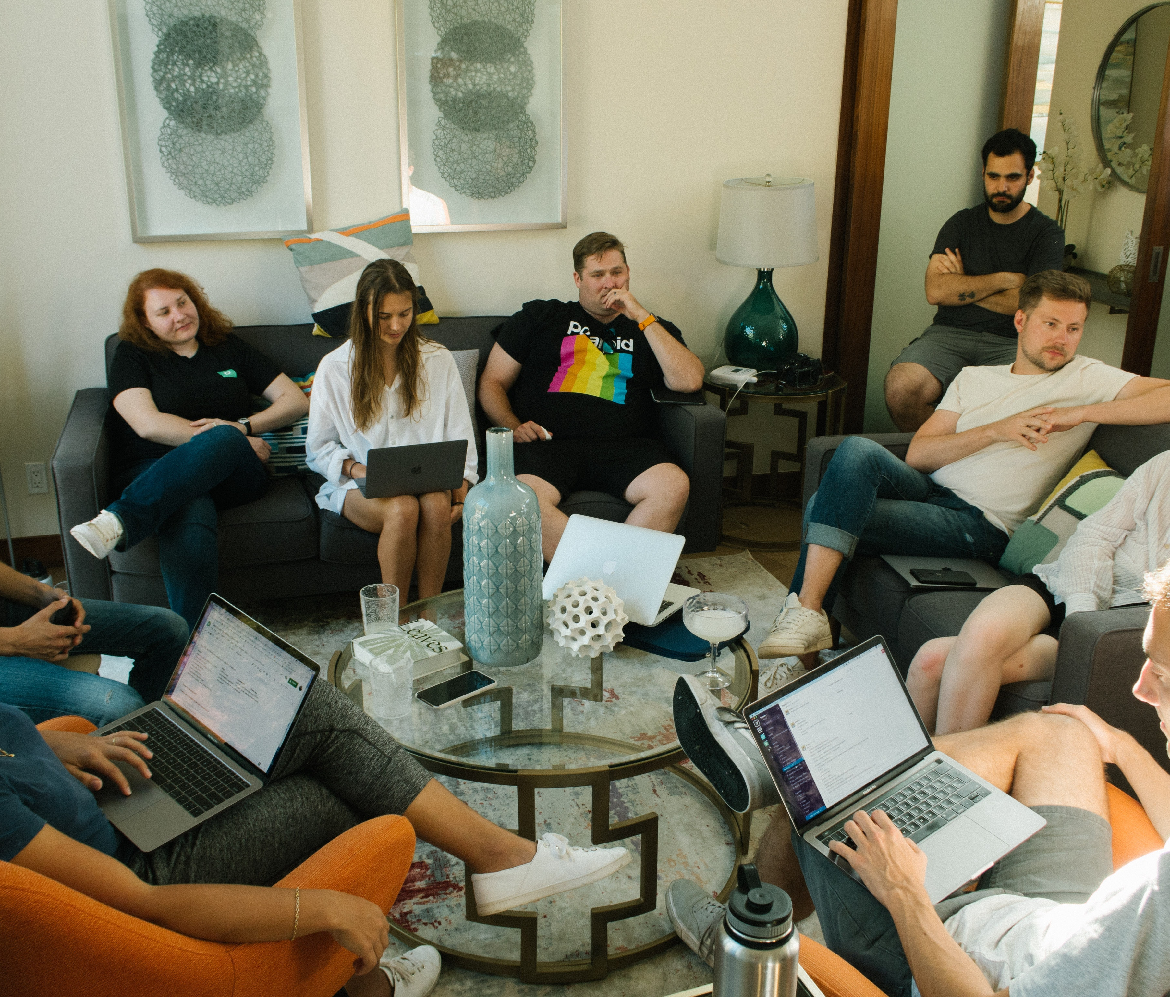
Time to Explore Immersive Opportunities
Workshop Discussion Section
This section helps you think practically about the financial realities behind your immersive ideas. It encourages you to consider the true costs involved, plan sustainably, and make responsible decisions that protect both your business and your destination. The aim is not to limit creativity, but to ensure your immersive experience is financially realistic, ethically grounded, and built for sustainable growth.
Approach the questions conversationally —for personal reflection, team discussion, or group workshops. There are no right or wrong answers. The goal is to explore possibilities, uncover opportunities, and identify what feels realistic and authentic for your business context.

Slide 21
Overview to Discussion Workshop
Executive Summary:
Immersive tourism projects can look expensive, but smart planning breaks costs into one-off investments and ongoing expenses.
By mapping out capital outlays (gear purchase, content creation, setup) versus recurring fees (software subscriptions, staff, updates), you prevent surprises later.
This workshop covers practical budgeting, low-cost pilot strategies, and the ethical/legal checklist for tourism tech (GDPR, IP, cultural respect).
We use plain language and real examples, so even first-timers in tech can plan responsibly.
Purpose of Discussion:
To help teams understand the true costs and cash flow needs of an immersive experience, and how to design a sustainable budget. We’ll identify
all major cost categories (hardware, content, staffing, etc.),
distinguish one-time investments from recurring expenses,
explore affordable/scalable approaches (pilots, phased budgets).
We also cover legal/ethical responsibilities (data protection, permissions, accessibility) so nothing is overlooked.
By the end, participants should be able to sketch a basic budget, find cost-saving strategies, and know what external rules apply to their project.

Slide 22
Section 1
Budgeting, Costs, Financial Planning
Photo Credit: Image title

Slide 23

Workshop 3 Section 1
Discussion Section
Build a Realistic Budget (Page 24)
Learn about Cost Components, One-Time Versus Ongoing Costs and Return on Investment
Identify Cost Drivers (Page 28)
Adapt & Repurpose Instead of Build (Page 32)
Affordable & Scalable Approaches (Page 34)

Slide 24
1
Workshop Topic
Build a Realistic Budget
Why this matters: To help participants:
Understand where immersive project costs really come from
Separate one-time vs ongoing costs
Identify value and return
Explore creative funding options
Build financial confidence
This session moves from idea to implementation.
Note: 5 Main Cost Categories
1 Content production
2 Technology platforms
3 Hardware and equipment
4 Installation and design
5 Maintenance and updates
Discussion Question 1: Cost Components
What are the main cost components involved in delivering your immersive experience?
Cost Components are the individual pieces that make up your total project budget.
Everyone brainstorm cost component categories: e.g. equipment/devices, software licenses, content creation, consulting/development, staff time, marketing of the experience, maintenance.
Writing these on a board lays out the puzzle pieces to consider.)

Slide 25
Workshop Topic
Build a Realistic Budget
Discussion Question 2
One-Time Versus Ongoing Costs
Which of these costs are one-time vs. ongoing?
One-time cost = Paid once (equipment purchase, development build).
Ongoing cost = Recurring (subscriptions, hosting, maintenance, updates).
Why this matters: Many immersive projects fail not because of upfront cost — but because ongoing costs weren’t planned.
Mark them, which of our listed costs are: One-time, Monthly, Annual
Likely to repeat in 2–3 years? Etc.
For example, buying a projector is one-time, but subscribing to an AR platform might be monthly. Annual license renewal = ongoing. Replacing devices every 3 years = future planned cost
Ongoing could include things like yearly updates or replacing devices every few years.
Understanding this helps plan for sustainability – ongoing costs need to be budgeted for future years too.)

Slide 26
Workshop Topic
Build a Realistic Budget
Discussion Question 3
Return on Investment (ROI)
How might this immersive project generate value or return?
How will this immersive idea create value?
ROI = What value the project creates compared to what it costs.
Return can be:
Direct financial (ticket sales, price increase)
Indirect financial (off-season bookings)
Strategic (brand relevance, repeat visits)
Operational (reduced printing costs)
Why this matters: It’s important to identify these because it’s part of justifying the expense. Write down at least a couple of expected benefits in monetary or strategic terms.) If you can’t articulate value, you can’t justify investment.
Discuss how the immersive experience creates value (more visitors, higher engagement, new income streams).
Focus on purpose-driven features: spend money only on elements that solve real needs or audience interests
Using this audience-centric approach (e.g. interactive maps if visitors get lost, or themed storytelling that connects with your audience) helps justify costs
Track simple metrics (visitor count, time on experience, satisfaction) later to measure return on investment.

Slide 27
Discuss in concrete terms:
Will we sell more tickets? e.g., +500 visitors × €10 = €5,000 extra revenue
Reduce printing costs? e.g., 1,000 fewer brochures printed = €200 saved
Increase prices?
Attract off-season business?
Or maybe indirect returns like higher customer satisfaction leading to repeat visits or good reviews. e.g., Higher TripAdvisor rating → stronger long-term positioning
Gain sponsorship?
https://chameleon-interactive.com/2024/12/17/planning-your-budget-how-to-invest-wisely-in-immersive-event-technology-solutions/#:~:text=,expand%20based%20on%20proven%20value
Go to Implementation Clinic 03 to learn how to apply these ideas in practice.

Slide 28
2
Workshop Topic
Identifying Costs Drivers
Discussion Questions
Identify cost drivers.
Definition: A cost driver is anything that makes your project more expensive. It is the reason costs increase. If something causes the budget to grow, it is a cost driver. A cost driver is a specific decision, feature, or design choice that directly increases the total cost of your project. It is not just “something expensive.”
What are the 3 biggest cost drivers in your immersive idea?
Which decisions in your project would cause costs to multiply rather than just increase slightly?
If your budget had to be cut by 40%, which features would you remove first?
That shifts thinking to strategic prioritisation.
Examples of Immersive Tourism Cost Drivers for an AR literary trail:
Number of locations (1 stop vs 10 stops)
Level of animation (simple overlay vs full 3D reconstruction)
Custom app vs using existing platform
Multilingual content
Professional actors vs volunteer voices
High-end VR headsets vs smartphones
The more complex the experience → the stronger the cost drivers.

Slide 29
Workshop Topic
Identifying Costs Drivers
How to identify Cost Drivers:
Look at your project on 3 levels (basic, medium, premium).
Construct your budgets for each level. Budgets must cover all possible expenses – both obvious and hidden. Beyond the main attraction itself, hardware (e.g. AR/VR headsets, displays, sensors), software and content creation (e.g. custom 3D assets, animations), system integration, on-site staffing/support, venue logistics (internet, lighting, space), marketing, insurance, etc. These factors will vary by project scale and sophistication.
For each level, ask yourself – What changed? What Caused Costs to Rise?
Now ask yourself if your budget was cut. This creates financial realism. – What is the hardest to remove? What are ‘nice to have’?
Imagine a small tourism group in Sligo creating an AR poetry trail inspired by W. B. Yeats.
Research Actual Costs of what you would like to consider to Construct Your Budget (Examples)
Hardware
4–6 iPads for guided tours (€400–€600 each)
Outdoor QR signage (€80–€120 per sign)
Portable WiFi router for reliability (€40/month)
Software & Content Creation
AR platform subscription (e.g. €100–€300/month)
Scriptwriting & voiceover recording (€800–€1,500 once-off)
3D animation of historical scenes (€1,500–€3,000 depending on complexity)

Slide 30
Integration
App testing & debugging (€500–€1,000)
Graphic design for branding (€500)
Staffing
Part-time guide trained in tech (€18–€22 per hour)
Venue Logistics
Insurance extension for tech equipment (€300–€600 annually)
Many Irish SMEs underestimate content creation costs — especially voiceovers, animation, and revisions.
Now Add the Immersive Piece
Now you have assessed realistic costs, now imagine three versions of the same project, examples below of what to consider;
Version 1 (Simple) Low Cost | Version 2 (Enhanced) Costs Increase Significantly | Version 3 (Premium) Costs Multiply
3 locations QR codes Hosted audio storytelling Basic graphic overlay Volunteers record narration | 8 locations Custom-designed visuals Professional voice actor Animated overlays Multilingual subtitles | 12 locations Fully custom AR app 3D historical reconstruction Licensed music Actors in costume Multilingual voiceovers Data analytics dashboard

Slide 31
Cost Driver Category | Examples of Costs | Type of Cost Driver
Number of Locations | Each additional stop increases: content creation, filming, testing, signage and maintenance | This is a scale or multiple driver.
Level of Animation / Production Quality | Simple overlay = low cost 3D reconstruction = high cost | This is a complexity driver.
Custom App vs Existing Platform | Using existing AR platform = subscription fee Building custom app = development, testing, updates | This is a customisation driver.
Multilingual Content | Each additional language multiplies script translation, voice recording, editing and quality control | This is a duplication driver.
Hardware Choice | Smartphone-based experience = low hardware cost VR headsets/tablets = capital expenditure + maintenance | This is a hardware driver.
Professional Talent | Professional actors, composers, designers increase production quality — and cost. | This is a quality driver.
Go to Implementation Clinic 03 to learn how to apply these ideas in practice.

Slide 32
3
Workshop Topic
Adapt & Repurpose Instead of Build
Discussion Questions
Why this matters: A custom VR or AR system can cost tens of thousands. Small SMEs should first ask: “What can we adapt that already exists?” Many immersive effects can be achieved with off-the-shelf tools or content you already own. This protects your budget and lets you test the concept quickly.
Discussion Questions
What assets do we already have (photos, video clips, existing exhibits) that could be used?
Can we achieve the experience with visitor smartphones instead of new hardware?
Could a 360° photo or video replace a “full VR” build? (For example, 360 video can be viewed on YouTube.)
Are there free or low-cost platforms (e.g. Google Poly, AR toolkits) we can use before developing our own app?
What simple tech (QR codes, mobile apps) can we integrate into our current site?
How can we avoid duplicated effort? For instance, can we use stock audio or music under creative commons instead of producing our own?
What low-tech alternatives exist (e.g. printed storyboards, live narration) if tech becomes problematic?

Slide 33
Workshop Topic
Adapt & Repurpose Instead of Build
Step-by-Step Actions
Inventory Assets: Identify existing media (photos/videos/audio). List existing videos, photographs, recordings, or exhibit materials.
Explore Free Tools: Research free or low-cost platforms (360 viewers, AR apps, etc.). Research off-the-shelf platforms (e.g. YouTube, Google Street View, free AR apps) that match your needs.
Develop a Minimal Prototype Quickly: Develope a minimal prototype (QR + video, smartphone AR filter, etc.). Create a proof-of-concept using these tools. For example, shoot a short 360° clip on a borrowed camera and test on phones.
Gather Feedback Early: Show the prototype to a small audience (staff, local volunteers) to check usability and interest.
Refine Content: Improve the story/dialogue using local input, without changing the underlying low-cost tech.
Decide Next Steps: Based on results, plan whether to scale up (more locations, higher-end tech) or pivot.
Go to Implementation Clinic 03 to learn how to apply these ideas in practice.

Slide 34
4
Workshop Topic
Affordable & Scalable
Approaches
Leverage What You Already Have (Before You Spend Big)
Immersive experiences do not have to start with large budgets.
Immersive experiences do not begin with technology.
They begin with assets.
The biggest mistake small businesses make is assuming innovation means buying something new. In reality, the most sustainable immersive projects are built by combining what you already have in smarter ways.
The smartest projects:
Start small - Reuse existing assets - Test engagement early as a priority - Scale only when demand is proven - Invest based on evidence — not excitement
Immersive is not about spending more. It is about thinking differently, smartly, and innovatively.
Brainstorm and research to find creative funding.
Brainstorm potential resources: small grants for culture/innovation, partnerships with sponsors (e.g. local businesses, universities), crowdfunding, or revenue from related activities. Even modest investments can seed a pilot.
As costs are often the biggest concern, remember that incremental funding (matched to each project phase) keeps budgets “manageable and responsible” – you scale up only as interest and confidence grow

Slide 35
Workshop Topic
Affordable & Scalable
Approaches
Discussion Questions
Start Small
Many immersive experiences fail because organisations try to launch the “full vision” immediately.
If you had only €3,000 to test your immersive idea, what would you build first?
What is the simplest version of your experience that still tells the story effectively?
Which parts of your concept are essential, and which are nice to have?
How could you test audience interest before investing heavily?
Test Before Scaling
The goal of a pilot is not perfection — it is learning.
What could you measure during a pilot phase?
(visitor engagement, dwell time, feedback, social media sharing)
How would you know if the experience is worth expanding?
What feedback from visitors would help improve the experience?
How can a pilot reveal unexpected costs or technical challenges?
Reduce Financial Risk
Affordable immersive experiences often rely on creativity rather than expensive technology.

Slide 36
Adapt & Repurpose Before You Build
Before investing in custom-built technology, pause and ask:
What can we adapt instead of build from scratch?
Custom tech sounds impressive, but it is expensive, risky, and often unnecessary at early stages.
Adapt or repurpose free/cheaper tools and content where possible.
For example, use off-the-shelf platforms (e.g. 360° image viewers, smartphone AR apps) instead of building from scratch.
Do you have any existing assets you could leverage?
Think in Layers. You likely already have:
A location
A story
A guide or narrator
A website
Social media channels
Photography
Video clips
A local network
Immersive is about combining these into a layered experience.
For example, instead of: €25,000 custom VR platform.
Use:
360° photography shot locally
Uploaded to an existing viewer platform
Accessible through QR code
Played on visitors’ own smartphones

Slide 37
Workshop Topic
Affordable & Scalable
Approaches
What existing assets could you use instead of building something new?
  historic literary locations
  local actors
  existing film footage
  smartphones instead of VR headsets
Adapt or repurpose free/cheaper tools and content where possible.
For example, use off-the-shelf platforms (e.g. 360° image viewers, smartphone AR apps) instead of building from scratch.
Reuse content in multiple ways (e.g. a video tour that can be both an exhibit intro and a social media teaser).
This repurposing and scalability spreads costs over time
Could you borrow or rent equipment rather than buying it?
What partnerships could help reduce costs?
  film schools
  theatre groups
  universities
  local tourism offices
Community Collaboration
Many successful immersive tourism projects involve the local community.
How could local people participate in creating the experience?
Could local artists, performers, or students help create content?
How might community involvement increase authenticity and visitor interest?

Slide 38
Workshop Topic
Affordable & Scalable
Approaches
Phased implementation
You don’t have to do everything at once. Start with a low-cost pilot to test one or two features before a big rollout.
As one expert note advises, “Start small – pilot a single AR demo or kiosk – then expand once you’ve measured engagement and confirmed value”.
In practice, that means perhaps renting or borrowing equipment initially, or using a pop-up installation. Gradual adoption mitigates risk and helps refine spending.
Irish Example:
A small centre in West Cork wants to create a fully immersive film scene simulation from a famous film.
Instead of building a €25,000 VR experience…
PHASE 1 – Low-Cost Pilot (€3,000–€5,000)
✔ 360° panoramic scenery and authentic buildings filmed locally. Local actors and community dressed up with props recreating one or more scenes
✔ Hosted on YouTube (private link)
✔ Viewed via visitor smartphones
✔ QR code signage installed
✔ Short 3-minute immersive story
Goal: Test engagement.
Go to Implementation Clinic 03 to learn how to apply these ideas in practice.

Slide 39

Section 1
Legal, Copyright, and Ethics
Photo Credit: Image title

Slide 40
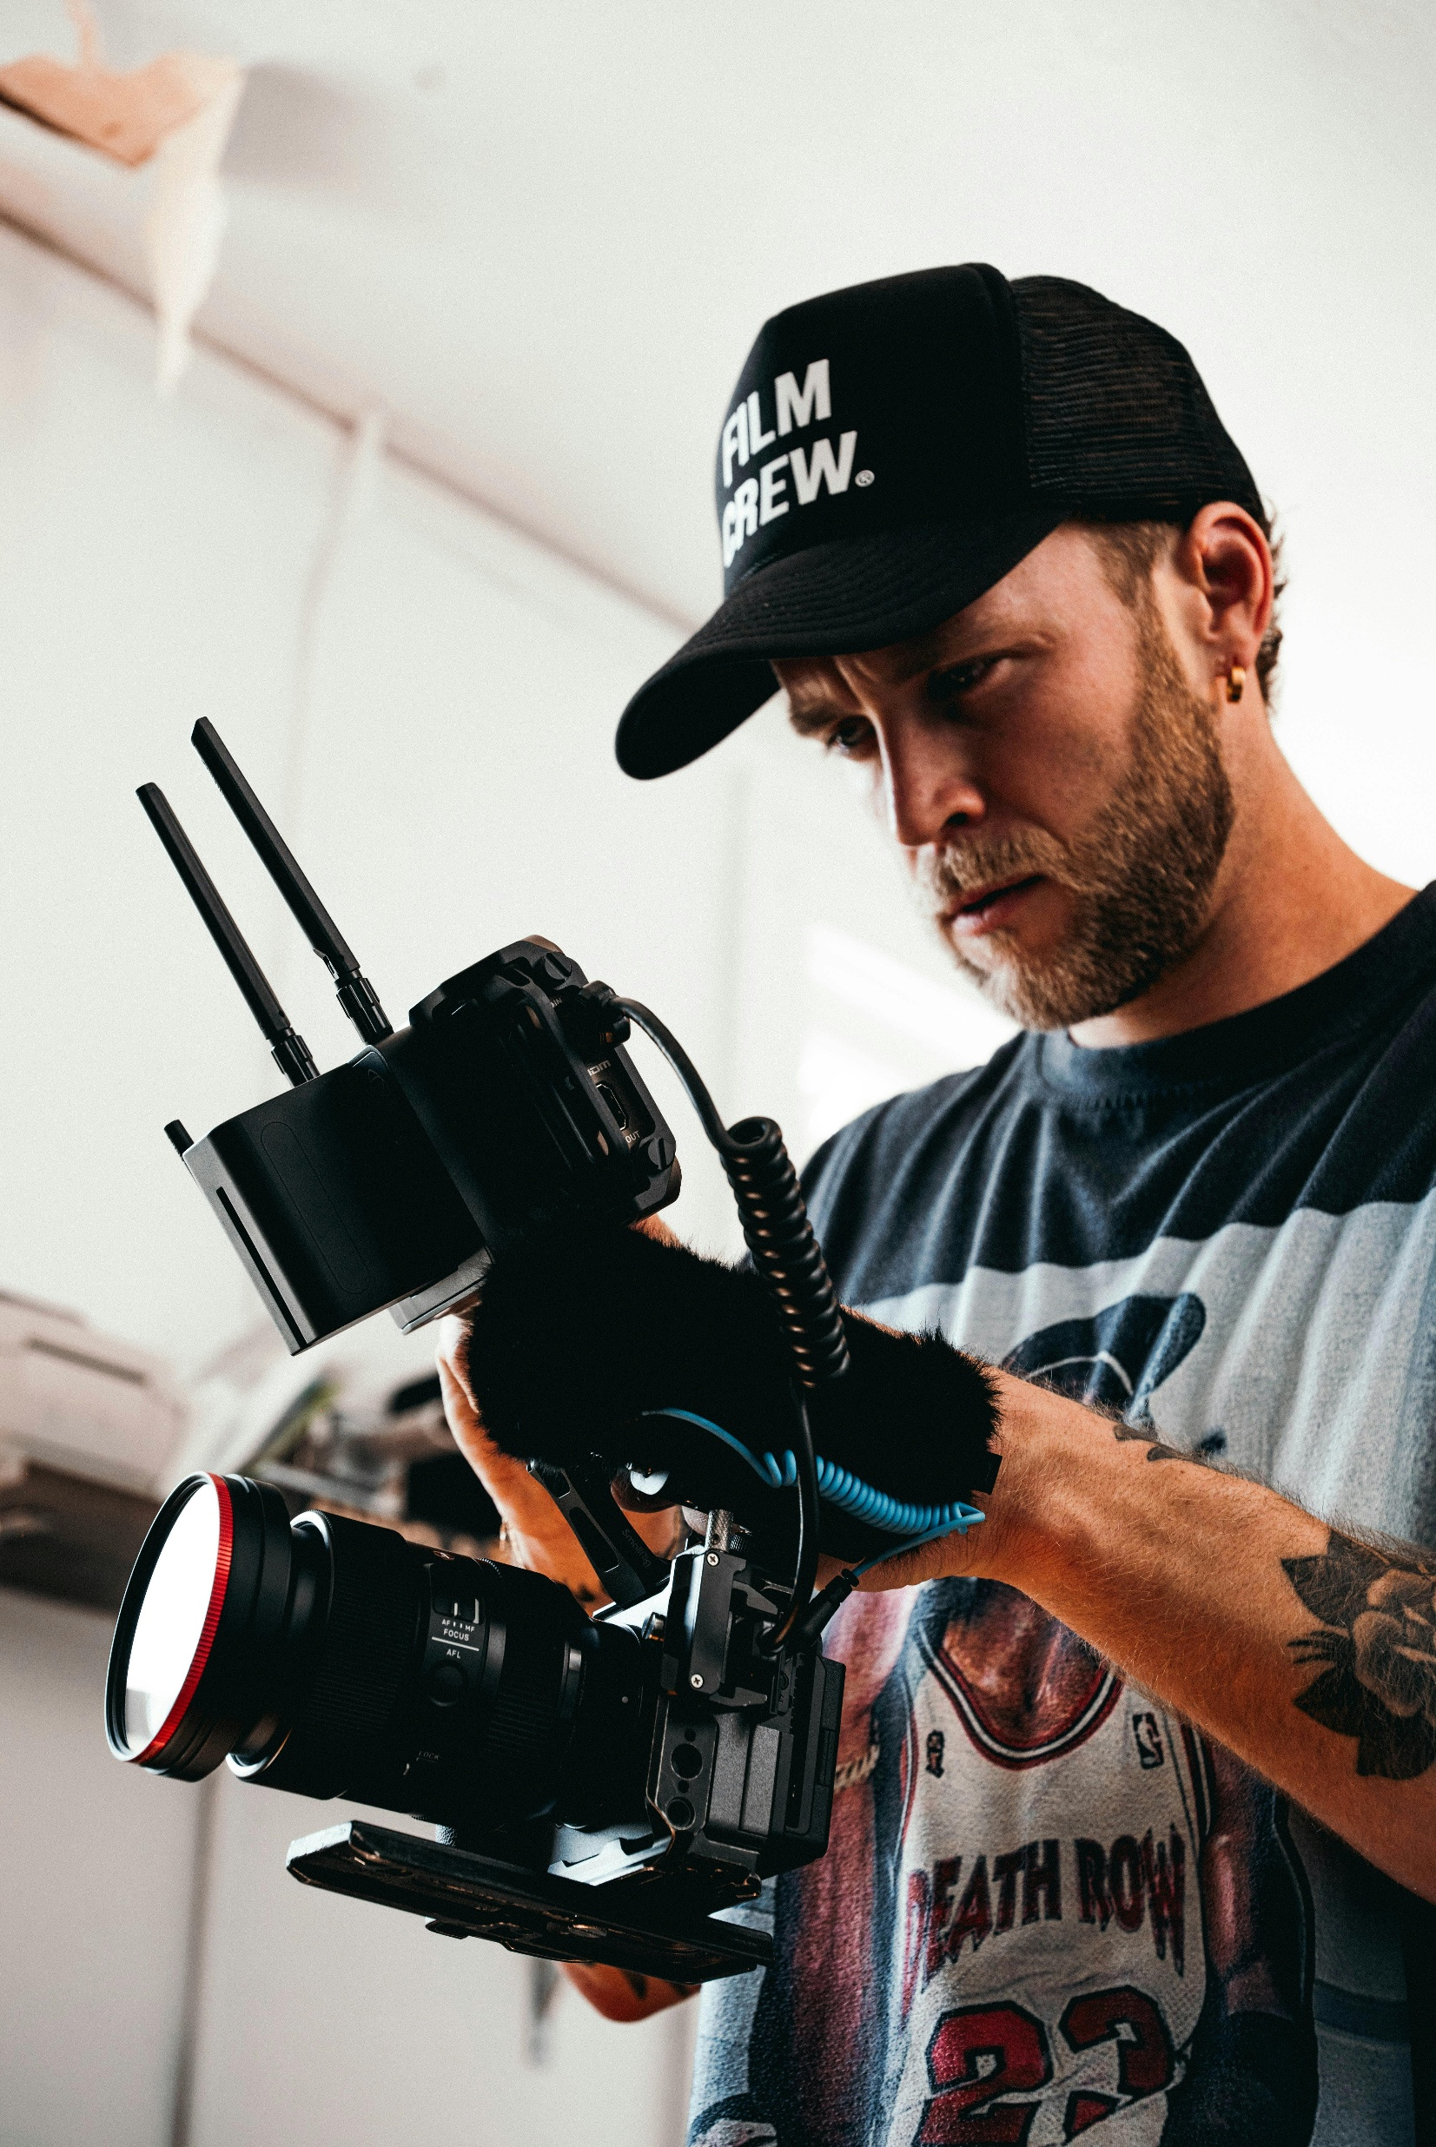
Workshop 3 Section 2
Discussion Section
Intellectual Property & Copyright (Page 42)
Includes data protection, domain usage, ethics, trademarks, content usage, public safety, and accessibility.
Common Challenges and Myths Explored (Page 44)
Guided Workshop Discussion Questions (Page 49)

Slide 41
Legal, Copyright, and Ethics
Overview: Immersive film and literary tourism often involves dealing with stories, characters, and locations that may be protected by intellectual property (IP) rights – plus, using technology brings in questions of data privacy, user safety, and cultural sensitivity. This section is all about making sure your exciting new experience is also legally compliant and ethically sound.
Immersive film and literary tourism doesn’t operate in a creative vacuum. When you build experiences around films, novels, characters, or real locations, you are operating in a space shaped by:
Intellectual property law
Trademark protections
Data protection regulations
Public safety responsibilities
Cultural and community ethics
This section is about making sure your immersive experience is:
Legally compliant
Ethically responsible
Community-aware
Future-proof
In simple terms, it looks like:
Copyright (text, images, video, music)
Trademarks (titles, logos, brand names)
AR/VR in real places (overlaying content on buildings, public spaces)
Privacy/GDPR (emails, logins, photos, location triggers)
Ethics (consent, culture, community impact, safety, accessibility)
The goal is not to scare you, but to prepare you – so you know the common pitfalls and can take simple steps to avoid legal trouble and do the right thing by your community and visitors.

Slide 42

1
Workshop Topic
Intellectual Property & Copyright
Immersive film and literary tourism often involves dealing with stories, characters, and locations that may be protected by intellectual property (IP) rights – plus, using technology brings in questions of data privacy, user safety, and cultural sensitivity. This theme is all about making sure your exciting new experience is also legally compliant and ethically sound.
Let’s start with some reassuring news: you don’t need to be a lawyer to address the basics of legal and ethical issues in immersive experiences. A lot of it is common sense once you know the key points.
Copyright is about who owns creative material (text, images, video, music). If you use someone else’s creation (like a movie clip or book excerpt), you usually need permission unless it’s public domain or a very small, “fair use” portion.
  It’s in the public domain. Public domain generally applies around 70 years after the author’s death in many countries, e.g., Shakespeare
  Or your use is extremely limited and qualifies under narrow “fair dealing/fair use” exceptions (often more limited than people assume).
Trademarks are brand names/logos – for example, “Harry Potter™” is trademarked, so you can’t just use that in your tour title without permission (though saying “the boy wizard from a famous book” might be a workaround).
Simple takeaway: Don’t assume tourism/education = automatic permission.

Slide 43
Workshop Topic
Intellectual Property & Copyright
On privacy, if your AR app is basically just visual and doesn’t collect personal data, you’re mostly fine. But if you ask users to login, or you take pictures/video of them, or track their location, you need to follow data protection rules (like GDPR in Europe) – which often means just being transparent and asking consent.
Ethics covers a broader area: are we respecting the story and community? For example, if using folklore or sacred sites, did we consult local stakeholders? Are we portraying groups of people (say, an indigenous story) accurately and sensitively? We’ll discuss scenarios to raise awareness.
Remember, an ethical, legal experience builds trust and avoids drama – and it can be a selling point (“official licensed tour” or “community-approved experience”).
So it’s worth spending a bit of time on these topics upfront.
Guided discussion questions
Is the underlying story public domain?
Are we accidentally using a modern adaptation’s imagery or branding?
Could we build the experience around public domain + local content to reduce legal cost?

Slide 44
Workshop Topic
Intellectual Property & Copyright
Common Challenges and Myths Explored
“If it’s educational or tourism-based, it’s fair use.”
Myth Alert
In many jurisdictions, there’s no broad exemption for tourism or education unless you’re a registered school perhaps. Using copyrighted material (like movie stills, character likenesses, or quotes beyond short phrases) usually requires permission or a license, even if your intent is educational. The challenge is understanding what is genuinely free to use. Public domain works (e.g., works by William Shakespeare or Jane Austen) are free because copyright has expired. Modern films, novels, scripts and characters are protected. There is limited fair use/fair dealing for commentary, criticism or parody — but it is narrow and highly context-specific. It’s safer to assume you need rights and then find out if an exception applies, rather than the other way around. Instead of uploading a film clip into your AR experience, consider: Linking to the official trailer on YouTube (embedding officially uploaded content is generally permitted because the rights holder authorised it). Creating your own original artwork or scene interpretation inspired by the story. Designing an immersive experience around themes, locations or atmosphere rather than reproducing protected content. You can evoke a world without copying it.

Slide 45
Workshop Topic
Intellectual Property & Copyright
Common Challenges and Myths Explored
“We’re small, no one will sue us.”
Myth Alert
Many assume big studios or publishers won’t bother with a tiny tour operator using their IP. The reality: while you might fly under the radar, it’s not guaranteed. Legally, being small doesn’t exempt you. You are not legally protected. Doesn’t remove liability. Doesn’t protect your reputation. Doesn’t help if you later want formal partnerships. Studios and publishers do issue cease-and-desist letters — even to small fan events or independent tours. A useful mindset shift: Would I be comfortable if someone used my original work this way without asking? Respecting IP is also about positioning yourself as a serious, trustworthy operator — especially if you ever want collaboration opportunities. The challenge is risk management: maybe you decide some minor reference is worth the tiny risk, but you should make that an informed choice, not just ignorance. Also, beyond lawsuits, consider reputation: you want to be seen as respectful of creators’ rights (especially if you ever seek partnerships with them).

Slide 46
Workshop Topic
Intellectual Property & Copyright
Common Challenges and Myths Explored
“Tech content is wild west – there are no rules yet.”
Myth Alert
Some folks think AR/VR exists in a legal gray area. But existing laws still apply. While laws are indeed catching up (and can be a bit fuzzy), existing laws on IP and privacy do apply to digital experiences. Challenge: there might not be AR-specific regulations, but general ones still hold. Copyright law still applies. Trademark law still applies. Data protection law still applies. Public safety regulations still apply. Accessibility expectations still apply. Recognising when digital = regulated. Examples: If your AR app allows users to post content (say, graffiti AR notes on locations), you now have user-generated content responsibilities. If you collect emails or analytics, data protection rules apply. If you digitally overlay content on a protected heritage site or monument local authorities may need to approve. If your immersive installation changes visitor movement patterns, safety compliance matters. New medium. Same legal framework. Assume the rules and normal laws apply — even if the format is innovative.

Slide 47
Workshop Topic
Intellectual Property & Copyright
Common Challenges and Myths Explored
“Ethics are optional; only legal compliance matters.”
Myth Alert
We strongly challenge this myth. This is the most dangerous myth. Legal compliance is the baseline. Ethics determines sustainability. Something can be technically legal but still: Offensive to a local community – bad practice using folklore without community engagement. Culturally insensitive - bad practice over-sensationalising conflict history. Extractive or appropriative – bad practice digitally recreating private homes or personal stories without consent. Exclusionary – bad practice ignoring accessibility considerations. Damaging to long-term trust – bad practice placing violent immersive content in family-oriented public spaces. Ethics – doing what’s right, not just what’s legal – is crucial for long-term success and community relations. Maybe it’s legally allowed to use a certain piece of folklore, but if the local community feels it’s misused or offensive, you’ll face backlash (and feel bad). Or legally you might not be obliged to make your app accessible to color-blind users, but ethically it’s good to consider (and it broadens your audience). Ethical tourism builds goodwill, strengthens partnerships, enhances brand credibility, expands your audience and supports long-term viability.

Slide 48
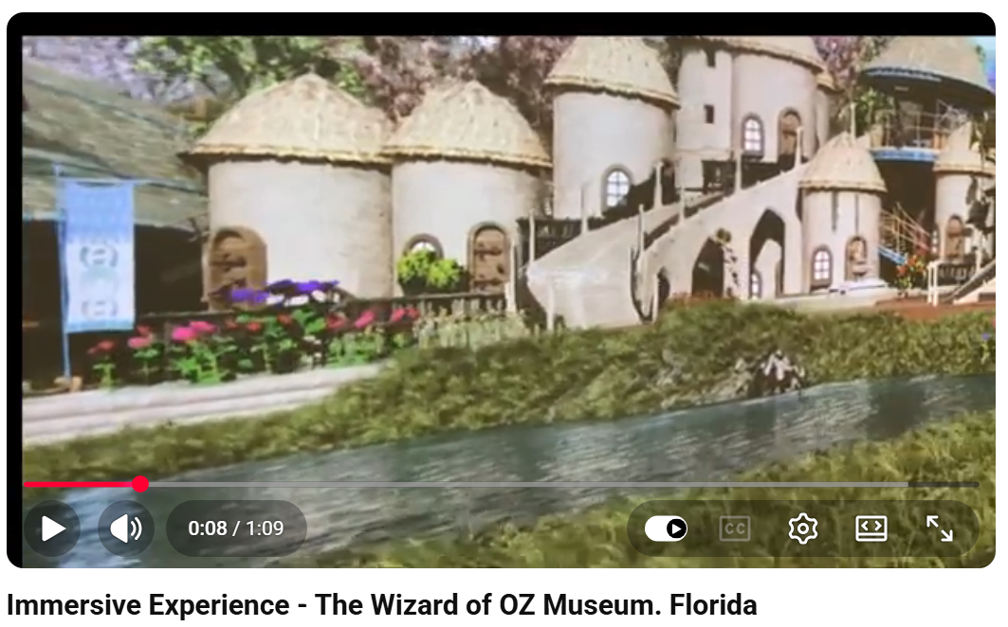
Myth Alert
Plus, being ethical can be a selling point (like being eco-friendly, being culturally sensitive, etc.). Assume: rights are protected, laws apply, communities matter, long-term reputation is more valuable than short-term convenience. The goal isn’t to be fearful. It’s to be informed, professional, and intentional.
Immersive Experience
The Wizard of OZ Museum. Florida
An Immersive experience is on display at the Wizard of Oz Museum in Cape Canaveral, Florida. In addition to over 2000 artifacts and original movie props such as the original Dorothy dress, Townsman jacket, and spear, the museum shows Immersive scenes. Here is a sample of the Wizard of oz scene. https://www.wizardofozflorida.com
Click to Watch Video
https://www.youtube.com/watch?v=sr7ZaFK5Ut0

Slide 49
Workshop Topic
Intellectual Property & Copyright
Guided Workshop Discussion Questions
What intellectual properties are you directly using?
What story/content elements are we using that might be owned by someone?
List the IP involved in your idea: specific book texts, film scenes, character names, music, titles, logos, images, music, artwork, etc. Also names/likenesses of real people if any – that’s another right (right of publicity).
Highlight any that are likely copyrighted/trademarked. For each, consider: is there a workaround (using generic references) or do you need permission?
Being clear on this list helps decide if you should reach out for licenses or play it safe with descriptive but not infringing terms.
For example, if your tour is about Game of Thrones filming sites, “Game of Thrones” is a trademark of HBO. What phrase in advertising will you call it? Identifying such helps target what permissions you may need. If your experience is based entirely on works in the public domain, that’s great – note that too.
Scenario: You created an AR tour of a city’s film locations and included a famous movie theme song as background music in the app without permission. What could happen?
Discuss likely outcome: copyright infringement – worst case, app stores take it down or you get a letter from rights holder to remove it; solution: use license-free music or get a license.

Slide 50
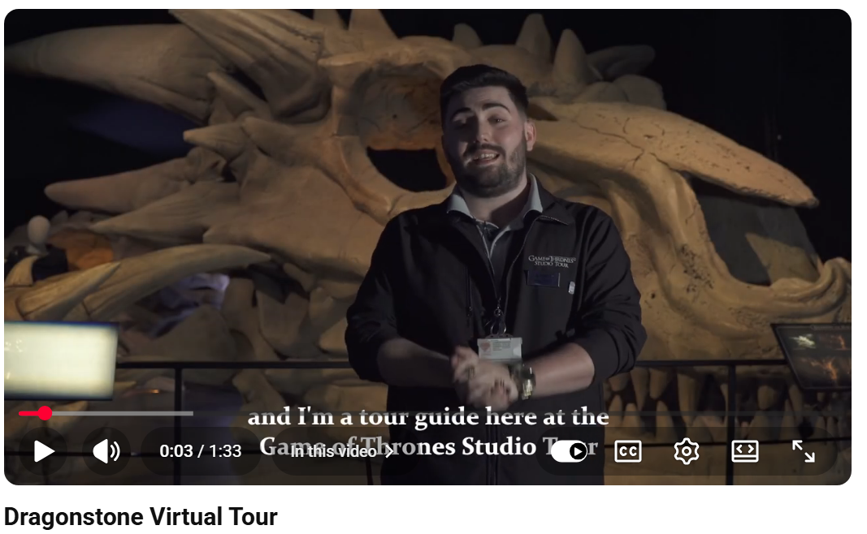
Immersive Experience
Game of Thrones Studio Tour, Ireland
Journey behind the cameras and discover the secrets that made HBO's Game of Thrones the world's most successful TV series. Game of Thrones Studio Tour is an unforgettable journey that takes you into the heart of Westeros, captivating families, fans and filmmaking enthusiasts of all ages
Walk into Westeros and uncover behind the scenes secrets about your favourite sets, costumes and props. Our mini-series continues with more epic discoveries presented by our tour guide Joe in Dragonstone… Plan your visit today at Game of Thrones Studio Tour: www.gameofthronesstudiotour.com
Click to Watch Video
https://www.youtube.com/watch?v=LQm9vrKcrus

Slide 51
Workshop Topic
Public Domain
Guided Workshop Discussion Questions
Is the underlying story in the public domain?
Do we have the rights or permissions for those, or are they public domain?
For each item above, discuss status. Public domain: generally, authors who died over 70 years ago in many countries – their works are free to use. Anything newer, likely protected. If protected, have we or can we get permission? For instance, Dracula (1897) is public domain – you can use the characters and text freely. But Dracula film imagery from, say, a 1992 movie is not. Knowing what material is free to use can shape your content.
If something is not public domain, consider if you really need to use the protected elements or if you can focus on factual/historical aspects that are not protected (like the fact that a movie was shot in a castle is a fact, you can say that; what you can’t do is use the movie’s logo without permission). Sometimes it’s as easy as emailing a local author for OK to use a quote – you’d be surprised, they might be thrilled. Write down any action: e.g. “Check if that 1940 film is PD or who to contact for rights.”
Scenario: You run literary tours and plan to quote extensively from a modern novel during the AR segments. Is that okay?
Likely not beyond short quotes; might need author/publisher permission unless it’s minimal and interpretative – or use public domain literature instead.

Slide 52
Workshop Topic
Data & Ethical Sensitivities
Guided Workshop Discussion Questions
What data will our immersive experience collect, if any?
This includes personal data like names, emails for an app account, photos of users, location tracking, etc. If your project doesn’t involve any user data, fantastic – you sidestep privacy issues. If it does, note each type of data.
Then discuss: why are we collecting it? Do we really need it? How will we protect it? Make a plan: e.g. if doing an email sign-up, we’ll need a privacy notice and maybe verify consent. If tracking location for AR triggers, we inform users and ensure it’s not stored unnecessarily.
Scenario: Your VR experience in a museum records users’ faces to insert them into a historical scene for fun. Did you consider privacy?
Answer: That’s biometric data possibly – need clear consent, maybe avoid storing it at all, just process live.

Slide 53
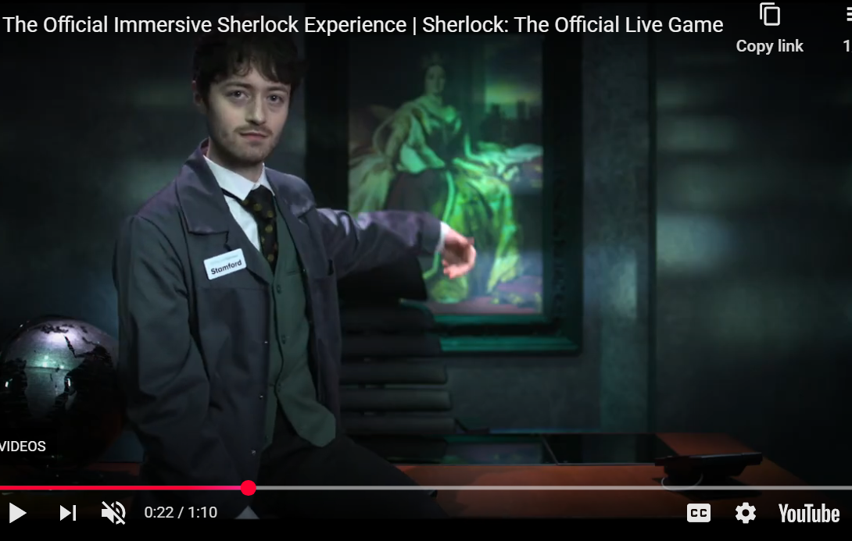
Are there any ethical sensitivities with our content or method?
Think of cultural, historical, or social issues. Examples: depicting a religious figure or sacred site in AR – is that respectful? Using horror content in a public space – could it scare kids unexpectedly? Encouraging behaviour – like an AR treasure hunt that might lead people off safe paths or disturb wildlife – any safety or environmental concerns?
Also, inclusion: are we considering differently-abled visitors – e.g. if VR, do we have an alternative for those who can’t wear headsets? This prompt is broad; brainstorm anything that could cause someone legitimate concern or harm, beyond the legal realm. List them and consider solutions or mitigations.
Immersive Experience
Sherlock Holmes, UK
Click to Watch Video
https://www.sherlockescaperooms.com/escape-rooms/sherlock-the-official-live-game

Slide 54


Slide 55

www.uplifttourism.eu

