Slide 1



Turning Film and Literary Tourism
into Immersive Experiences
Implementation Clinic 02
Positioning, Branding, and Audience Goals
Learn how to create immersive film and literary tourism through practical workshops and hands-on clinics.
Together, we explore key priority areas, tackle real challenges, discuss solutions, and explore practical approaches you can apply in real contexts.
January 2026
By Feltech Ireland

Slide 2

Bringing European Film & Literature to Life
Implementation Clinic Section
This section helps you explore how immersive experiences can strengthen your positioning, clarify your brand, and better connect with your target audiences.
Use the questions and prompts as conversation starters — for personal reflection, team discussions, or group workshops. There are no right or wrong answers. The purpose is to examine how immersive ideas could support your brand story, resonate with the audiences you want to attract, and feel authentic to your place and values.

Slide 3

Implementation Clinic 2
Exercise 1 – Map brand assets (Page 4)
Case Study: Implementation: Pirate-Themed Coastal Café (Page 7)
Exercise 2 – Choose a story anchor (Page 10)
Exercise 3 – Design a micro immersive experience (Page 12)
Case Study: H.C Anderson Festival (Page 13)
Case Study: Fiction Footsteps, Scotland (Page 16)
Approaches & Solutions (Page 19)
Action Plan (Page 20)

Slide 4
Practical Exercises
1
DISCOVERY: Map Your Brand Assets
Many tourism businesses already possess valuable storytelling assets. These may include photographs, archives, local knowledge, or community memories. The goal of this exercise is to identify those assets and explore how they could be transformed into immersive storytelling elements.
Identify the resources you already have.
List all story elements, media, and audience knowledge.
STEP 1: List your immersive & digital resources
Look at your existing content and assets (brochures, photos, stories on your website).
Media Assets Website text I Brochures or leaflets I Photos (locations, people, details)
Video clips or interviews I Archives, props, costumes, letters
People Assets Local writers, filmmakers, historians I Community members or families connected to stories I Guides, volunteers, educators
STEP 2: Decide what digital form they could take (e.g. audio readings of book excerpts).
Immersive & Digital Guidance Look at each asset and ask:
Could this become audio? (spoken story, reading, memory)
Could this become visual? (gallery, projection, AR overlay)
Could this become interactive? (choice-based story, map, trail)
Example
Website paragraph → short audio reading
Old photograph → story hotspot with narration
Film location → scene re-creation prompt for visitors

Slide 5
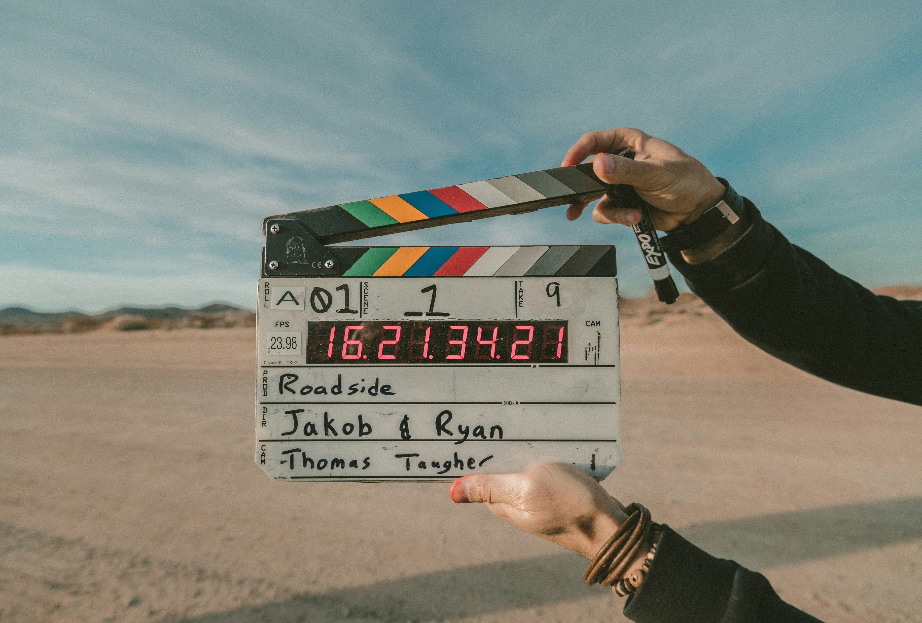
New to Tech: Hold a team brainstorm with paper and markers to sketch your brand (keywords, logo ideas, story themes) and write down current materials (photos, props, archives).
Familiar with Tech: Use a simple Google Form or Trello board to catalogue assets: images, quotes, video clips you own.
Note potential for AR/VR (e.g. panoramic views or 3D scans of a landmark).
No need for a consultant – a half-day workshop with staff or community volunteers can surface brand stories and identify one “hero” element (like a famous scene location or quote) that embodies your narrative.

Slide 6
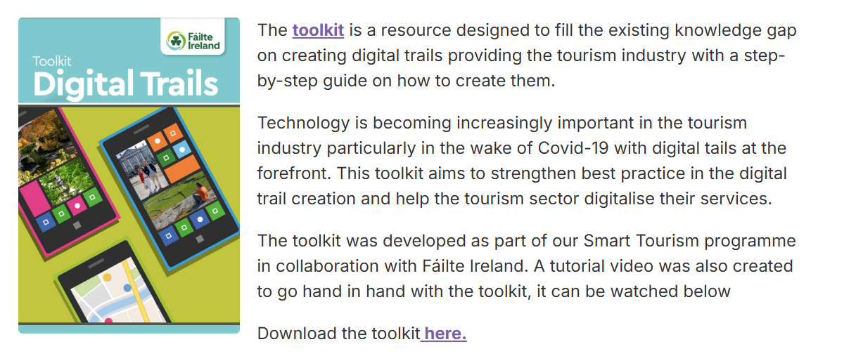
Brand & Digital Story Resources
DISCOVERY: Map Your Brand Assets
SmartSheet
Free Brand Guidelines / Brand Style Guide Templates (landing page with downloads)
Brand Strategy Templates (includes a “Brand Strategy Brainstorming Worksheet”)
Printable Brand Story Template (PDF download)
Brand Identity Creative Brief Template (PDF download)
Nielsen Norman Group
A simple “story mapping” method (great for workshops)
Mapping User Stories in Agile (easy framework to map experiences step-by-step; works well for visitor journeys and “story stops”)
Journey Mapping 101 (clear guide for mapping a visitor experience from start to finish)
StoryCorps
Practical ommunity story collection
Tips for a Great Conversation (excellent for gathering local stories/interviews respectfully)
Failte Ireland Tourism
Digital Trails Toolkit (PDF) (step-by-step industry toolkit)
Smart Dublin – Digital Trails Toolkit + tutorial video post (context + practical support)
Dublin regional page (includes Digital Trails Toolkit download link)

Slide 7
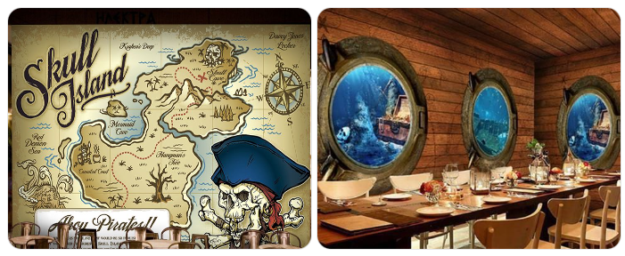

Case Study Implementation: Pirate-Themed Coastal Café
Low-Budget Immersive Storytelling for Small Tourism & Hospitality Businesses (Fictional Example)
This example works because it has a clear narrative anchor, uses simple technology, short experience length and easy visitor participation
Story-Led Concept
Narrative Anchor:
A local pirate legend associated with the harbour.
Story Question:
“What if visitors could step aboard the pirate ship—even for two minutes?”
This clear narrative allowed every experience element to reinforce one story, rather than disconnected gimmicks.

Slide 8
Case Study Implementation: Pirate-Themed Coastal Café
Immersive Elements Used (Low + Light Digital)
Element | Practical Application | Cost
Pirate ship wall mural | Hand-painted by local art student | €80
Simple staff costumes | Scarves, hats, waistcoats (weekends only) | €40
Role-play micro-interaction | “Find the hidden treasure under your table!” (QR sticker) | €0
Treasure clues | Printed riddles on coasters | €10

Slide 9
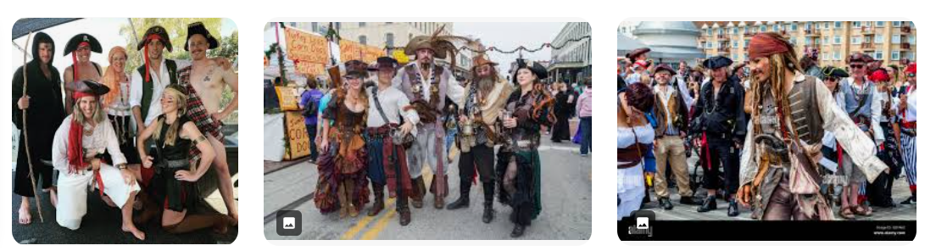
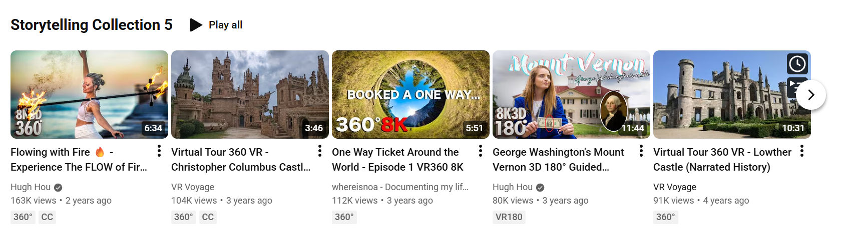
Case Study Implementation: Pirate-Themed Coastal Café
No tech skills needed
Adds theatre and playfulness
Easy to switch on/off during busy periods
Digital / Immersive Tech (Affordable & Accessible)
360° Pirate Ship Scene (Tablet-Based VR)
Tool: YouTube 360° video
Hardware: Borrowed tablet + cardboard viewer
Delivery: QR code on table / wall
Example links:
360° video platform: https://www.youtube.com/360
Free cardboard viewer: https://arvr.google.com/cardboard/
Visitors scan → watch 2-minute “on deck” pirate scene → back to coffee.

Slide 10
2
PLANNING: Prototype a Branded Experience
Get a page and plan a small-scale activity that aligns with your brand.
Call it “Minimum Viable Experience.”
Immersive & Digital Guidance: Decide how and where the story meets the visitor. Sketch a quick storyboard for a key scene or interaction.
Decide where and how the story meets the visitor.
Identify one key moment, place, or interaction
Sketch a simple storyboard for a single scene or experience
Focus on emotion, atmosphere, or meaning, not scale
Ask:
What does the visitor see, hear, or do?
How long does the experience last (5–15 minutes)?
What makes this moment distinctively your brand?
New to Tech: Create a themed self-guided tour with printed maps or a story map that highlights brand elements. e.g., place story-relevant quotes on signs, or stage a mini-performance in a historic site.
Examples:
A themed self-guided walk using printed maps or story cards
Story-relevant quotes, extracts, or scenes placed discreetly on signs
A short live or semi-scripted moment (e.g. a reading, character monologue, or soundscape) in a historic or meaningful location
A simple story map highlighting places linked to your narrative
Focus on authenticity, place, and human connection.
Familiar with Tech: Develop a simple social-media campaign or app prototype.
For instance, build an Instagram AR filter featuring a story character that users can “try on,” or a basic web-based AR view (using tools like Lens Studio or WebXR) that animates a mural when scanned.
Test one simple digital touchpoint.
Examples:
A short social-media storytelling campaign linked to a place or character
A basic app or web prototype showcasing one scene or interaction
An Instagram AR filter where visitors can “step into” a character, costume, or mood
A web-based AR moment that animates a mural, object, or location when scanned
Choose one tool, one location, one story moment.

Slide 11
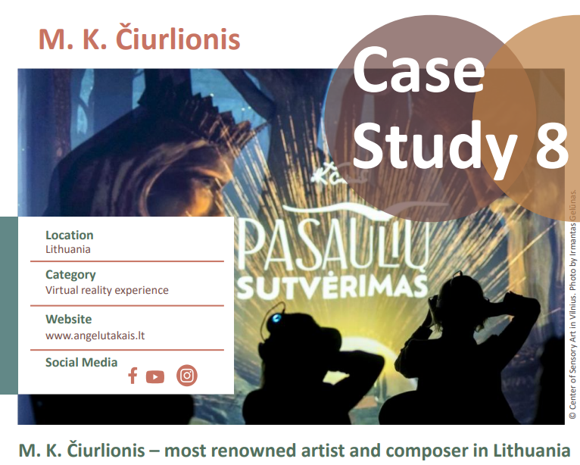
PLANNING: Prototype a Branded Experience
Example
One mural or landmark
One short AR animation or audio scene
One call-to-action: “Scan here to unlock the story”
This is enough to test visitor interest and response.
Keep the Scope Small and Iterative
Start with one location
Use existing content where possible
Test with a small audience
Gather feedback and refine
You can expand later — after you know what works.
You might launch a single-location prototype (like an AR effect at one landmark) at low cost.
Use free or freemium tools (e.g. free QR code generators or template AR apps) so you don’t need developers immediately.
Click to check out
our case studies for inspiration and to learn how it can be done!

Slide 12
3
BECOMING IMMERSIVE: Choose Your Touchpoint
Select a critical moment or location to add an immersive layer.
Focus on a high-impact spot – a place visitors linger or feel curious. Decide what tech (if any) enhances that moment without overshadowing the real experience.
New to Tech: At a key site, provide a physical prop or printed “story card” that visitors can interact with (e.g. a book excerpt or puzzle piece). Or have a guide in costume tell a brief story segment. At the location:
A discreet sign with a short excerpt or quote
A printed story card or prompt
“Pause here. Imagine this moment…”
This works even if the digital layer is not used.
Familiar with Tech: At the same spot, set up a tablet or smartphone station that plays a short video reenactment or hosts an interactive quiz.
OPTION A: QR Code → Web-Based Story Scene (No App Required)
Place a QR code that launches an AR animation (e.g. a character appearing in the location). Visitors scan a QR code
A mobile-friendly web page opens
They experience: A 2-minute audio reading (local voice or actor)
OR a short-filmed re-enactment
OR a simple AR animation (character appears briefly)
Tools that already do this:
STQRY – https://stqry.com/(QR-triggered stories, audio, video, images)
Echoes.xyz – https://echoes.xyz/(Web-based AR, no app download)
This can be built with existing images, illustrations, or simple animation — no 3D film required.
OPTION B: AR Character Moment (Lightweight & Wow-Factor)
A QR code launches a WebAR scene
A character appears in the real location for 10–20 seconds
They speak one line or gesture
The experience ends naturally

Slide 13
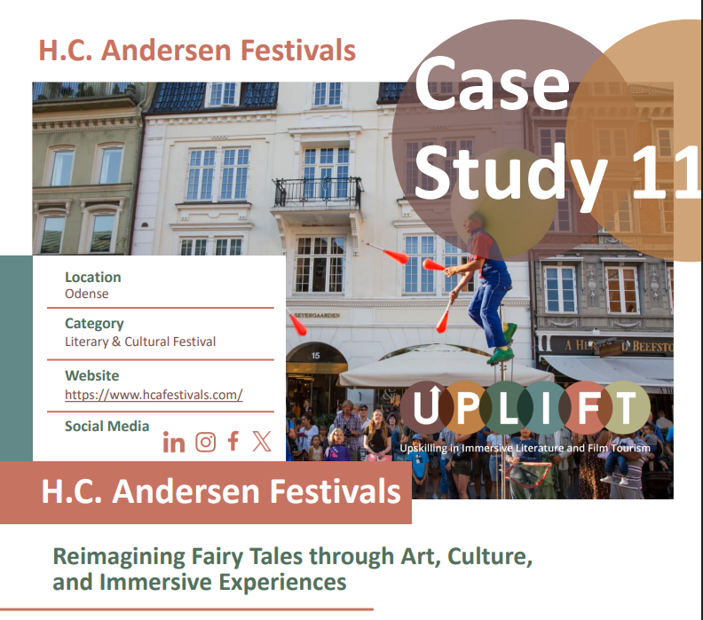
Immersive Storytelling
Click to check out
our case studies for inspiration and to learn how it can be done!
Held annually in August in Odense, Denmark— the birthplace of the beloved storyteller Hans Christian Andersen—the Hans Christian Andersen Festival is a week-long celebration of culture, creativity, and storytelling. Since its launch in 2013, the festival has become a major cultural event in Denmark, featuring more than 500 activities for people of all ages across theatre, music, literature, art, performance, and digital innovation.
Set against the charming cobblestone streets and half-timbered houses of Andersen’s hometown, the festival brings his timeless tales to life through vibrant and varied programming. Odense is transformed into a living storybook, with street performers, parades, concerts, light shows, exhibitions, and immersive theatre. Many of the events are inspired directly by Andersen’s fairy tales, celebrating themes of imagination, transformation

Slide 14
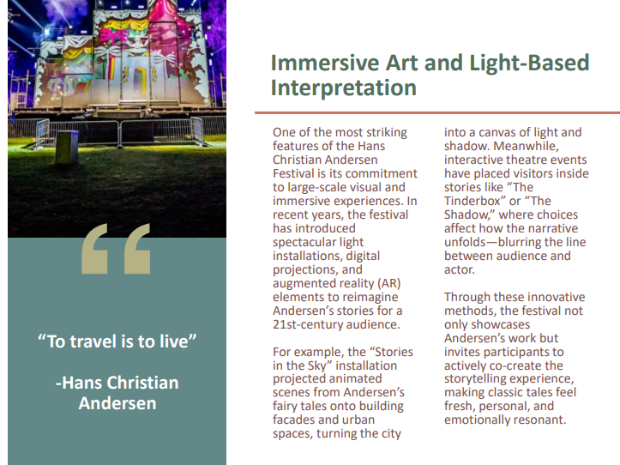
Immersive Art and Light Based Interpretation
, and human emotion that continue to resonate across generations.
One of the most striking features of the Hans Christian Andersen Festival is its commitment to large-scale visual and immersive experiences. In recent years, the festival has introduced spectacular light installations, digital projections, and augmented reality (AR) elements to reimagine Andersen’s stories for a 21st-century audience.
For example, the “Stories in the Sky” installation projected animated scenes from Andersen’s fairy tales onto building facades and urban spaces, turning the city into a canvas of light and shadow. Meanwhile, interactive theatre events have placed visitors inside stories like “The Tinderbox” or “The Shadow,” where choices affect how the narrative unfolds—blurring the line between audience and actor.
Through these innovative methods, the festival not only showcases Andersen’s work but invites participants to actively co-create the storytelling experience, making classic tales feel fresh, personal, and emotionally resonant.

Slide 15
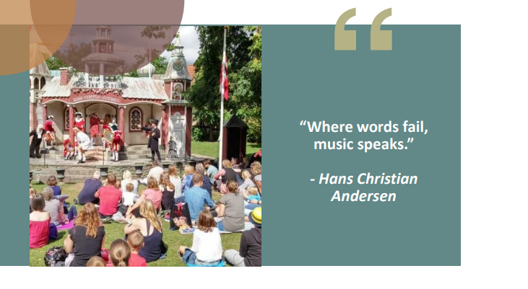
A Festival of Multisensory Encounters
Much like Andersen’s own writing, which blended visual description, rhythm, and symbolism, the festival engages multiple senses to deepen emotional connection and participation.
Music, costume, sculpture, and culinary experiences are woven into the programming, with performers donning fairy tale-inspired attire and street musicians serenading crowds with compositions from Nordic folklore.
Workshops and pop-up events offer hands-on activities in puppetry, storytelling, digital art, and music-making—especially for young people. This multisensory engagement reflects the idea that stories are best remembered when they are felt, heard, seen, and enacted.
These experiential layers expand the audience’s role from passive observer to active participant, enhancing the festival’s educational value and emotional resonance.

Slide 16
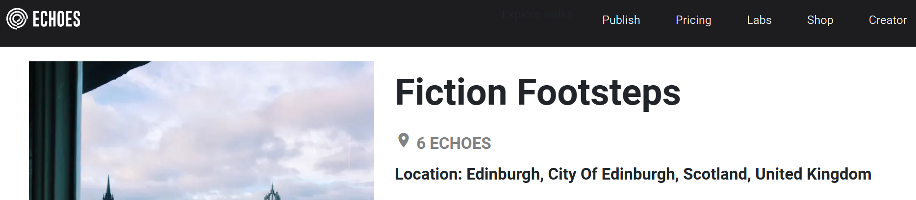


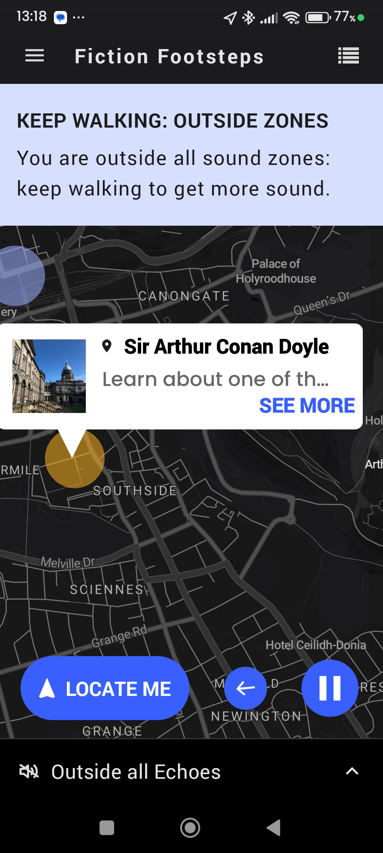
Case Study Implementation.
Fiction Footsteps, Scotland
Check out the Echoes App, where you can explore amazing GPS-triggered audio walks from around the world – both indoors and outdoors.
Stream walks or download and save your collection online (if there is patchy connectivity)
Wander and let your audio follow your steps. Make sure you have your GPS enabled, plug in your headphones and start walking.
"Edinburgh Fiction Footsteps" refers to exploring the city's rich literary heritage by visiting locations from famous books or tracing the lives of writers like
Sir Walter Scott, Robert Louis Stevenson, and Ian Rankin, with specific spots like Jean Brodie Steps and Inspector Rebus's haunts offering tangible connections, often via dedicated tours or self-guided walks through the Old Town, New Town, and Leith.
https://explore.echoes.xyz/collections/6fZ5zUfx1nFBDfYC
Faceboo: https://www.facebook.com/edinburghcityofliterature/
Edinburgh celebrates 20 years since becoming first City of Literature
16

Slide 17
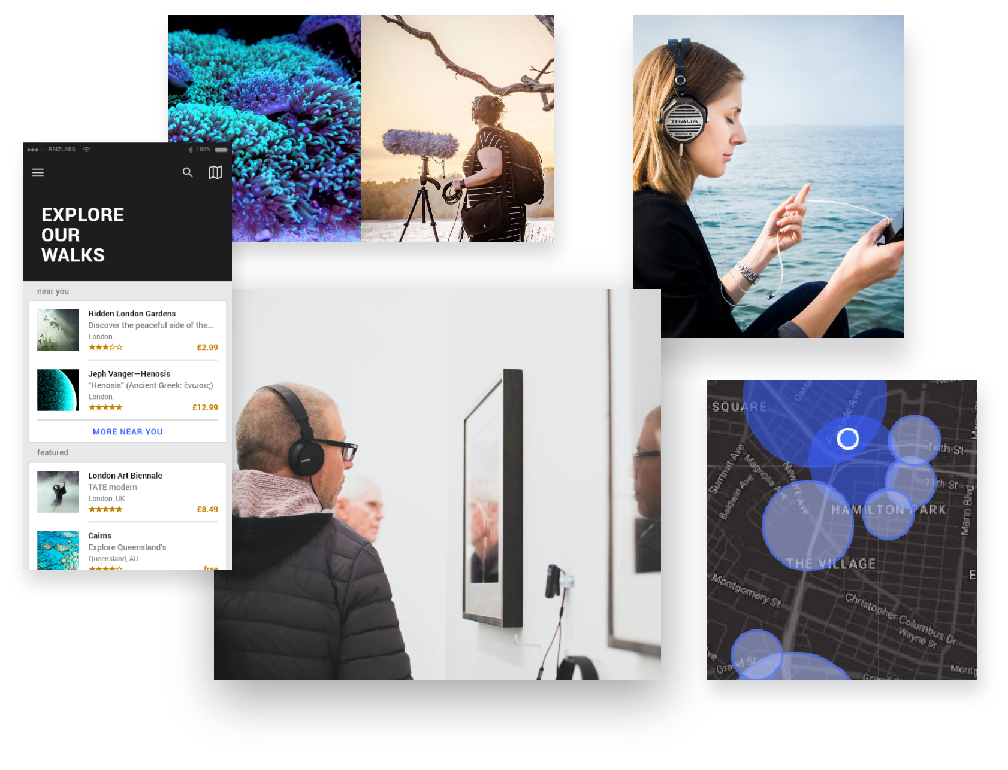
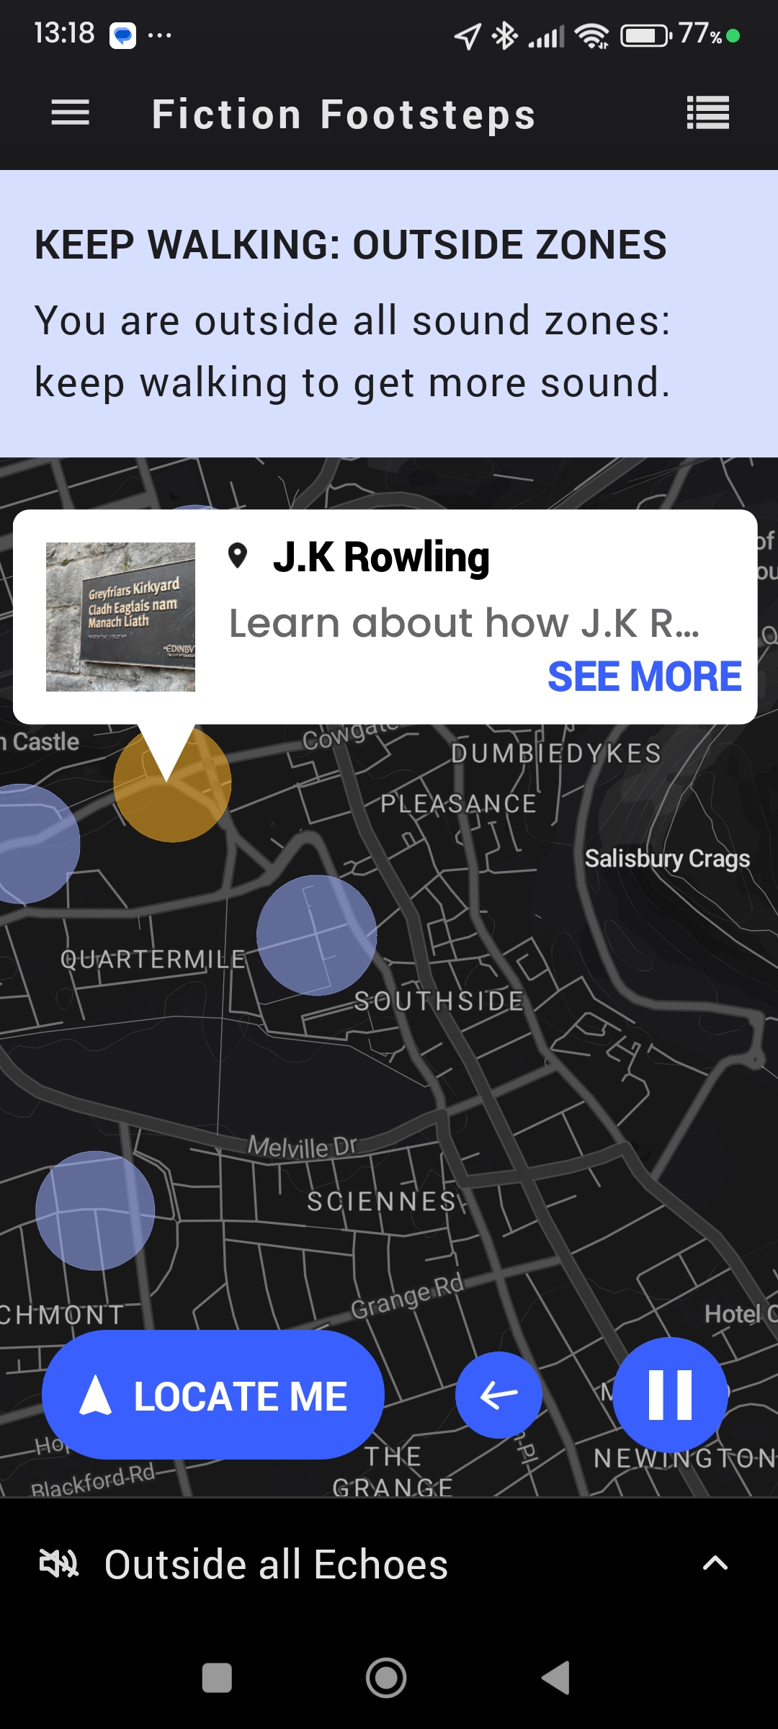
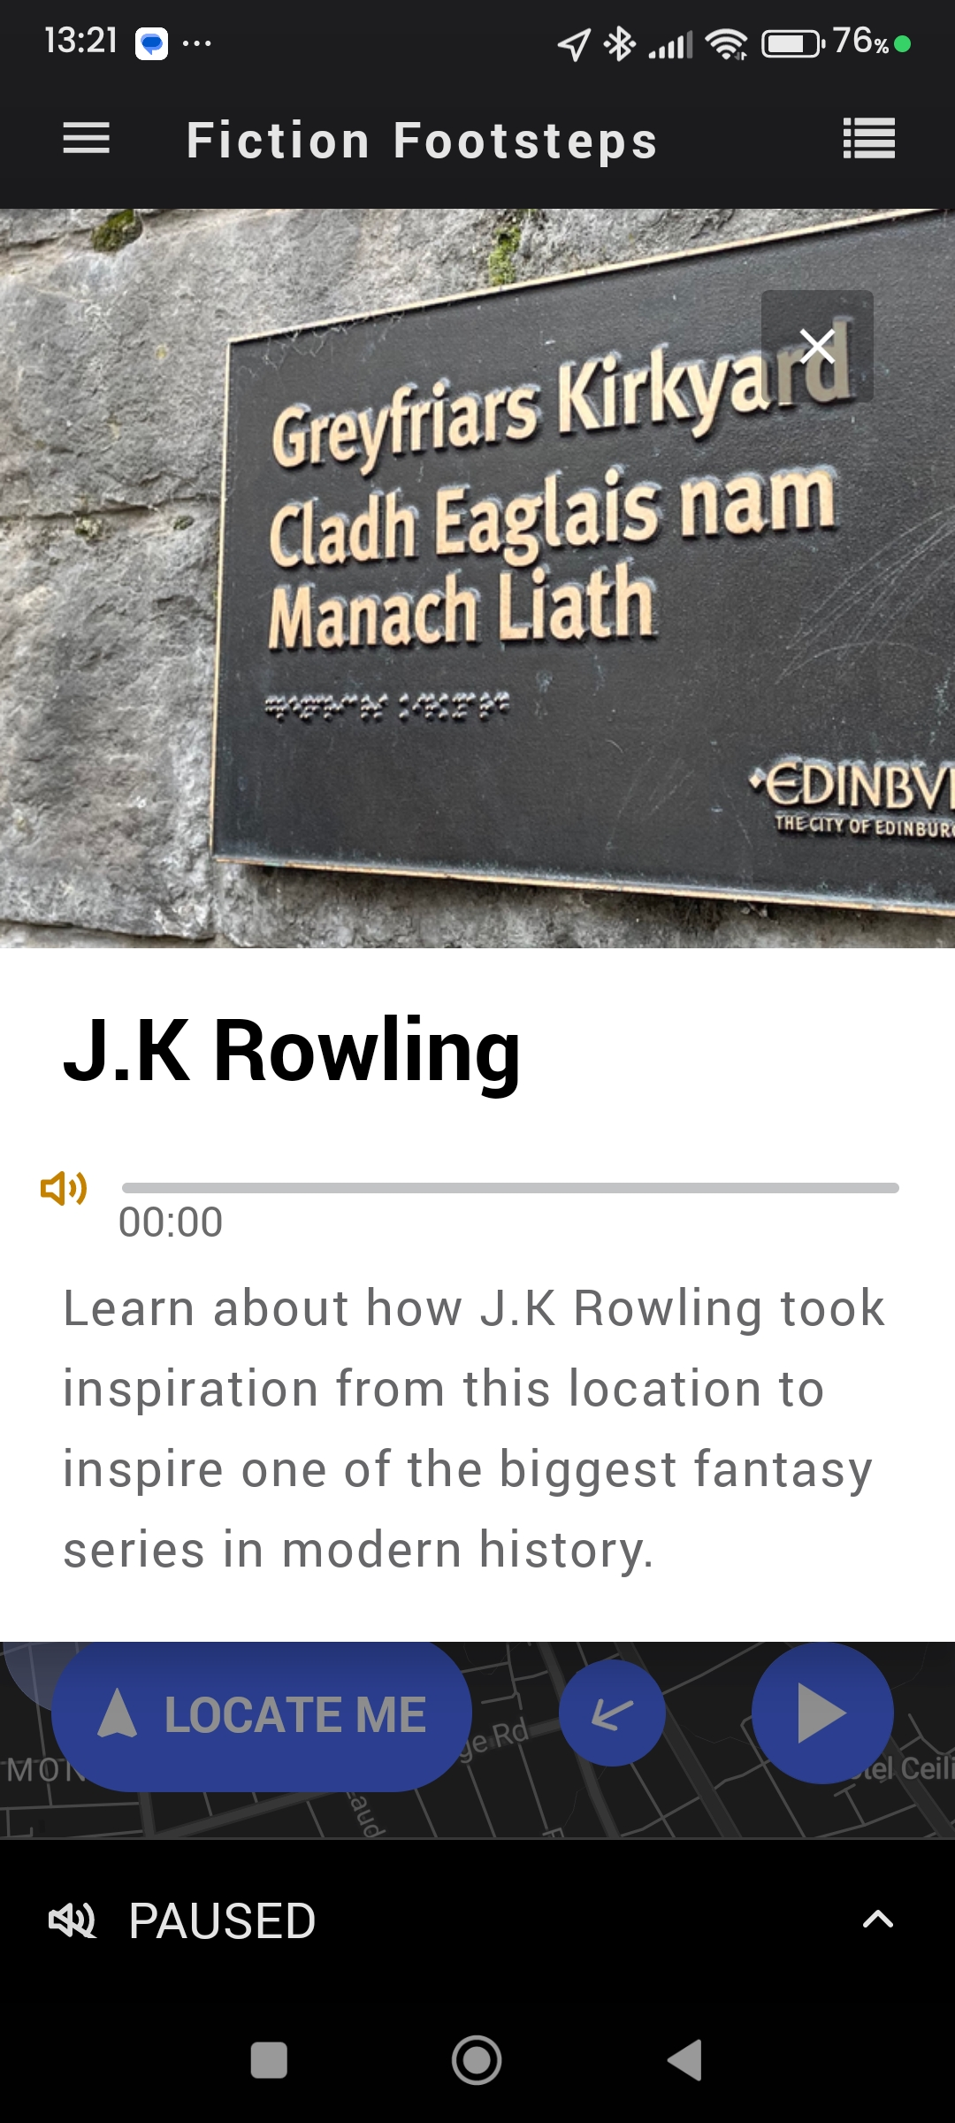
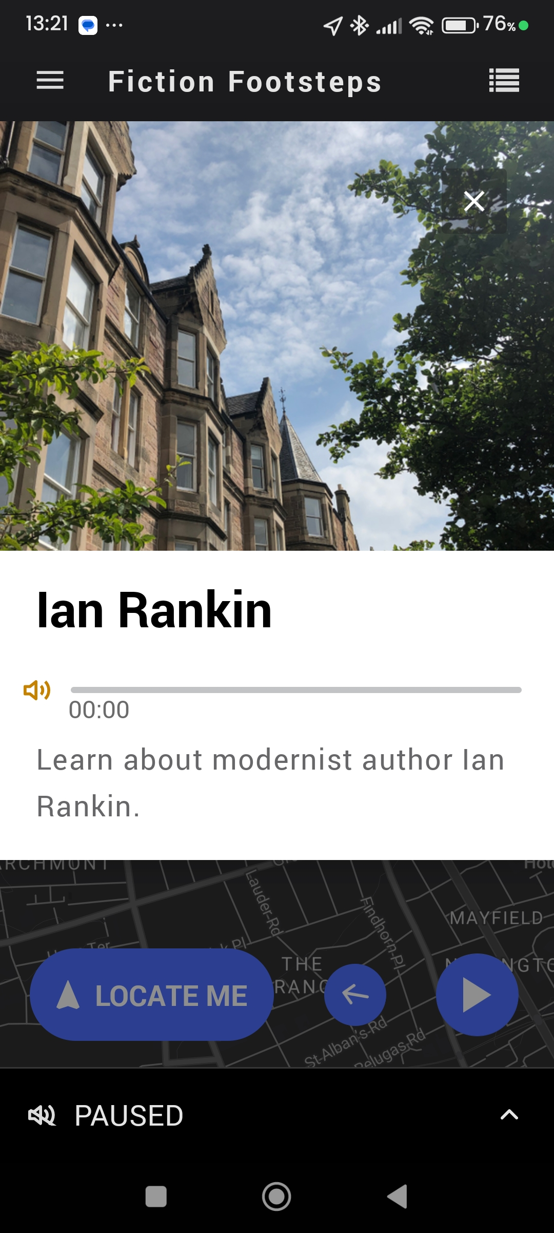
Case Study Implementation.
Fiction Footsteps, Scotland
17

Slide 18
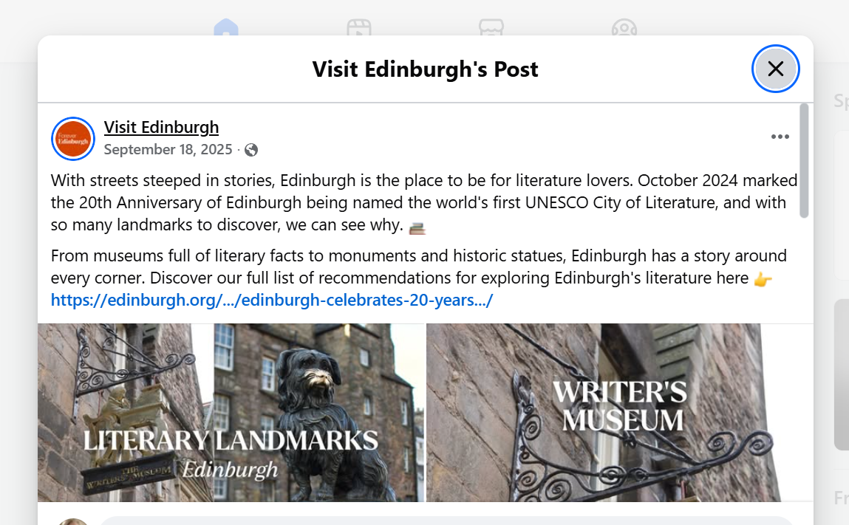
Key Literary Connections & Places:
The Prime of Miss Jean Brodie (Muriel Spark): Visit the Grassmarket and the Vennel Steps, renamed Jean Brodie Steps, for iconic views.
Trainspotting (Irvine Welsh): Explore Leith for the gritty reality depicted in the novel.
Inspector Rebus Series (Ian Rankin): Walk the streets and pubs frequented by Rebus, with his handprints found at the City Chambers.
Robert Louis Stevenson & Sir Walter Scott: Discover spots connected to these giants at the Writers' Museum and around the city.
The 39 Steps (John Buchan): Trace elements of this thriller across the city and Highlands.
How to Follow the Footsteps:
Literary Tours: City of Edinburgh Tours and others offer guided walks focused on Dickens, Scott, Burns, Stevenson, and more.
Self-Guided Exploration: Use resources from Edinburgh City of Literature Trust and Forever Edinburgh to find key locations.
Museums: Visit the Writers' Museum, which houses relics of Burns, Scott, and Stevenson.

Slide 19
Approaches & Solutions
Tie Tech to Purpose: Always align technology with your brand story. Don’t use AR/VR just for novelty; use it to deepen your narrative.
For example, add an AR scene only if it makes the plot clearer or more exciting.
Leverage What You Have: You likely already own the essentials (smartphones, photos, quotes). Even simple tools can add immersion.
For instance, upload a 360° photo of your site to Google or Facebook for a free virtual visit, or put QR codes on signs linking to audio or video clips.
Off-the-Shelf Solutions: Many platforms let you plug in your content without coding. Consider generic AR apps where you upload images, or free online map/story platforms. This avoids big upfront costs.
Combine Tech with Human Touch: Use digital as a complement, not replacement. A guide might carry a tablet to show film clips, or you could hand out simple audio players with character narration. This blend keeps the experience personal while adding interactivity.
Prototype and Iterate: Treat early efforts as pilots. Try a low-cost prototype (e.g. a simple audio trail or AR postcard) and ask visitors for feedback. Use what you learn to refine or expand. Even modest budgets can produce memorable content for year-round engagement.

Slide 20
Develop Your Action Plan
Immediate next steps (0–6 months)
Pick one small immersive element that you can realistically implement soon — something low-cost, low-risk, and easy to test. This could be as simple as: Adding a short audio storytelling segment (accessed via a QR code) at a key point of interest Creating a single WebAR moment with a local tech or media student (e.g. a simple character animation or visual overlay) Implement it and observe how visitors respond. Do they scan? Do they pause longer? Do they talk about it or share it?
Mid-term (6–24 months)
If the initial trial is successful, plan a modest expansion. You might: Develop a guided AR or digital story trail with multiple points Apply for a small local or regional grant to improve content quality Invest in basic equipment or staff training (e.g. audio, performance, or digital storytelling skills) At this stage, think about how the immersive element supports your marketing and brand positioning — for example, promoting it through social media, festivals, or partnerships.
Long-term (2–5 years)
Envision a more integrated immersive experience across your entire offer. This could include: A connected story experience across multiple sites Semi-virtual or hybrid elements (e.g. interactive spaces, digital guides, layered storytelling) Collaboration with technology partners to create a signature immersive product for your destination or town Keep an eye on emerging technologies and accessibility — as tools become lighter, cheaper, and more user-friendly, you’ll be well positioned to adopt them. Because you’ve already tested and learned in the early stages, you can scale confidently when the timing is right.
without smartphones. If a VR experience isn’t wheelchair accessible (due to space or hardware), consider having a 2D video version. This inclusive approach keeps the experience positive for all.

Slide 21
www.uplifttourism.eu

