Slide 1
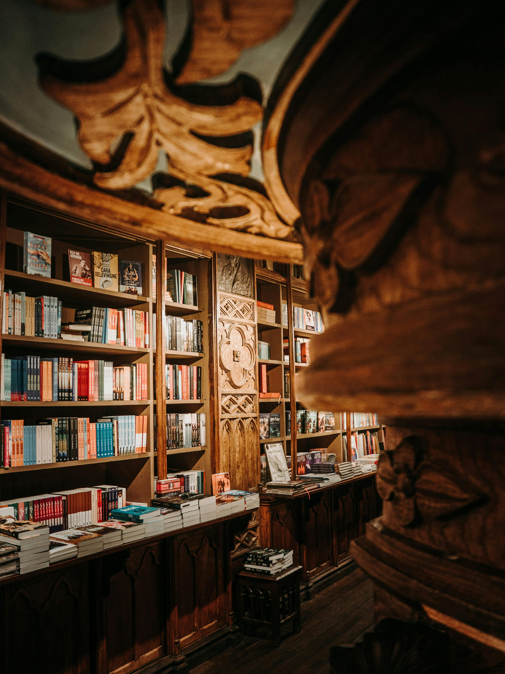


Turning Film and Literary Tourism
into Immersive Experiences
Workshop 02
Learn how to create immersive film and literary tourism through practical workshops and hands-on clinics.
Together, we explore key priority areas, tackle real challenges, discuss solutions, and explore practical approaches you can apply in real contexts.
Positioning, Branding and Audience Goals
January 2026
By Feltech Ireland

Slide 2

Contents
Introduction Workshop 2 (Page 4)
Key Challenges (Page 7)
Key Opportunities (Page 8)
Workshop Discussion Section (Page 9)
Defining Your Story & Brand (Page 11)
Identifying Your Target Audience (Page 15)
Setting Visitor Experience Goals(Page 18)
Differentiating Your Offer (Page 21)
Community Engagement and Partnerships (Page 24)

Slide 3

Workshop 2
Positioning, Branding, Designing and Audience Goals
Photo Credit: Image title

Slide 4
Introduction
Positioning, Branding and Audience Goals
This workshop builds on the previous session exploring immersive technologies.
While Workshop 1 introduced the concept of immersive experiences, this workshop focuses on:
• aligning immersive ideas with your brand
• understanding your audience
• designing meaningful story-led visitor experiences
Workshop & Clinic 2 focuses on strengthening your brand identity, understanding your target audiences, and ensuring immersive ideas align clearly with your business goals.
It guides you through identifying who your experience is for, what you want visitors to feel and do, and how immersive storytelling can support those objectives.
You’ll explore how to translate your brand, place, or cultural asset into engaging narratives and interactive story elements, helping visitors connect emotionally while staying true to your values and positioning.
The goal is to ensure immersive technology supports your identity, values and visitor expectations.

Slide 5
In this workshop, we shift from “what can we do?” to “who are we doing it for and why?”.
It’s all about marketing and branding your immersive film/literary experience and aligning it with your business goals. Even the most amazing immersive tour or exhibit won’t succeed if nobody knows about it or if it doesn’t resonate with your target audience. So, before diving deeper into creating experiences, we need to clarify your audience, brand story, and objectives. This will ensure that the cool ideas from other Workshops and Implementation Clinics (tech, storytelling, etc.) actually support your overall mission and can be communicated clearly to potential visitors.
Marketing in this context means identifying the fans or visitor segments who would be interested in your film/literary connection and finding the best ways to reach and engage them. Branding means shaping how you present your experience – the narrative, visuals, and values that make your offering unique. Is your vibe fun and adventurous (maybe a fantasy film tour where visitors dress up as wizards), or is it educational and reflective (a literary trail where visitors contemplate poems at each stop)? Defining this will guide everything from your social media posts to the design of the experience itself.
Because film and literary tourism often taps into very passionate communities. Think of Harry Potter fans, Jane Austen readers, Game of Thrones enthusiasts, etc. These groups have active online forums, fan clubs, and events. If you align your marketing to speak their language and ignite their curiosity, they can become your biggest promoters. On the other hand, if your branding is unclear (e.g., people can’t tell if your “Immersive Tour” is about movies or something unrelated), those potential visitors might overlook you.
A great example is how destinations capitalised on HBO’s Game of Thrones: Northern Ireland branded itself as part of the “Game of Thrones Territory,” creating marketing campaigns with official imagery, behind-the-scenes content, and even a Tourism Ireland website section for GoT travel. By clearly targeting GoT fans and offering themed experiences (like touring filming locations, visiting a GoT exhibition, or dining in a GoT-style feast), they turned a niche interest into a mainstream tourism draw.
The result: hundreds of thousands of visitors and substantial revenue flowing in due to the show’s popularity.
Why is this important?

Slide 6
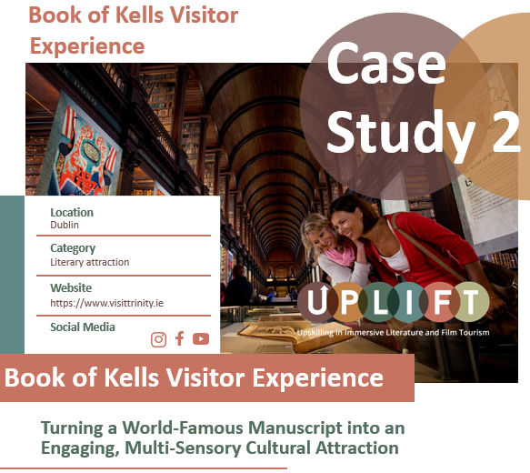
Lastly, setting clear goals is part of the workshop and implementation clinic. What do you hope to achieve by introducing immersive elements? Examples of goals could be: “increase off-season visits by 20% next year,” “attract a younger demographic of travelers,” “generate new income via premium experiences,” or “raise our profile and get media attention.”
Having specific goals will help you measure success and justify the effort and investment.
In short, this clinic will ensure your immersive initiative is visitor-centered and goal-oriented. We’ll tackle challenges like reaching the right audience on a small budget and maintaining authentic branding. Let’s get started on making sure your amazing experience finds its eager fans!
Click to check out
our case studies for inspiration and to learn how it can be done!

Slide 7
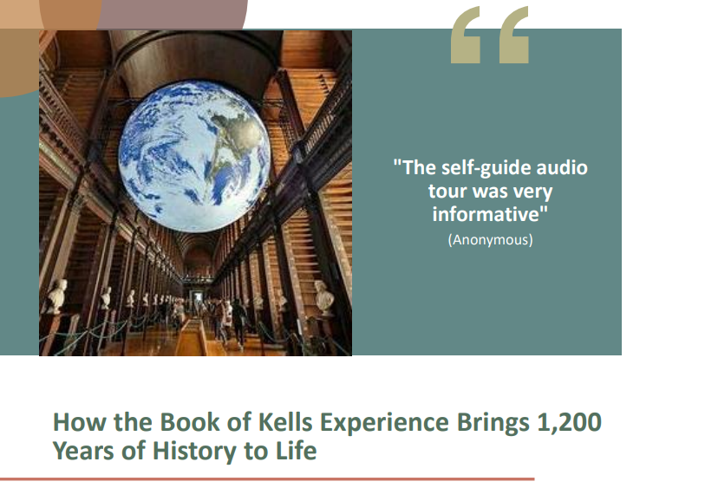
Key Challenges
When it comes to marketing and branding for immersive tourism, consider the following:
Challenges
Perhaps the biggest challenge is reaching the niche audience that cares about your story. Unlike generic tourism, film/literary tourism markets can be narrower. If you’re promoting a literary heritage trail, the average sun-seeking tourist might not bite – you need to find the book lovers. This can make marketing feel like finding a needle in a haystack, especially if you have limited budget for advertising.
There’s also the challenge of branding consistency: making sure all elements of your experience and promotion convey a coherent story. Small businesses might struggle with design, copywriting, or branding expertise – your website, flyers, and on-site experience all need to match in tone.
Another challenge is standing out in a crowded online space. Social media is a key channel (Instagram, TikTok, YouTube, Facebook groups, etc., where fan communities live), but you’re competing with countless other attractions and content for attention.
Finally, measuring success of marketing efforts can be tricky – if someone visits because they saw a random post, you might never know. It can be discouraging to put effort into content and not see immediate results or feedback.
Click to find out more. Download UPLIFT’s Best Practice Case Studies.

Slide 8
Key Opportunities
Opportunities
The good news is film and literary tourism naturally comes with a built-in emotional hook – the story itself. You can tap into existing fandoms and communities. For example, if your region is related to Harry Potter, there are global fan sites and local fan clubs for Harry Potter – fertile ground for partnerships or targeted ads.
A huge opportunity lies in content marketing: because you have an interesting narrative (not just a generic hotel or generic museum, but “the place that inspired X novel” or “where Y movie was filmed”), you can pitch stories to media or create engaging posts that fans will share. Local or niche media love these angles – e.g., a travel blog might feature “Top 5 literary pilgrimages”.
Another opportunity: branding through storytelling. Instead of traditional ads, you can create short narratives or behind-the-scenes looks (videos, blog articles) that draw people in. For instance, a blog post titled “Walk in the Footsteps of James Joyce: A Day in Our Literary Tour” can both educate and entice readers, subtly promoting your tour. Such content can increase your visibility with minimal cost.
Moreover, if you create an immersive experience, that itself can generate buzz – word-of-mouth and social media shares from visitors who had a great time. People love sharing novel experiences: “I just tried an AR-powered mystery trail – it was awesome!” This user-generated promotion is invaluable.
Lastly, aligning your offering with broader tourism goals (like regional initiatives) can open opportunities for support: your local tourism board might help market you if it fits their strategy, or you might join a themed route (e.g. a national literary trail network).

Slide 9
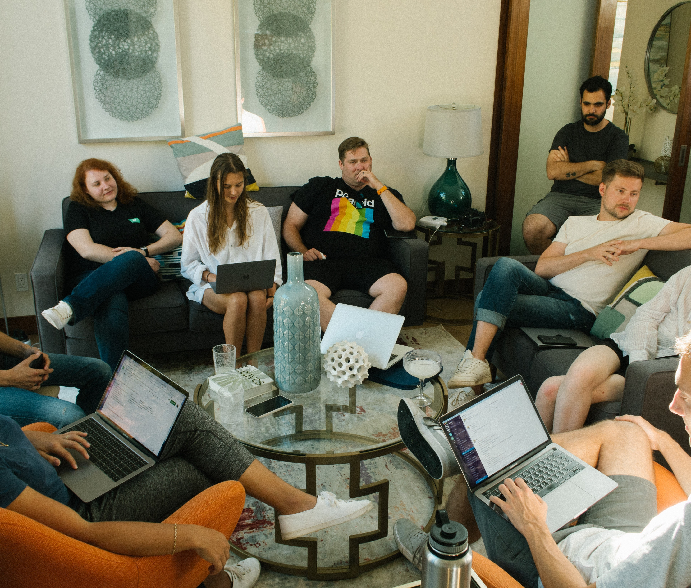
Time to Explore Immersive Opportunities
Workshop Discussion Section
This section helps you explore how immersive experiences can strengthen your positioning, clarify your brand, and better connect with your target audiences.
Use the questions and prompts as conversation starters — for personal reflection, team discussions, or group workshops. There are no right or wrong answers. The purpose is to examine how immersive ideas could support your brand story, resonate with the audiences you want to attract, and feel authentic to your place and values.

Slide 10

Workshop 2 Discussion Section
Defining Your Story & Brand
Identifying Your Target Audience
Setting Visitor Experience Goals
Differentiating Your Offer
Community Engagement and Partnerships

Slide 11
Workshop Topic
Positioning, Branding, Audience Goals and Designing Immersive Storytelling
Purpose of this discussion
Immersive experiences are most successful when they are clearly connected to a brand, story, or place. Before designing technology or interactive elements, tourism businesses should first understand:
• their identity
• their story
• their audience
In film- and literary-inspired tourism, a clear story brand helps visitors connect emotionally and differentiates a destination. This section explores how, even on small budgets, a strong brand needs to be supported by a consistent narrative. Having an audience focus can turn casual visitors into enthusiastic fans. Through discussions and planning, you can successfully link every immersive idea to your core brand identity and the people you want to reach – this is vital to ensure any technology or experience truly serves your brand and business goals.
Q1
Discussion Questions
Defining Your Story & Brand
A strong brand evokes your story’s essence. Consider what makes your story unique and how it reflects your place or business.
What is the core narrative or theme of your story? Describe in one sentence (e.g. “a mythic battle”, “the life of a local author”).
How does this story align with your business identity? (e.g., does it fit your location’s history, local culture, identity, or mission?
What emotions or values do you want visitors to feel? (e.g., pride, wonder, curiosity, etc.)
What visual or symbolic elements represent your brand? (e.g., icons, colours, mascots (quills, lamps, books, swords, clothing) from the story.)

Slide 12
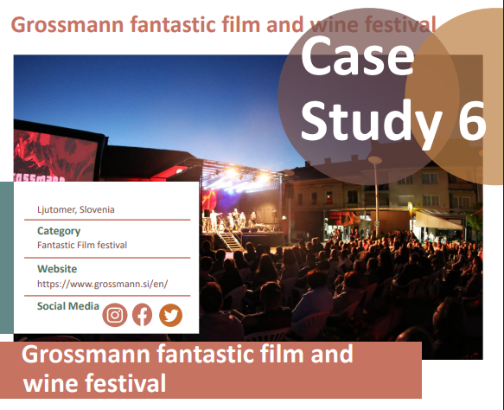
5. Immersive Digital Technology Considerations
What digital layer could amplify your brand?
For instance, could an AR filter overlay your logo or characters onto visitor photos, or might a narrative audio clip triggered at a key landmark reinforce the theme?
Click to check out
our case studies for inspiration and to learn how it can be done!
Innovative Approaches to Tourism
Through UPLIFT, Grossmann Festival is becoming a laboratory for testing the latest tourism models, exploring how immersive technologies impact visitor engagement. Virtual guides, AR exhibitions, and interactive film workshops elevate the festival to a new digital dimension. As a case study in the UPLIFT project, Grossmann Festival proves that technology can enhance cultural heritage, making it more accessible and interactive for audiences worldwide!

Slide 13

Question Responses
Use this space to respond directly to the discussion questions.
Share your thoughts, ideas, reflections, or examples based on your own experience or context. There are no right or wrong answers, and not every question needs a response right now — this is about exploring possibilities..
Defining Your Story & Brand
Question 1: [add response]
Question 2: [add response]
Question 3: [add response]
Question 4: [add response]
Question 5: (Immersive & Digital Technology Considerations)
[add response]

Slide 14
Notes Section
Use this space to capture key discussion points, ideas,
reflections, challenges/solutions, gaps/opportunities,
expertise advice, suitable digital and immersive technologies, etc.
This is a working area — note thoughts, questions, or actions as they emerge
Defining Your Story & Brand
Challenges and solutions; [add response]
Gaps and opportunities; [add response]
Good ideas and expert advice; [add response]
Digital and immersive technologies to explore; [add response]
Other: [add response]

Slide 15
Q2
Understanding Your Audience
Different visitors seek different experiences. Pinpoint who will care most about your story.
Different audiences look for different experiences:
Film Fans - Want recognisable locations and behind-the-scenes stories.
Cultural Tourists - Want deeper interpretation and historical context.
Families - Enjoy interactive and playful elements.
Literature Enthusiasts - Value quotes, readings and narrative atmosphere.
Who are your ideal visitors or “story fans”? e.g., families, film students, tech curious tourists, historians, book clubs, film buffs, local schools?
Where do these people typically learn about new attractions? (e.g., social media, travel blogs, local tourism offices, fan clubs, local festival)
What motivates them to travel? (e.g., seeking film location adventures, cultural or author insights, witnessing what the author describes in his book, educational trips on literature, and social media photo ops.)
How can you reach broader audiences? (e.g. arranging school trips, engaging influencers, or partnering with travel agencies.)
5. Immersive & Digital Technology Considerations
Which tech tools suit your audience best?
For example, a smartphone-based AR scavenger hunt might excite teens, while a downloadable audio guide could appeal to older visitors.
Could an interactive map on your website let potential visitors choose a route, or could social-media AR effects raise awareness among online fans?

Slide 16
Question Responses
Use this space to respond directly to the discussion questions.
Share your thoughts, ideas, reflections, or examples based on your own experience or context. There are no right or wrong answers, and not every question needs a response right now — this is about exploring possibilities..
Identifying Your Target Audience
Question 1: [add response]
Question 2: [add response]
Question 3: [add response]
Question 4: [add response]
Question 5: (Immersive & Digital Technology Considerations)
[add response]

Slide 17
Notes Section
Use this space to capture key discussion points, ideas,
reflections, challenges/solutions, gaps/opportunities,
expertise advice, suitable digital and immersive technologies, etc.
This is a working area — note thoughts, questions, or actions as they emerge
Identifying Your Target Audience
Challenges and solutions; [add response]
Gaps and opportunities; [add response]
Good ideas and expert advice; [add response]
Digital and immersive technologies to explore; [add response]
Other: [add response]

Slide 18
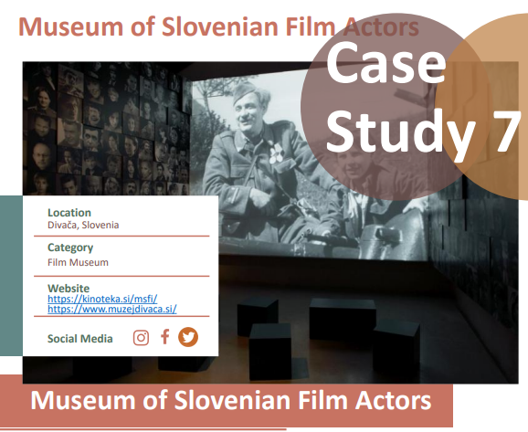
Q3
Setting Visitor Experience Goals
Clarify what you want visitors to do and feel. Define measurable outcomes.
What feelings should visitors leave with? (e.g., inspiration, connection to local culture or author, excitement, awe at a panoramic view in a film.)
What customer actions do you hope to achieve? (e.g., spreading the word on social media, longer stay in town, buying a souvenir, wanting to know more,.)
How do these goals support your brand or mission? (e.g., increasing local pride, boosting slow-season tourism, offering something special, promoting the destination, promoting the location for more film sets.)
How will you measure success? (e.g., visitor surveys and satisfaction, number of visitors, social media tags, repeat visits, local economic impact.)
5. Immersive & Digital Technology Considerations
What immersive element can nudge these goals?
For example, a shareable AR “photo moment” tied to your brand can encourage social posts, or a short VR clip might inspire longer visits.
Would an interactive touchscreen quiz (educational + entertaining) reinforce learning outcomes?
Click to check out
our case studies for inspiration and to learn how it can be done!

Slide 19
Question Responses
Use this space to respond directly to the discussion questions.
Share your thoughts, ideas, reflections, or examples based on your own experience or context. There are no right or wrong answers, and not every question needs a response right now — this is about exploring possibilities..
Setting Visitor Experience Goals
Question 1: [add response]
Question 2: [add response]
Question 3: [add response]
Question 4: [add response]
Question 5: [add response]
(Immersive & Digital Technology Considerations)

Slide 20
Notes Section
Use this space to capture key discussion points, ideas,
reflections, challenges/solutions, gaps/opportunities,
expertise advice, suitable digital and immersive technologies, etc.
This is a working area — note thoughts, questions, or actions as they emerge
Setting Visitor Experience Goals
Challenges and solutions; [add response]
Gaps and opportunities; [add response]
Good ideas and expert advice; [add response]
Digital and immersive technologies to explore; [add response]
Other: [add response]

Slide 21
Q4
Differentiating Your Offer - Story Anchors
A strong immersive experience usually begins with one clear story anchor:
• a famous scene
• a character
• a moment in a story
• a location connected to the author
• a cultural legend
Identify what makes your experience stand out. Leverage unique angles to position yourself in the market.
What sets your story or site apart from similar attractions?
(e.g., unique locale features, a new narrative twist, stunning scenery, preservation of the author’s writing room, provision of special souvenirs (author inspired journalling kits) or experiences (touch the author’s book or turn the pages))
How can you highlight hidden gems or local secrets?
(e.g., insider stories, author anecdotes, photos that can only be seen on-site, film trivia, workshops where guests get to see and feel the author or film brought to life, reconstruction via plays or classes.)
What niche can you fill?
(e.g., family-friendly legend tours to special locations, off-season literature and cultural events reliving the era or set, interactive workshops, a day in the life of a character or poet itinerary, seasonal retreats that match the scene.)
How do local community values shape your story?
(e.g., respect for culture, heritage, and place; sustainability and care for the environment; creative expression rooted in the community; involving local people as storytellers or guides; inviting visitors to participate respectfully in traditions, spaces, or re-enactments.)
5. Immersive & Digital Technology Considerations
Could a tech feature be your “wow factor”?
For instance, a location-based AR game could make you the only destination offering a treasure hunt around your story. Or an app that plays voiceover stories at different spots might give you a distinctive interactive audio-tour edge.

Slide 22
Question Responses
Use this space to respond directly to the discussion questions.
Share your thoughts, ideas, reflections, or examples based on your own experience or context. There are no right or wrong answers, and not every question needs a response right now — this is about exploring possibilities..
Differentiating Your Offer
Question 1: [add response]
Question 2: [add response]
Question 3: [add response]
Question 4: [add response]
Question 5: (Immersive & Digital Technology Considerations)
[add response]

Slide 23
Notes Section
Use this space to capture key discussion points, ideas,
reflections, challenges/solutions, gaps/opportunities,
expertise advice, suitable digital and immersive technologies, etc.
This is a working area — note thoughts, questions, or actions as they emerge
Differentiating Your Offer
Challenges and solutions; [add response]
Gaps and opportunities; [add response]
Good ideas and expert advice; [add response]
Digital and immersive technologies to explore; [add response]
Other: [add response]

Slide 24
Q5
Community Engagement and Partnerships
Think about local stakeholders and collaborations. Community support can strengthen branding and reach.
Who in your community is already involved with your story?
(e.g., local historians, bookstores, schools, themed events, provide live-in experiences, guides, cultural groups.)
Are there local artists or tech-savvy volunteers you could engage?
( e.g., illustrators for AR content, author relatives, painters, special effects consultants interested in the literature or film, film students or tech students coding an app.)
How can local culture be authentically represented?
(e.g., use regional composed music, dialects, or crafts used in the film or literature, place-based audio with speech over, build on the story or film with local stories (e.g., historical fits with fictional story), give different narratives and perspectives that build on the story related to the area, placed based story cards, QR codes linking short videos to place and people.)
What partnerships could expand your audience?
(e.g., Partner with local museums, heritage sites, landmarks or galleries to create joint routes or themed trails or festivals. Offer combined tickets or passes (e.g. “Film Location + Museum Visit”). Co-host seasonal or themed events that encourage visitors to explore multiple sites. Collaborate with local theatres, writers, filmmakers, musicians, or artists for live performances, readings, or pop-up experiences)
5. Immersive & Digital Technology Considerations
Could low-cost tech foster community involvement?
For example, setting up a simple QR-triggered interview with a local storyteller, or mapping a community photo wall on an interactive website, helps embed local voices in the experience.

Slide 25
Question Responses
Use this space to respond directly to the discussion questions.
Share your thoughts, ideas, reflections, or examples based on your own experience or context. There are no right or wrong answers, and not every question needs a response right now — this is about exploring possibilities..
Community Engagement and Partnerships
Question 1: [add response]
Question 2: [add response]
Question 3: [add response]
Question 4: [add response]
Question 5: (Immersive & Digital Technology Considerations)
[add response]

Slide 26
Notes Section
Use this space to capture key discussion points, ideas,
reflections, challenges/solutions, gaps/opportunities,
expertise advice, suitable digital and immersive technologies, etc.
This is a working area — note thoughts, questions, or actions as they emerge
Community Engagement and Partnerships
Challenges and solutions; [add response]
Gaps and opportunities; [add response]
Good ideas and expert advice; [add response]
Digital and immersive technologies to explore; [add response]
Other: [add response]

Slide 27
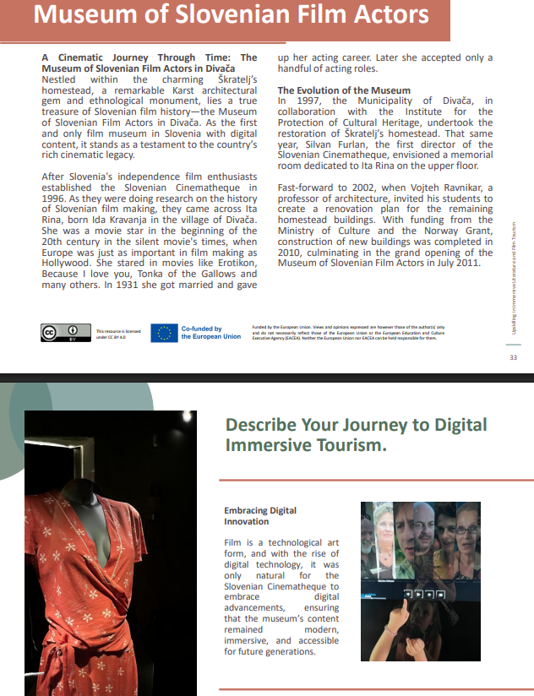
Photo Credit: Image title
Click to check out
our case studies for inspiration and to learn how it can be done!

Slide 28
www.uplifttourism.eu

