Slide 1
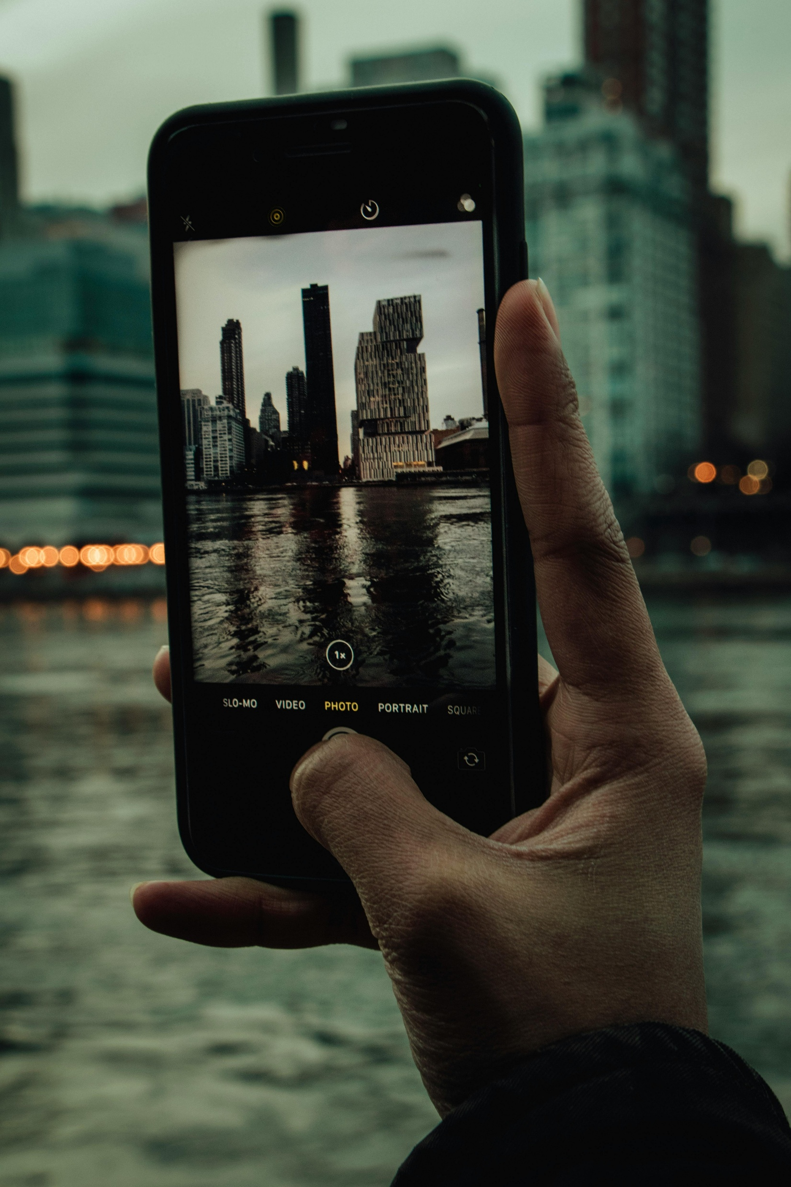

Turning Film and Literary Tourism
into Immersive Experiences
Workshop 01
Learn how to create immersive film and literary tourism through practical workshops and hands-on clinics.
Together, we explore key priority areas, tackle real challenges, discuss solutions, and explore practical approaches you can apply in real contexts.
Why Immersive Technologies Matter for Your Business
January 2026
By Feltech Ireland

Slide 2
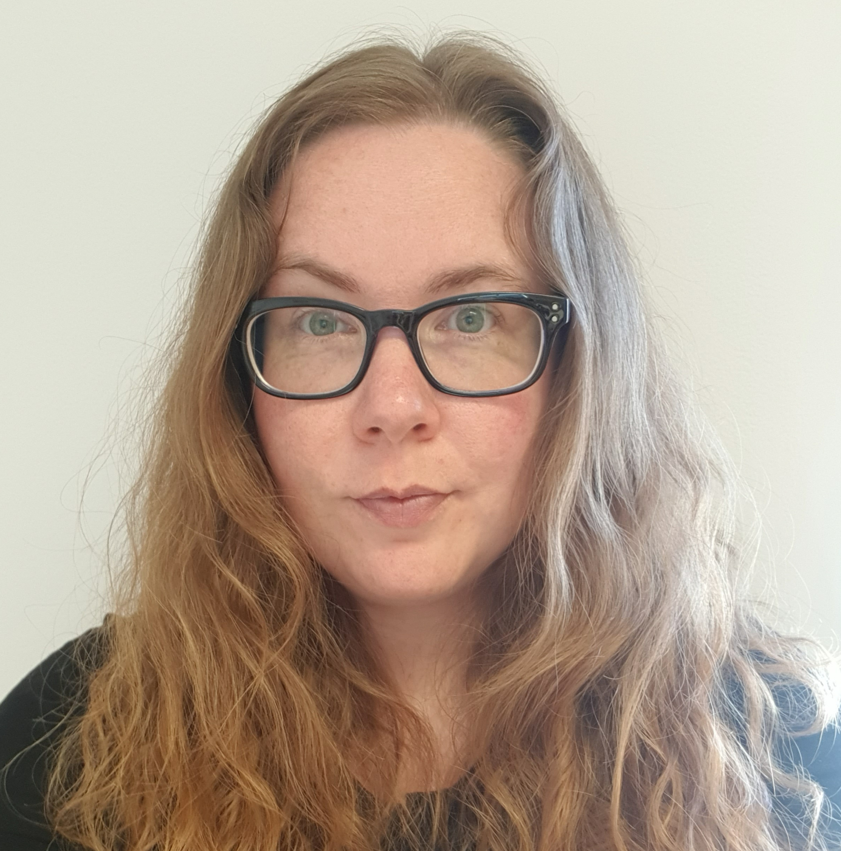





Meet the Partners
The UPLIFT partnership brings together a diverse group of organisations from across Europe — combining expertise in tourism, digital innovation, vocational education and training (VET), immersive technologies, and regional development.
Working across Ireland, Iceland, Denmark, Slovenia, and Lithuania, the partners share a common goal: to help tourism SMEs and destinations harness the power of film and literary heritage through immersive, sustainable, and digitally enhanced experiences.
Through the UPLIFT workshops and implementation clinics, the consortium blends practical tourism know-how with innovation in AR, VR, storytelling, and smart tourism strategy, ensuring that regions can confidently design, deliver, and implement future-ready, collaborative, and market-grounded immersive experiences.
5
Vera Vilhjálmsdóttir , UNAK
Guðrún Þóra Gunnarsdóttir, UNAK
Lina Pečiūrė, VILNIUS TECH
Vilma Purienė, VILNIUS TECH
Monika Grinevičiūtė, VILNIUS TECH
Tanja Abarca Kokol , VSGT

Slide 3



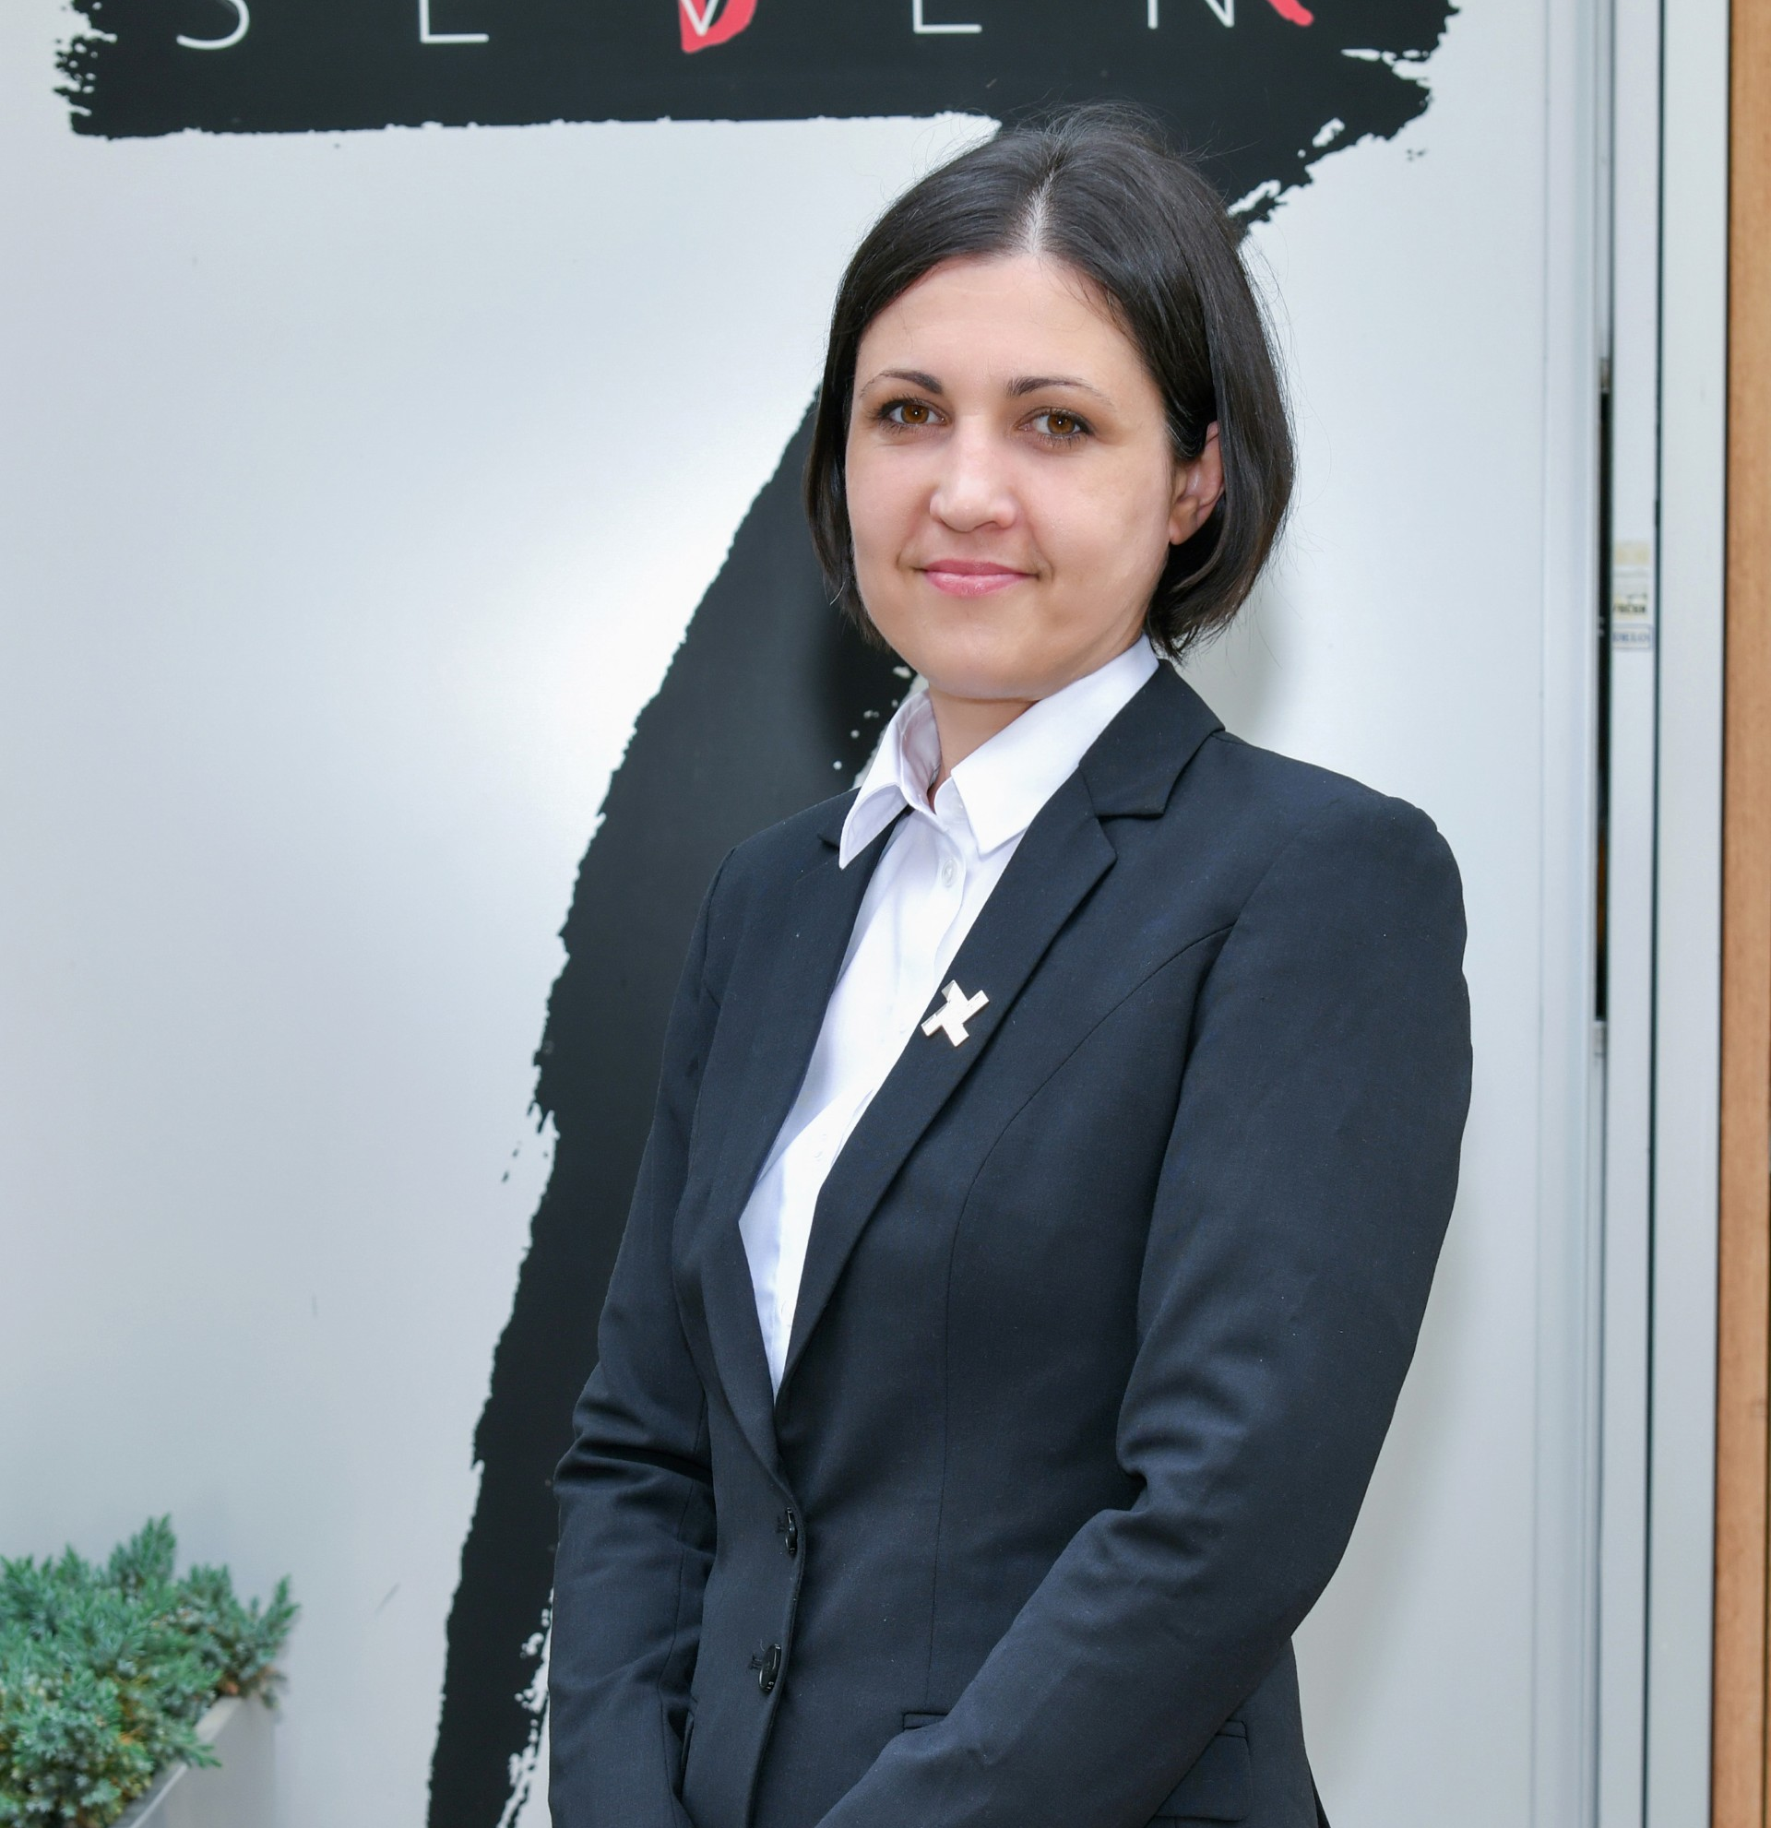









Dr Tony Johnston, TUS, Ireland
Dr Noelle O’Connor, TUS, Ireland
Mr Alex Yu, TUS, Ireland
Ms Laura Magan, Feltch
Irena Krošl, VSGT
Catherine Neill, EUEI

Slide 4

Contents
Introduction to Immersive Film & Literary Tourism Guide (Page 5)
Overview: Immersive Film & Literary Tourism Workshops & Clinics (Page 8)
How the Workshops & Implementation Clinics Work (Page 11)
Workshop 1 Introduction (Page 12)
Why Immersive Technologies Matter for Your Business
Workshop Discussion Section (Page 24)
Exploring Digital & Immersive Opportunities
Existing Film &/or Literature Connections (Page 27)
Existing Visitor Interest in Film and Literature (Page 30)
Identifying the Need for Film & Literature Storytelling (Page 33)
Identifying where your Film & Literature Visitor Experience may Fall Short (Page 36)
Identifying the “How” – Approaches and Technologies (Page 36)
Identifying Business Challenges to Developing Immersive Film & Literature Experiences (Page 42)

Slide 5

Introduction
To Our Practical Guide
Immersive Film & Literary Tourism Workshops and Implementation Clinics
Photo Credit: Image title

Slide 6
Immersive Film & Literary Tourism Workshops and Implementation Clinics
Welcome to UPLIFT’s Immersive Film & Literary Tourism Workshops and Implementation Clinics!
This guide introduces four practical workshops and implementation clinics designed to help tourism businesses explore immersive storytelling and visitor experiences inspired by film and literature.
With the help of experts, we will walk you through a series of stand-alone “clinics” – each focusing on a core theme – that together form a roadmap for bringing books and movies to life in your tourism offerings.
If you are new and a bit nervous about using digital tools, or just exploring ideas to engage visitors, this guide will meet you where you are and provide practical, affordable approaches to implementing immersive experiences in your film and/or literature experience.
By the end, you should feel more confident and equipped with clear next steps to start implementing immersive experiences.
Fans often travel to see the real-world locations of their favourite stories – from the Glenfinnan Viaduct in Scotland (the “Harry Potter bridge”) to New Zealand’s rolling hills of Middle-earth.
Particularly in recent years, we have seen the film and literature tourism has surged in popularity; when a place is showcased in a hit show or movie, it can experience a boom in interest – for example, after The Lord of the Rings films, New Zealand saw a 50% increase in inbound tourists, contributing tens of millions to the economy sciencedirect.com.
More recently, streaming platforms such as Netflix have amplified this effect. Global series can introduce locations to international audiences almost overnight, sparking curiosity, travel planning, and long-term destination
awareness.
Why is the focus on film and literary tourism?

Slide 7
As a result, destinations featured on screen are no longer just places to visit — they become experiences people want to step into, relive, and emotionally connect with. This growing demand creates clear opportunities for tourism businesses and destinations, but it also raises important questions: how do you manage increased interest responsibly, move beyond simple location visits, and turn attention into meaningful, immersive experiences that benefit local communities over the long term?
Clearly, stories told through literature, film, and/or television are a powerful draw, and using immersive approaches can make those story-driven visits even more engaging.
What do we mean by “immersive” experiences?
Immersive tourism means letting visitors step into a story or world, rather than passively learning facts. It can involve technology like augmented or virtual reality to overlay digital story elements onto real places, or simple creative touches like role-playing and storytelling.
The goal is to create unique, memorable moments where visitors feel connected to the narrative. This trend is growing fast – augmented reality (AR) and similar tech are reshaping the tourism industry and expected to reach a $23.5 billion market value by 2028, as more travel brands use AR to offer interactive experiences rockpaperreality.com.
The European tourism sector is increasingly driven by demand for unique, engaging visitor experiences, and film/literary tourism is one of the most exciting ways to explore culture and heritage. By harnessing immersive methods, you can bring stories to life in your locale, providing deeper engagement for visitors and new opportunities for your business.
The power of immersive storytelling
Increase in demand for unique engaging experiences

Slide 8

Objective & Overview: Uplift’s 4 Workshops & Implementation Clinics
UPLIFT’s Turning Film and Literary Tourism into Immersive Experiences – Discussion Workshops and Practical Implementation Clinics.
We have carefully crafted 4 Practical Discussion Workshops and 4 Implementation Clinics, where you will learn to create and develop an SME friendly immersive film and/or literature experience.
They are specifically designed for tourism, film and literature SMEs, entrepreneurs, community groups or destinations. Careful consideration has been given to budget, access to resources, and tech capacity. Each Workshop & Clinic can be taken in sequence or independently, depending on where you are in your journey.
Together, we explore key priority areas, tackle real challenges, discuss solutions, and explore practical implementation approaches you can apply in real contexts.
Workshop 1:
Why Immersive Technologies Matter for Your Business. This section explains why immersive technologies are increasingly important for tourism and experience-based businesses and introduces the core concepts in a clear, accessible way.
It helps you explore different levels of immersion—from simple, low-tech approaches to more advanced digital

Slide 9

experiences—so you can identify what best fits your business, skills, and budget.
You’ll also be guided to plan a realistic immersion roadmap, showing how your experience could evolve gradually over the next 1 to 5 years, rather than requiring a large upfront investment.
Workshop 2:
Positioning, Branding, Audience Goals & Designing Immersive Storytelling. This section focuses on strengthening your brand identity, understanding your target audiences, and ensuring immersive ideas align clearly with your business goals.
It guides you through identifying who your experience is for, what you want visitors to feel and do, and how immersive storytelling can support those objectives.
You’ll explore how to translate your brand, place, or cultural asset into engaging narratives and interactive story elements, helping visitors connect emotionally while staying true to your values and positioning.
Workshop 3:
Budgeting, Costs, Financial Planning & Responsible Practice for Immersive Experiences. This workshop helps you understand the real costs involved in developing immersive experiences and how to plan for them in a practical, manageable, and responsible way.

Slide 10

It explores affordable and scalable approaches, showing how immersive ideas can be tested and introduced through low-cost pilots, phased budgeting, and gradual investment as confidence and demand grow.
The workshop also introduces key legal, copyright, and ethical considerations, including permissions, content ownership, data protection, and cultural sensitivity — helping you avoid common risks and make informed decisions from the outset.
Workshop 4:
Promotion & Selling Immersive Experiences Through Storytelling. This workshop focuses on how to communicate, promote, and sell immersive film and literary experiences by using storytelling as a powerful tool to connect with audiences and drive engagement. It guides you through how to turn your experience into a compelling visitor journey — bringing places, characters, and narratives to life in ways that are clear, authentic, and aligned with your business goals.
You’ll explore how to position and promote your experience across websites, social media, and tourism platforms, while designing simple and effective pricing, booking, and on-site selling journeys that make it easy for visitors to understand, connect, and take part.The focus is on turning stories into action — helping people discover your experience, recognise its value, and feel inspired to book, without adding unnecessary complexity or pressure.

Slide 11
How the Workshops & Implementation Clinics work
Many tourism businesses assume immersive technology means expensive VR equipment or complex apps. In reality, immersive experiences can be created using simple tools such as audio storytelling, QR codes, projections, or smartphone content.
Each section contains:
an Introduction to the theme or topic (why it matters),
the purpose, or objective of the section, so you are clear on what you are aiming to achieve
key Challenges & Opportunities to consider,
a Workshop with Questions for exploration and discussion to guide your thinking or group discussion,
an Implementation Clinic with practical exercises and tasks to start applying the ideas, putting them into action and testing them,
suggested Approaches & Solutions (best practices or methods to overcome challenges), and
a real-world Example or case study for inspiration.
We also include links to further resources (toolkits, case studies, blogs and other UPLIFT resources and supports) so you can dive deeper or see how others have done it.
Feel free to start with the topic that interests you most – the clinics are separated and can be used in sequence or interchangeably. However, if you go through them in order, they will build on each other and together provide a comprehensive roadmap.
We understand this may be your first foray into immersive tourism, and it’s normal to feel a bit unsure. We’ve included plenty of examples.
As you progress, we’ll gently build up from simple, quick-win ideas (that you could try in the next 6 months) to more ambitious projects over a couple of years or beyond, so you can plan for both short-term actions and long-term vision.
Let’s get started on unlocking the potential of immersive film and literary tourism for your business!

Slide 12
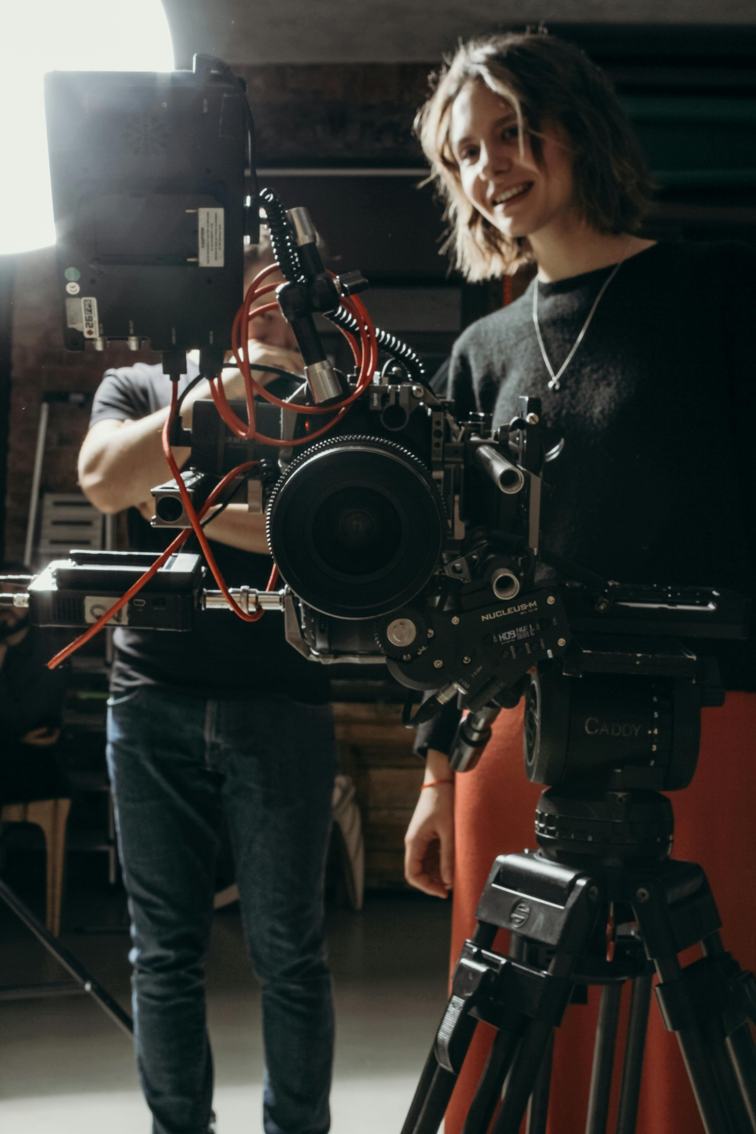
Workshop 1 Introduction
Why Immersive Technologies Matter for Your Business.
Photo Credit: Image title

Slide 13
Overview
Immersive technologies might sound high-tech, but at their core they are about drawing visitors into a story or place. Traditional tourism is often about “look and listen,” while immersive tourism invites people to “experience and take part.”
For example, instead of simply reading a plaque about a famous movie scene, a visitor could lift their phone and watch that scene unfold on the spot through augmented reality (AR). Rather than imagining a historic moment from a book, they could put on a virtual reality (VR) headset and feel as though they are standing right there. These tools enrich real places with digital layers – adding visuals, sound, and interactive elements that make experiences more engaging and memorable.
Importantly, immersive technology doesn’t replace the real location; it enhances it. AR keeps visitors grounded in their surroundings by overlaying digital content onto what they already see, while VR places users inside a fully virtual environment. Both approaches can be powerful in film and literary tourism, bringing book passages, characters, or iconic screen moments to life in meaningful ways.
Immersive tools include technologies such as Augmented Reality (adding digital images or information to the real world via smartphones or AR glasses) and Virtual Reality (fully simulated environments accessed through VR headsets). Alongside interactive digital media and AI, these technologies are transforming how visitors engage with tourism experiences. They allow people to step inside stories – overlaying historical or fictional scenes onto real locations, or recreating famous film settings for exploration on-site or remotely.
For tourism businesses, especially small and medium-sized ones, immersive technologies offer new ways to connect with audiences. They can make tours more engaging, extend visitor interest beyond peak seasons, and appeal to a generation seeking meaningful, experience-led travel. Crucially, adopting immersive tools doesn’t require advanced technical skills or large budgets. Simple solutions, such as QR-triggered content or smartphone-based AR, can be affordable and effective.
Making it possible for small businesses with limited budgets

Slide 14
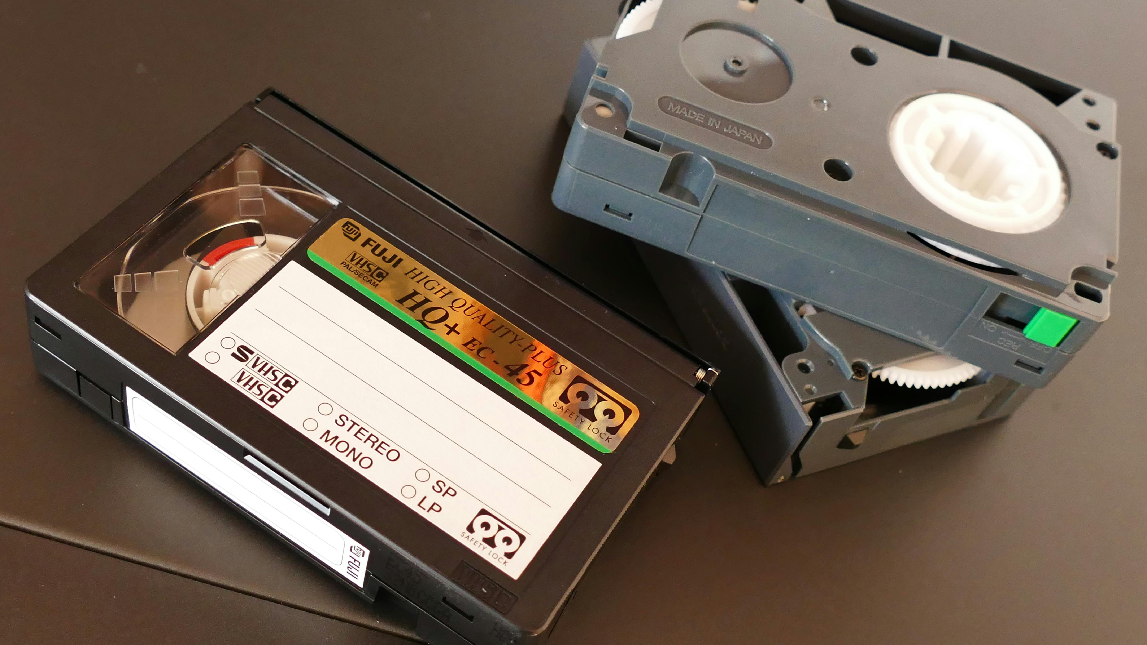
Research shows that AR and VR can significantly enhance the quality of visitor experiences, and the tourism sector is increasingly driven by demand for unique, engaging offerings. Film and literary tourism, in particular, benefit from immersive storytelling that deepens emotional connection and brings narratives to life. Because most visitors already carry smartphones, even small businesses can introduce immersive elements in a cost-effective way.
In short, immersive technology turns a visit into an interactive experience. It offers destinations and tourism providers a practical, accessible way to engage visitors more deeply and transform stories into living experiences – without losing sight of the real place at the heart of the journey.
Enhanced engagement: AR/VR let visitors explore and influence content, turning passive tours into active adventurespmc.ncbi.nlm.nih.govhospitalitynet.org.
Scalable creativity: Even modest budgets can create AR/VR content (e.g. mobile AR apps on smartphones) that provides richer experiences and year-round.
Competitive differentiation: Unique immersive tours help small destinations stand out in a crowded market and meet modern travelers’ expectations.
Immersive technologies for tourism: a systematic review
Immersive Hospitality: Redefining the Guest Experience

Slide 15

Purpose: Why Immersive Technologies Matter for Your Business.
Photo Credit: Image title
This workshop is about understanding, not doing.
It is designed to:
Introduce immersive approaches in a simple, non-technical way
Help participants understand why immersion matters in film and literary tourism
Address fears, misconceptions, and skills gaps
Create confidence before any decisions are made
There is no expectation to commit to technology or solutions in this workshop.

Slide 16
First, we need to understand what “immersive technologies” are, and why tourism businesses should care.
Immersive technologies include tools like Virtual Reality (VR), Augmented Reality (AR), interactive digital media, and even artificial intelligence (AI) that together allow visitors to experience stories and places in more engaging ways.
In the context of film and literary tourism, this might look like an AR app that shows movie scenes superimposed on the real location you’re standing in, or a VR experience that lets a visitor virtually step into a scene from a novel. These technologies blend the physical and digital worlds to add new layers of storytelling to real places rockpaperreality.com.
For tourism SMEs (small and medium enterprises), embracing immersive tech can seem intimidating – but it’s increasingly becoming a competitive advantage.
Visitors, especially younger and tech-savvy ones, now expect interactive, personalised experiences.
If done right, immersive elements can significantly boost visitor satisfaction and set your offering apart from traditional tours. They enable deeper emotional connections: instead of just hearing about a story, your guests can participate in it, which often leaves a stronger impression. Immersive tech can also help you reach new audiences – including people who might not normally be interested in history or heritage, but will come for a fun interactive experience (think of how Pokémon Go got people exploring their cities!).
Crucially, using technology doesn’t mean replacing the human touch or the authentic charm of your site – rather, it enhances it.
Trinity College Dublin’s Book of Kells
Trinity College Dublin’s Book of Kells exhibits (a famous medieval manuscript display) incorporated digital innovation to enrich the visitor experience. They blended cutting-edge interactive elements with the book’s rich heritage, and it became a benchmark for sustainable, immersive tourism in Ireland [find out more in our Resources].
Dublin’s Museum of Literature Ireland (MoLI)
Similarly, Dublin’s Museum of Literature Ireland (MoLI) uses interactive installations to make literary heritage feel magical – within six months of opening, MoLI attracted nearly 40,000 visitors, showing the strong public interest in these novel experiences feltech.ie.
Case Studies

Slide 17
What do we mean by “immersive”?
Immersion is about connection and interaction, not complexity.
Immersive tourism is about how visitors experience a story or place, not the technology itself.
An experience is immersive when it:
Helps visitors feel emotionally connected Encourages participation rather than observation Deepens understanding of a story, place, or character
Immersion can be:
Digital (audio, AR, 360° content) Low-tech (storytelling, guided interaction, atmosphere) Or a mix of both
Why Immersion Matters for Film & Literary Tourism
Film and literary tourists:
Arrive with emotional attachment to a story Want to step into a world they already care about Expect more than signs, plaques, or photo stops
Without immersion
Visits can feel flat or rushed Economic value is limited Pressure increases on physical locations
Immersive approaches help:
Extend visitor engagement Improve visitor satisfaction Reduce reliance on physical access Create richer, more memorable experiences

Slide 18
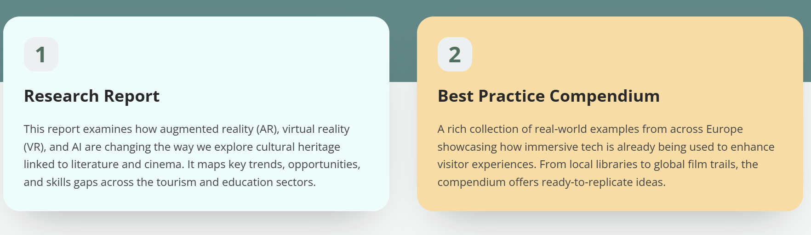
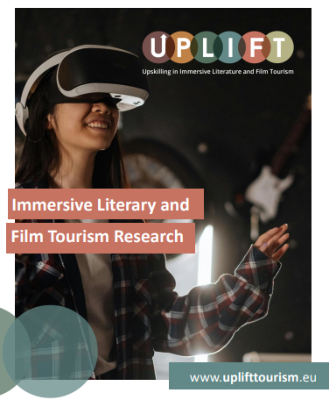
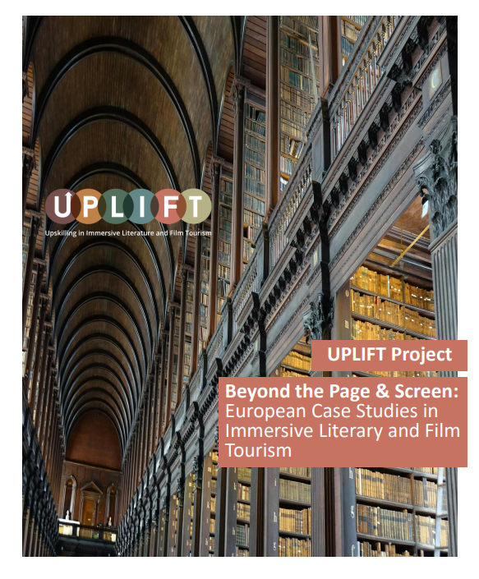
The bottom line: Immersive approaches are not a gimmick; they respond to a real shift in what visitors want. The tourism market for VR/AR is growing rapidly (over 30% annually) rockpaperreality.com, and those who adapt early can ride that wave. By weaving story and technology together, even a small tourism business can offer something unique and memorable that keeps visitors talking (and sharing on social media) long after they leave.
Explore more examples of best practice and delve deeper into this topic. We have developed two in-depth resources that offer insights into trends shaping immersive tourism and showcasing successful examples from different types of offerings across Europe and beyond.
Click the link to access
https://uplifttourism.eu/resources/immersive-tourism-insights-research-best-practices/

Slide 19
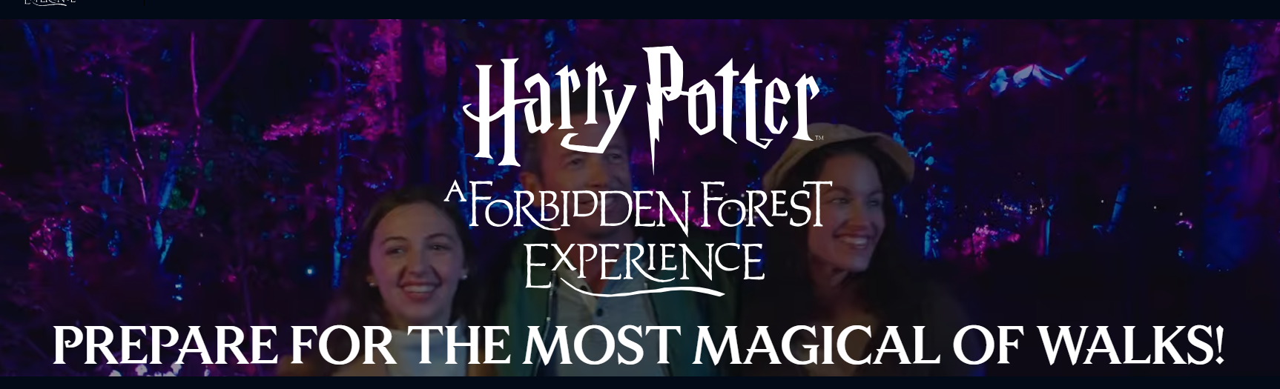
Key Challenges
Like any innovation, immersive tech in tourism comes with challenges as well as exciting opportunities:
Challenges
Many SMEs worry about the cost and complexity of high-tech solutions. You might ask, “Do I need to invest in expensive VR headsets or hire developers?”
There’s also a learning curve – if you’re not techy, figuring out AR apps or interactive media can be daunting at first.
Additionally, not all visitors are equally comfortable with tech; some might not download an app or could face accessibility issues.
Maintenance and updates for digital tools are another concern (what if the AR app crashes during a tour?).
Finally, there’s a fear of losing the authentic feel – you don’t want shiny tech to overshadow the real story or location.
The Harry Potter Immersive Experience, London
https://hpforbiddenforestexperience.com/
A nighttime woodland trail filled with magical creatures and wizarding wonders from the Harry Potter™ and Fantastic Beasts™ films. Set in beautiful woodland, this experience has been brought to life by award-winning theatrical designers and experiential creators.

Slide 20

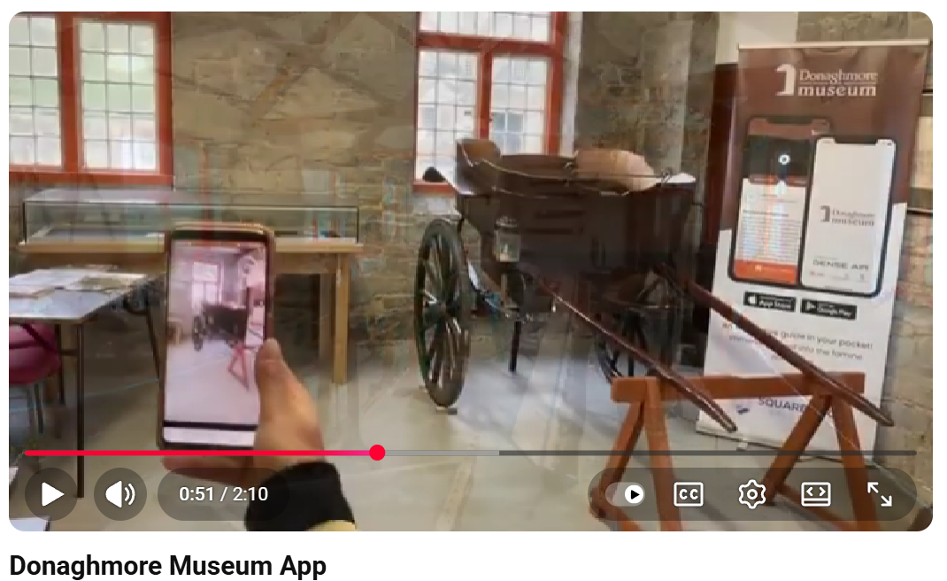
Click to Watch Video
Donaghmore Museum App, Ireland
Donaghmore Museum App https://www.youtube.com/watch?v=sEbTzBnCGPE
Square Root Solutions, Ireland developed an app for the Donaghmore museum which would let the visitors scan the artefacts and provide them with detailed descriptions, images, videos, and audio.
In addition, the visitors can also view some of the artefacts in action through the Augmented reality and 3D technologies.
More information on Donaghmore Museum
https://www.discoverireland.ie/laois/donaghmore-famine-workhouse-museum
More information on the immersive App creators
https://squareroot.ie/achievements
Download the app now on:
Google play store: https://play.google.com/store/apps/de...
App store: https://apps.apple.com/us/app/donaghm...

Slide 21
Other Common Concerns (Let’s Name Them)
Many businesses feel:
These concerns are normal and expected. This project is built on the idea that:
Immersive tourism can start small
Start with affordable technologies that work with your priorities and build from there
Engage in plenty of testing and aligning to customer needs
Shop around and get informed, see what works and what doesn’t
Skills are built gradually
Learning comes before action
“This sounds expensive”
“We might get it wrong”
01
Text
“We don’t have the skills”
“This is too technical for us”

Slide 22
Key Opportunities
Opportunities
On the flip side, immersive tech offers huge opportunities to elevate the visitor experience.
It enables storytelling in new dimensions – for instance, showing a scene from decades ago right before a visitor’s eyes on their phone, or letting them virtually “meet” characters. This can create emotional engagement and wow moments that traditional exhibits can’t.
Tech can also increase accessibility: people who can’t climb a castle tower could still see the view via VR, or international visitors could get info in their own language via AR overlaysrockpaperreality.com.
Moreover, many immersive solutions can generate additional revenue – like offering paid VR experiences, or simply attracting more visitors because of the novelty. There are also more affordable and user-friendly tools now than ever (we’ll explore some in the “High-Tech” clinic) that put AR/VR within reach of small businesses.
In short, the question is no longer if immersive tech will be part of tourism, but how you can smartly adopt it to benefit your business.
What does “immersive experience” mean to you in the context of your business?
(Think of any film or literary tour or museum visit that left a strong impression on you – what made it immersive or engaging?)

Slide 23
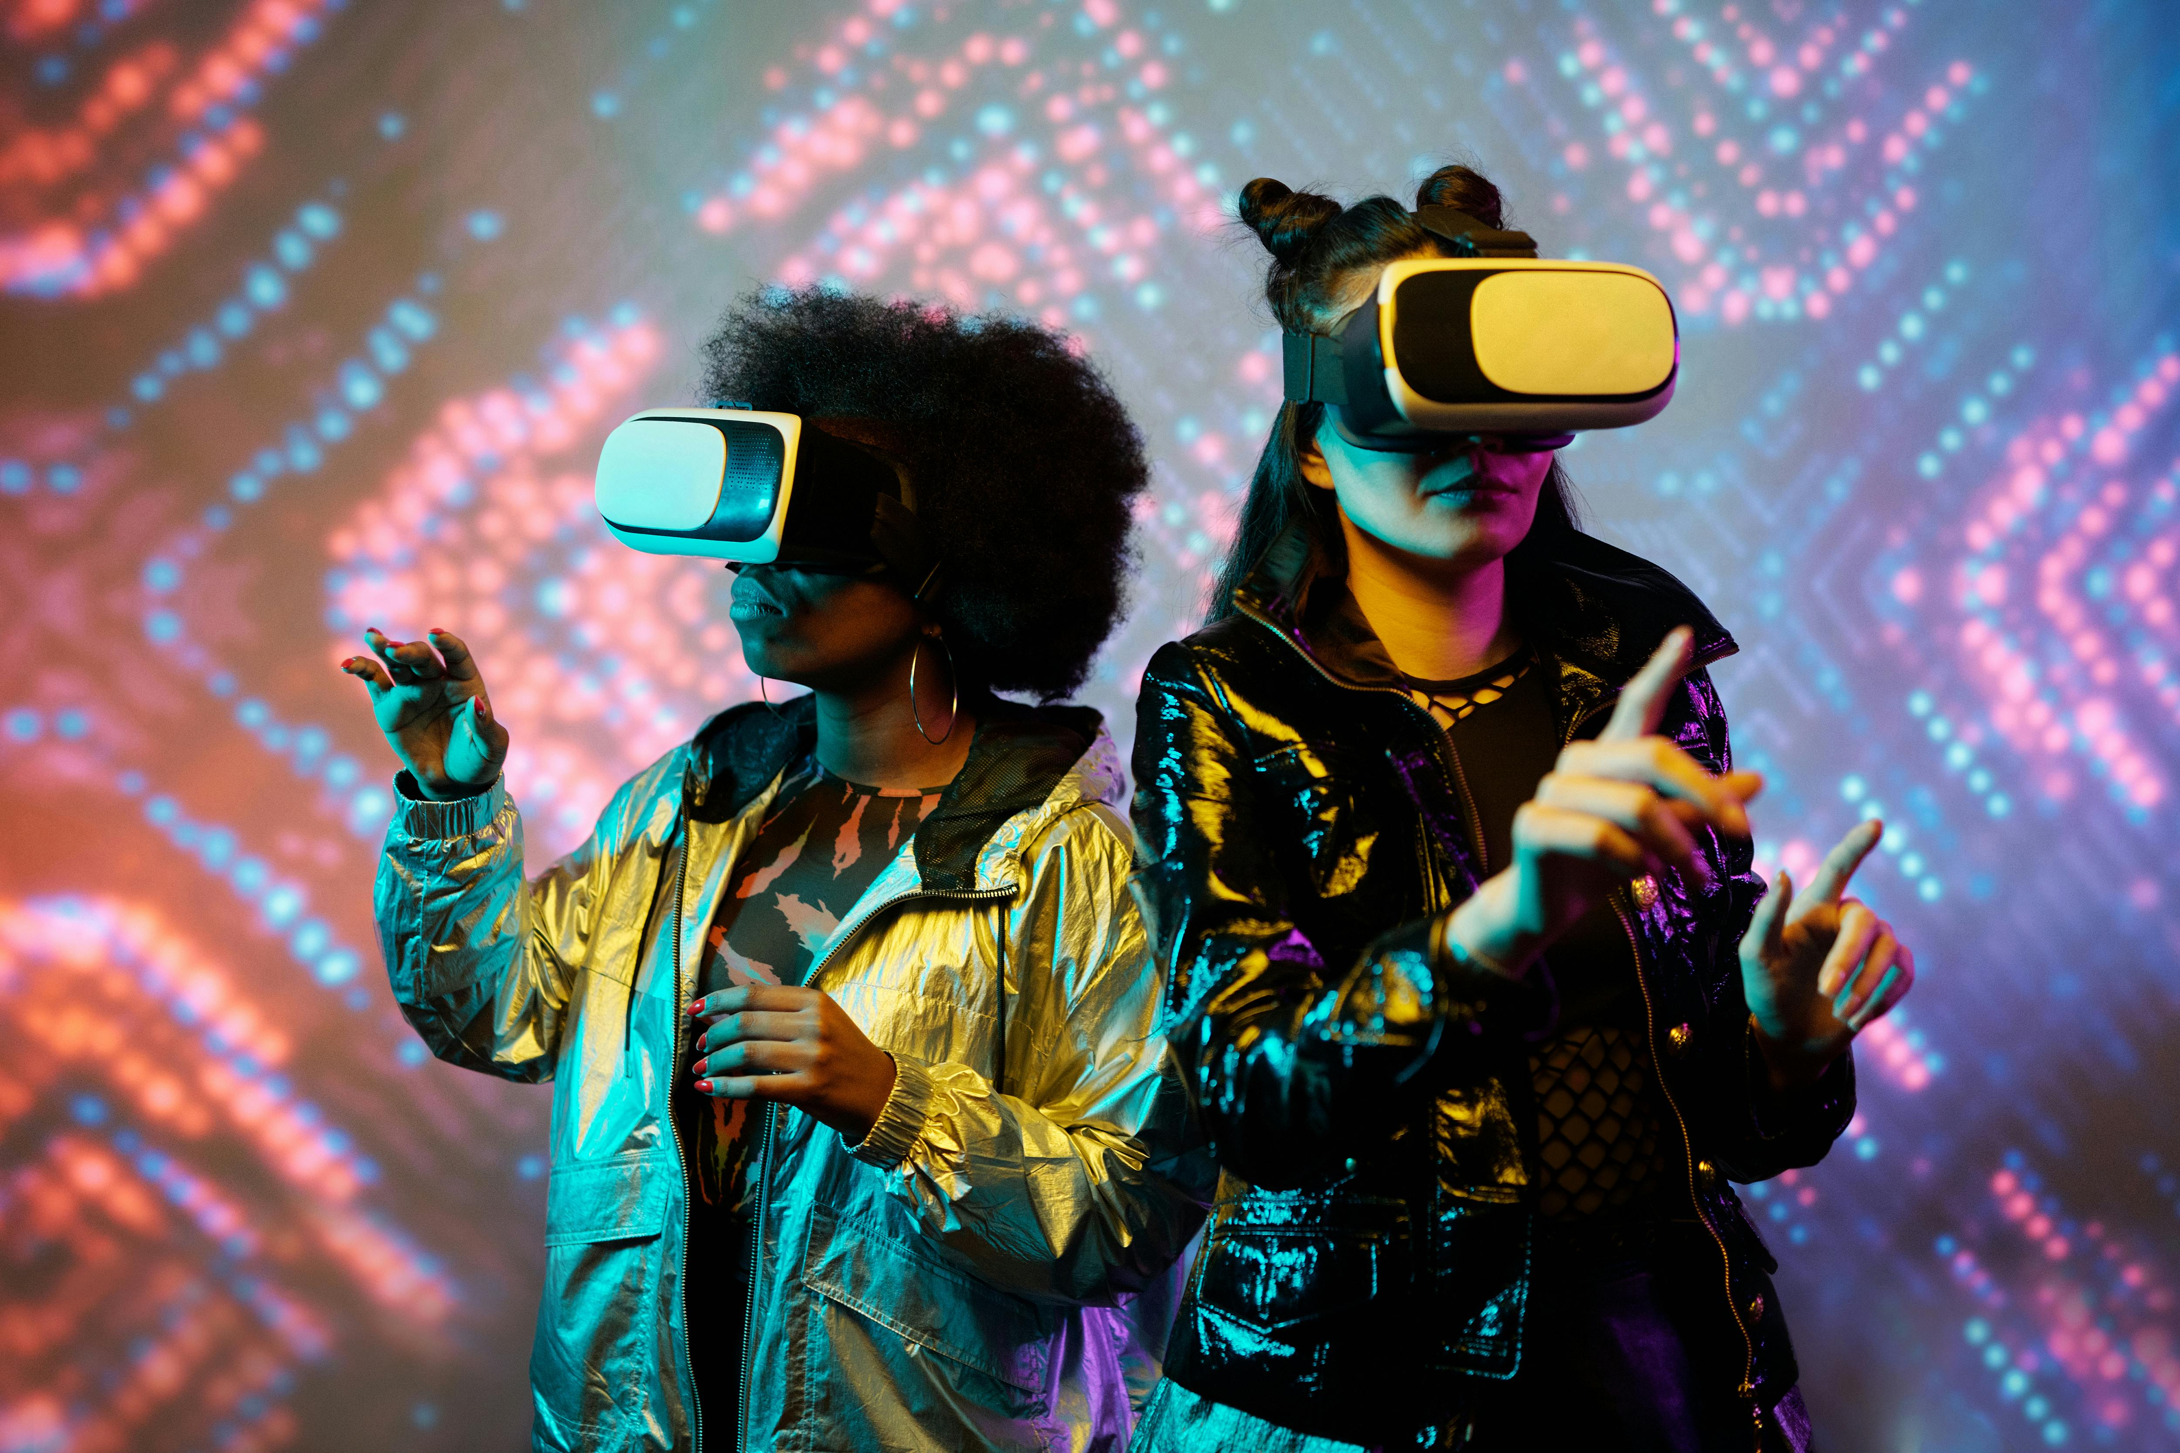
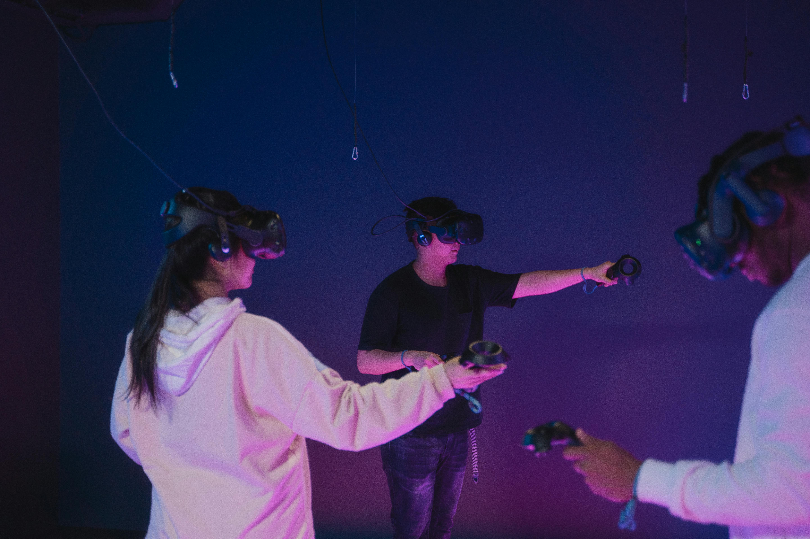
Photo Credit: Image title
Photo Credit: Image title
Create your own visual style…
let it be unique for yourself
and yet identifiable to others

Slide 24
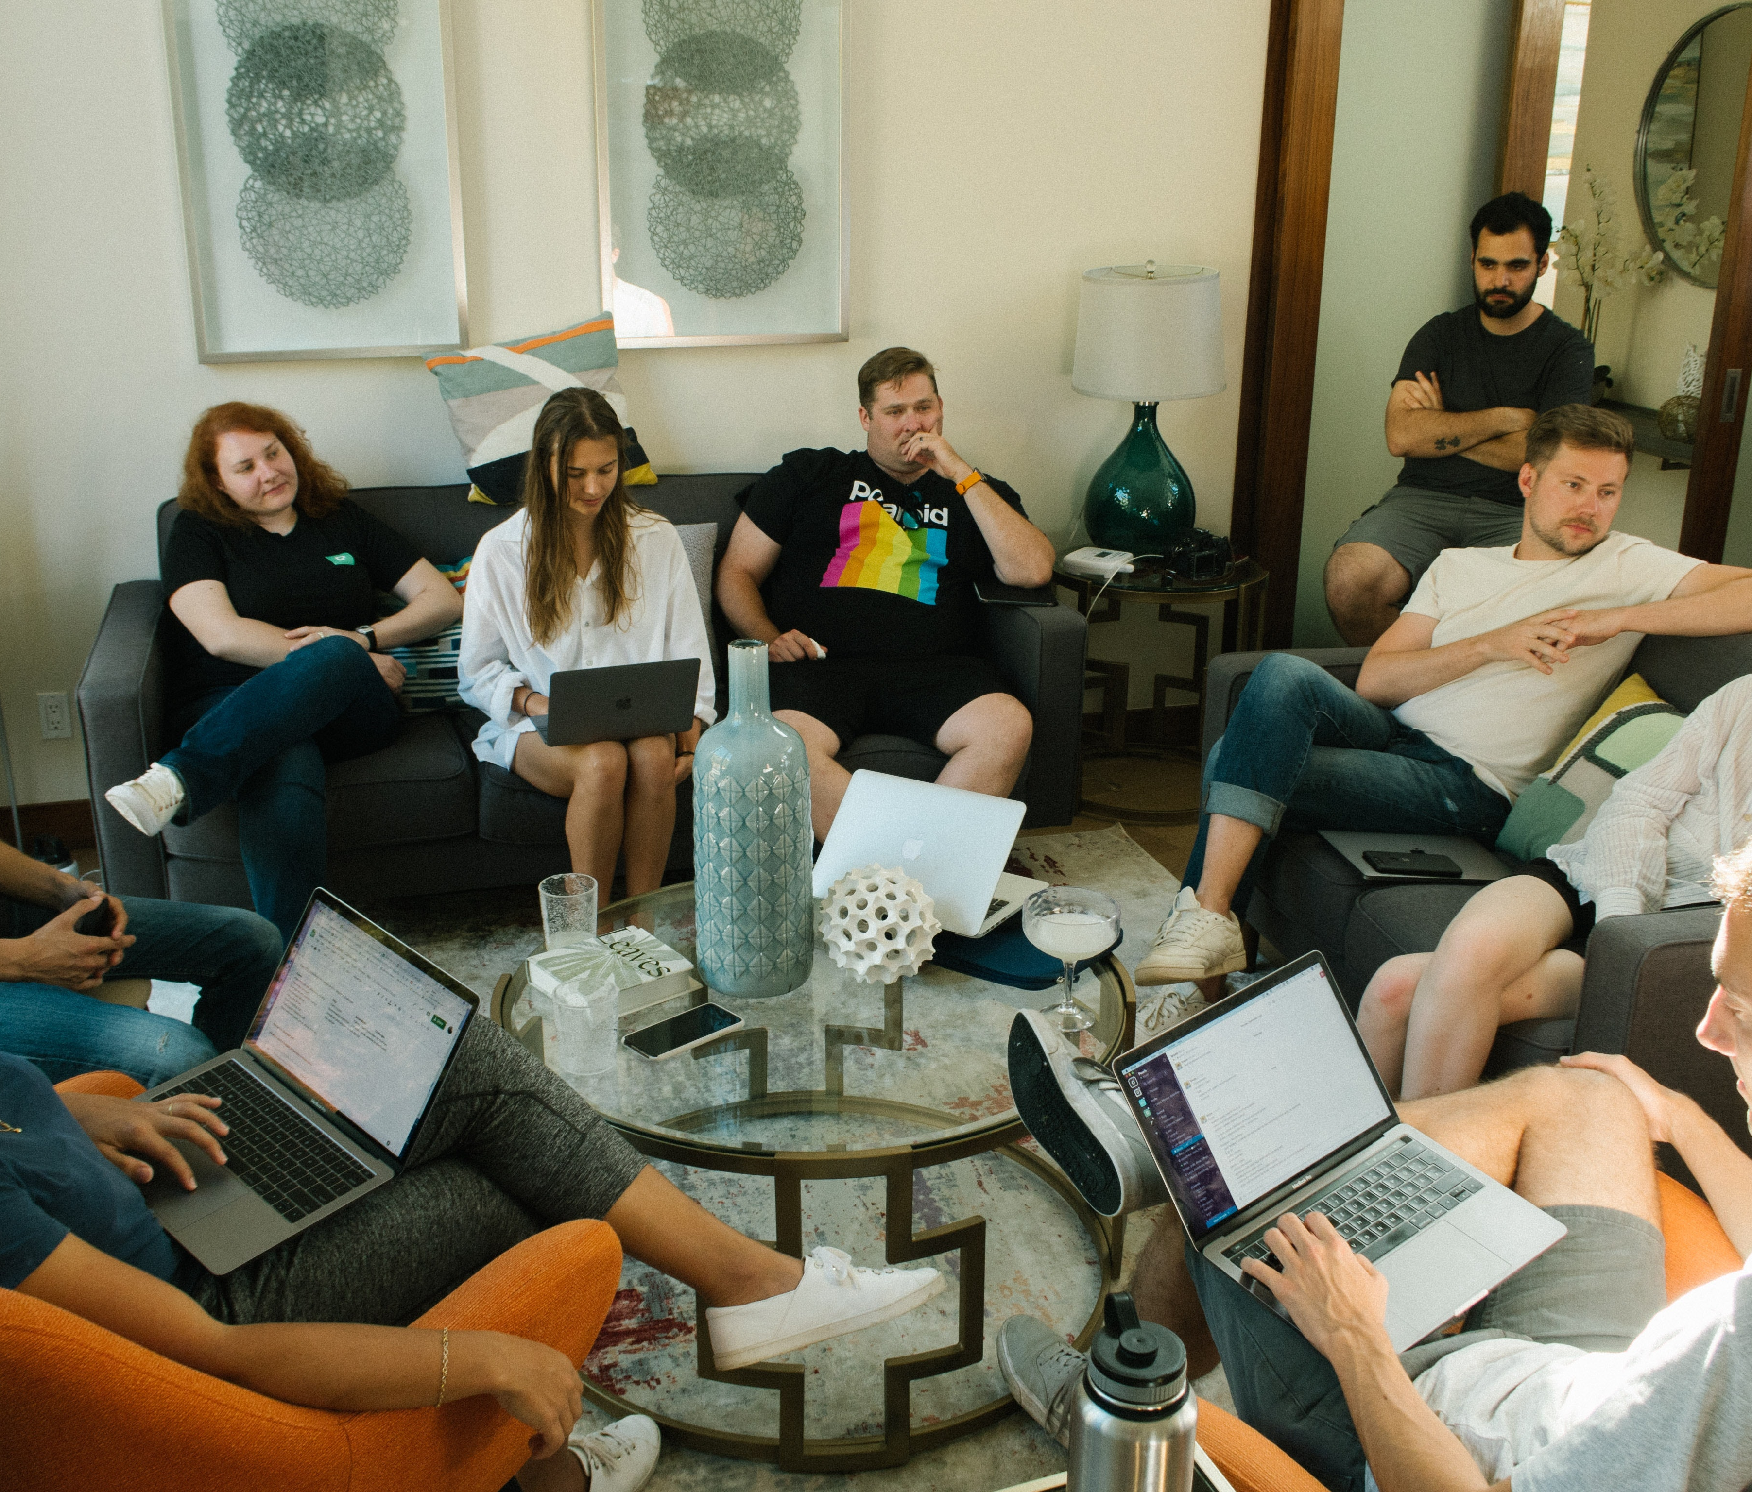
Time to Explore Immersive Opportunities
Workshop 1 Discussion Section
This section is designed to help you go a little deeper and reflect on how immersive experiences could meaningfully support your business, place, or story.
Approach the questions conversationally —for personal reflection, team discussion, or group workshops. There are no right or wrong answers. The goal is to explore possibilities, uncover opportunities, and identify what feels realistic and authentic for your business context.

Slide 25
Many destinations already have hidden film or literary connections. Before creating an immersive experience, it is important to identify existing stories linked to your place, landscape, or cultural heritage.
Workshop 1
Existing Film &/or Literature Connections
Existing Visitor Interest in Film and Literature
Identifying the Need for Film & Literature Storytelling
Identifying where your Film & Literature Visitor Experience may Fall Short
Identifying the “How” – Approaches and Technologies

Slide 26
Workshop Topic
Exploring Digital & Immersive Opportunities
Purpose of this discussion
To identify immersive potential in their place — whether visible, hidden, underused, or not yet developed — and to understand how visitors currently experience (or miss) these film and literature experiences.
Q1
Discussion Questions
Existing Film &/or Literature Connections
What film or literary stories, places, or connections are linked to your area — if any?
(This helps you identify what you already have, and what can be translated into engaging visitor experiences.)
Is your area associated with a book, film, TV series, author, poet, playwright, or screenwriter (even loosely)?
Was anything filmed here, set here, or clearly inspired by this place (landscapes, towns, buildings, atmosphere)?
Which connection is easiest to “show” on-site, and which is harder to explain without help?
What existing materials already exist (quotes, photos, archives, scenes, locations, interviews, local memories)?
5. Immersive Digital Technology Considerations
Which stories are hard to communicate with just words and would benefit from being seen/heard/experienced (e.g., a scene overlay, narrated excerpt, interactive map)?
What story or content could be enhanced with an interactive element? For example, do you have a famous scene or piece of lore that people love – and could you let visitors see or hear something extra about it through AR, or perhaps let them choose a path in the story?

Slide 27
Question Responses
Use this space to respond directly to the discussion questions.
Share your thoughts, ideas, reflections, or examples based on your own experience or context. There are no right or wrong answers, and not every question needs a response right now — this is about exploring possibilities..
Existing Film &/or Literature Connections
Question 1: [add response]
Question 2: [add response]
Question 3: [add response]
Question 4: [add response]
Question 5: (Immersive & Digital Technology Considerations)
[add response]

Slide 28
Notes Section
Use this space to capture key discussion points, ideas,
reflections, challenges/solutions, gaps/opportunities,
expertise advice, suitable digital and immersive technologies, etc.
This is a working area — note thoughts, questions, or actions as they emerge
Existing Film &/or Literature Connections
Challenges and solutions; [add response]
Gaps and opportunities; [add response]
Good ideas and expert advice; [add response]
Digital and immersive technologies to explore; [add response]
Other: [add response]

Slide 29
Q2
Existing Visitor Interest in Film and Literature
How do visitors currently show interest in film and literary
stories connected to your area — if at all?
(This shows what visitors want today — and whether “quick info” or “deeper immersion” is needed.)
Who are your target visitors or fan base? Are they younger people glued to their phones, older literary enthusiasts, families, or international travellers? Understanding your audience will help decide which technologies (if any) make sense and how to implement them.
Do your visitors ask questions like “Was this filmed here?”, “Where is the scene set?”, or “What book is this from?”
What triggers curiosity most: a location, a character, a well-known title, or a shareable photo spot?
Do visitors seem to want quick highlights, or do they ask for deeper context and background?
How are visitors currently getting answers: guide/host, Google, social media, signage, or nothing at all?
6. Immersive & Digital Technology Considerations
When visitors want more context but don’t have time for a guided tour, what would work best: a QR-linked micro-story, an interactive graphic, an audio snippet, a short video, an app trail, or a digital map?

Slide 30
Question Responses
Use this space to respond directly to the discussion questions.
Share your thoughts, ideas, reflections, or examples based on your own experience or context. There are no right or wrong answers, and not every question needs a response right now — this is about exploring possibilities..
Existing Visitor Interest in Film and Literature
Question 1: [add response]
Question 2: [add response]
Question 3: [add response]
Question 4: [add response]
Question 5: [add response]
Question 6: (Immersive & Digital Technology Considerations)
[add response]

Slide 31
Notes Section
Use this space to capture key discussion points, ideas,
reflections, challenges/solutions, gaps/opportunities,
expertise advice, suitable digital and immersive technologies, etc.
This is a working area — note thoughts, questions, or actions as they emerge
Existing Visitor Interest in Film and Literature
Challenges and solutions; [add response]
Gaps and opportunities; [add response]
Good ideas and expert advice; [add response]
Digital and immersive technologies to explore; [add response]
Other: [add response]

Slide 32
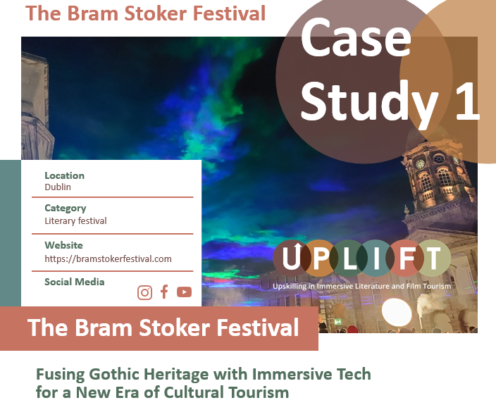
Q3
Identifying the Need for Film & Literature
Storytelling
Why might film and literature storytelling be important or valuable for your area?
(This clarifies the purpose, so you choose the right type of experience and technology.)
What is the main goal: longer stays, repeat visits, off-season appeal, stronger identity, better reviews, or local pride?
What do you want visitors to feel: emotion, connection, curiosity, belonging, or wonder?
Where is the biggest opportunity: turning “nice scenery” into a meaningful story experience, or turning fans into active explorers?
4. Immersive & Digital Technology Considerations
Which goals need more than signage (e.g., to increase dwell time, create shareable moments, or make stories accessible in multiple languages)?
If you had one simple digital layer, would it be: QR trail, audio guide, interactive map, or app-based route?
Click to check out
our case studies for inspiration and to learn how it can be done!

Slide 33
Question Responses
Use this space to respond directly to the discussion questions.
Share your thoughts, ideas, reflections, or examples based on your own experience or context. There are no right or wrong answers, and not every question needs a response right now — this is about exploring possibilities..
Identifying the Need for Film & Literature
Storytelling
Question 1: [add response]
Question 2: [add response]
Question 3: [add response]
Question 4: (Immersive & Digital Technology Considerations)
[add response]

Slide 34
Notes Section
Use this space to capture key discussion points, ideas,
reflections, challenges/solutions, gaps/opportunities,
expertise advice, suitable digital and immersive technologies, etc.
This is a working area — note thoughts, questions, or actions as they emerge
Identifying the Need for Film & Literature
Storytelling
Challenges and solutions; [add response]
Gaps and opportunities; [add response]
Good ideas and expert advice; [add response]
Digital and immersive technologies to explore; [add response]
Other: [add response]

Slide 35
Q4
Identifying where your Film & Literature
Visitor Experience may fall short or be missing
something important?
What is currently missing or underdeveloped in how your film and literary stories are experienced by visitors?
(This identifies the exact “experience problem” that technology can solve.)
Are story connections hard to discover unless visitors already know they exist?
Do visitors arrive at a place but fail to understand what happened here in the story / scene?
Is there a lack of context, interpretation, or emotional connection (e.g., “I saw it, but I didn’t get it”)?
Is engagement too passive (just reading) instead of active (listening, exploring, interacting)?
5. Immersive & Digital Technology Considerations
What would best fill the gap:
QR codes linking to short story/scene content
interactive signage or visual graphics
audio narration for mood and storytelling
app trail / map to connect multiple points
AR overlay to place scenes/quotes in the location

Slide 36
Question Responses
Use this space to respond directly to the discussion questions.
Share your thoughts, ideas, reflections, or examples based on your own experience or context. There are no right or wrong answers, and not every question needs a response right now — this is about exploring possibilities..
Identifying where your Film & Literature Visitor Experience may fall short or be missing something important?
Question 1: [add response]
Question 2: [add response]
Question 3: [add response]
Question 4: [add response]
Question 5: (Immersive & Digital Technology Considerations)
[add response]

Slide 37
Notes Section
Use this space to capture key discussion points, ideas,
reflections, challenges/solutions, gaps/opportunities,
expertise advice, suitable digital and immersive technologies, etc.
This is a working area — note thoughts, questions, or actions as they emerge
Identifying where your Film & Literature Visitor Experience may fall short or be missing something important?
Challenges and solutions; [add response]
Gaps and opportunities; [add response]
Good ideas and expert advice; [add response]
Digital and immersive technologies to explore; [add response]
Other: [add response]

Slide 38
Q5
Identifying the “How” – Approaches and
Technologies
How could film and literary stories be shared in more engaging, accessible, or meaningful ways — and what technologies are realistic for your context?
(This turns insights into practical options and next steps.)
What delivery format best matches visitor behaviour: quick scans (QR), listen while walking (audio), follow a route (map/app), interactive learning (touchscreens), or wow moments (AR)?
Where should storytelling happen: before the visit, on-site, between locations, or after the visit?
What is the simplest prototype you could test quickly:
5-stop QR micro-trail with 60–90 second audio clips
a digital map with pins and story snippets
a small in-venue interactive graphic
a basic app-style route (web-based)
4. Immersive & Digital Technology Considerations
What would make the story more memorable:
hearing voices,
seeing scenes layered over place,
interacting with choices, or
collecting story “chapters” as you move?
What resources do you currently have?
Do you have decent internet at your site?
Do you or any staff have tech hobbies? Maybe a local college or startup could be a partner?)
These can be starting points for integrating tech.

Slide 39
Question Responses
Use this space to respond directly to the discussion questions.
Share your thoughts, ideas, reflections, or examples based on your own experience or context. There are no right or wrong answers, and not every question needs a response right now — this is about exploring possibilities..
Identifying the “How” – Approaches and
Technologies
Question 1: [add response]
Question 2: [add response]
Question 3: [add response]
Question 4: (Immersive & Digital Technology Considerations)
[add response]

Slide 40
Notes Section
Use this space to capture key discussion points, ideas,
reflections, challenges/solutions, gaps/opportunities,
expertise advice, suitable digital and immersive technologies, etc.
This is a working area — note thoughts, questions, or actions as they emerge
Identifying the “How” – Approaches and
Technologies
Challenges and solutions; [add response]
Gaps and opportunities; [add response]
Good ideas and expert advice; [add response]
Digital and immersive technologies to explore; [add response]
Other: [add response]

Slide 41

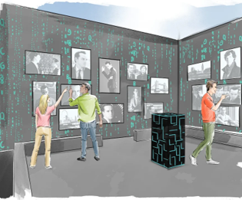
Q6
Identifying Business Challenges to Developing
Immersive Film & Literature Experiences
What business challenges (e.g., operational, legal or practical) make it difficult to develop or deliver film and literature-based immersive experiences?
(This helps you understand what is getting in your way and helps you choose affordable, realistic tools and levels of immersion approaches.)
What is the biggest barrier: budget, time, skills, staffing, permissions, copyright, or fragmented ownership?
Is it hard to deliver experiences because sites are remote, weather-dependent, seasonal, or not staffed?
Do you need solutions that are self-guided, 24/7, and/or with low maintenance?
4. Immersive & Digital Technology Considerations
Could a light-touch option solve constraints better than a staffed tour (e.g., QR + audio, interactive map, app, downloadable trail)?
What level is realistic right now:
Level 1: signage + QR + web page
Level 2: audio trail + interactive map
Level 3: AR / immersive installations / interactive exhibits
See our best practices research report for more information.

Slide 42
Question Responses
Use this space to respond directly to the discussion questions.
Share your thoughts, ideas, reflections, or examples based on your own experience or context. There are no right or wrong answers, and not every question needs a response right now — this is about exploring possibilities..
Identifying Business Challenges to Developing Immersive Film & Literature Experiences
Question 1: [add response]
Question 2: [add response]
Question 3: [add response]
Question 4: (Immersive & Digital Technology Considerations)
[add response]

Slide 43
Notes Section
Use this space to capture key discussion points, ideas,
reflections, challenges/solutions, gaps/opportunities,
expertise advice, suitable digital and immersive technologies, etc.
This is a working area — note thoughts, questions, or actions as they emerge
Identifying Business Challenges to Developing Immersive Film & Literature Experiences
Challenges and solutions; [add response]
Gaps and opportunities; [add response]
Good ideas and expert advice; [add response]
Digital and immersive technologies to explore; [add response]
Other: [add response]

Slide 44

Photo Credit: Image title
I don’t dream at night, I dream at day, I dream all day; I’m dreaming for a living.
Steven Spielberg

Slide 45
www.uplifttourism.eu

