Slide 1
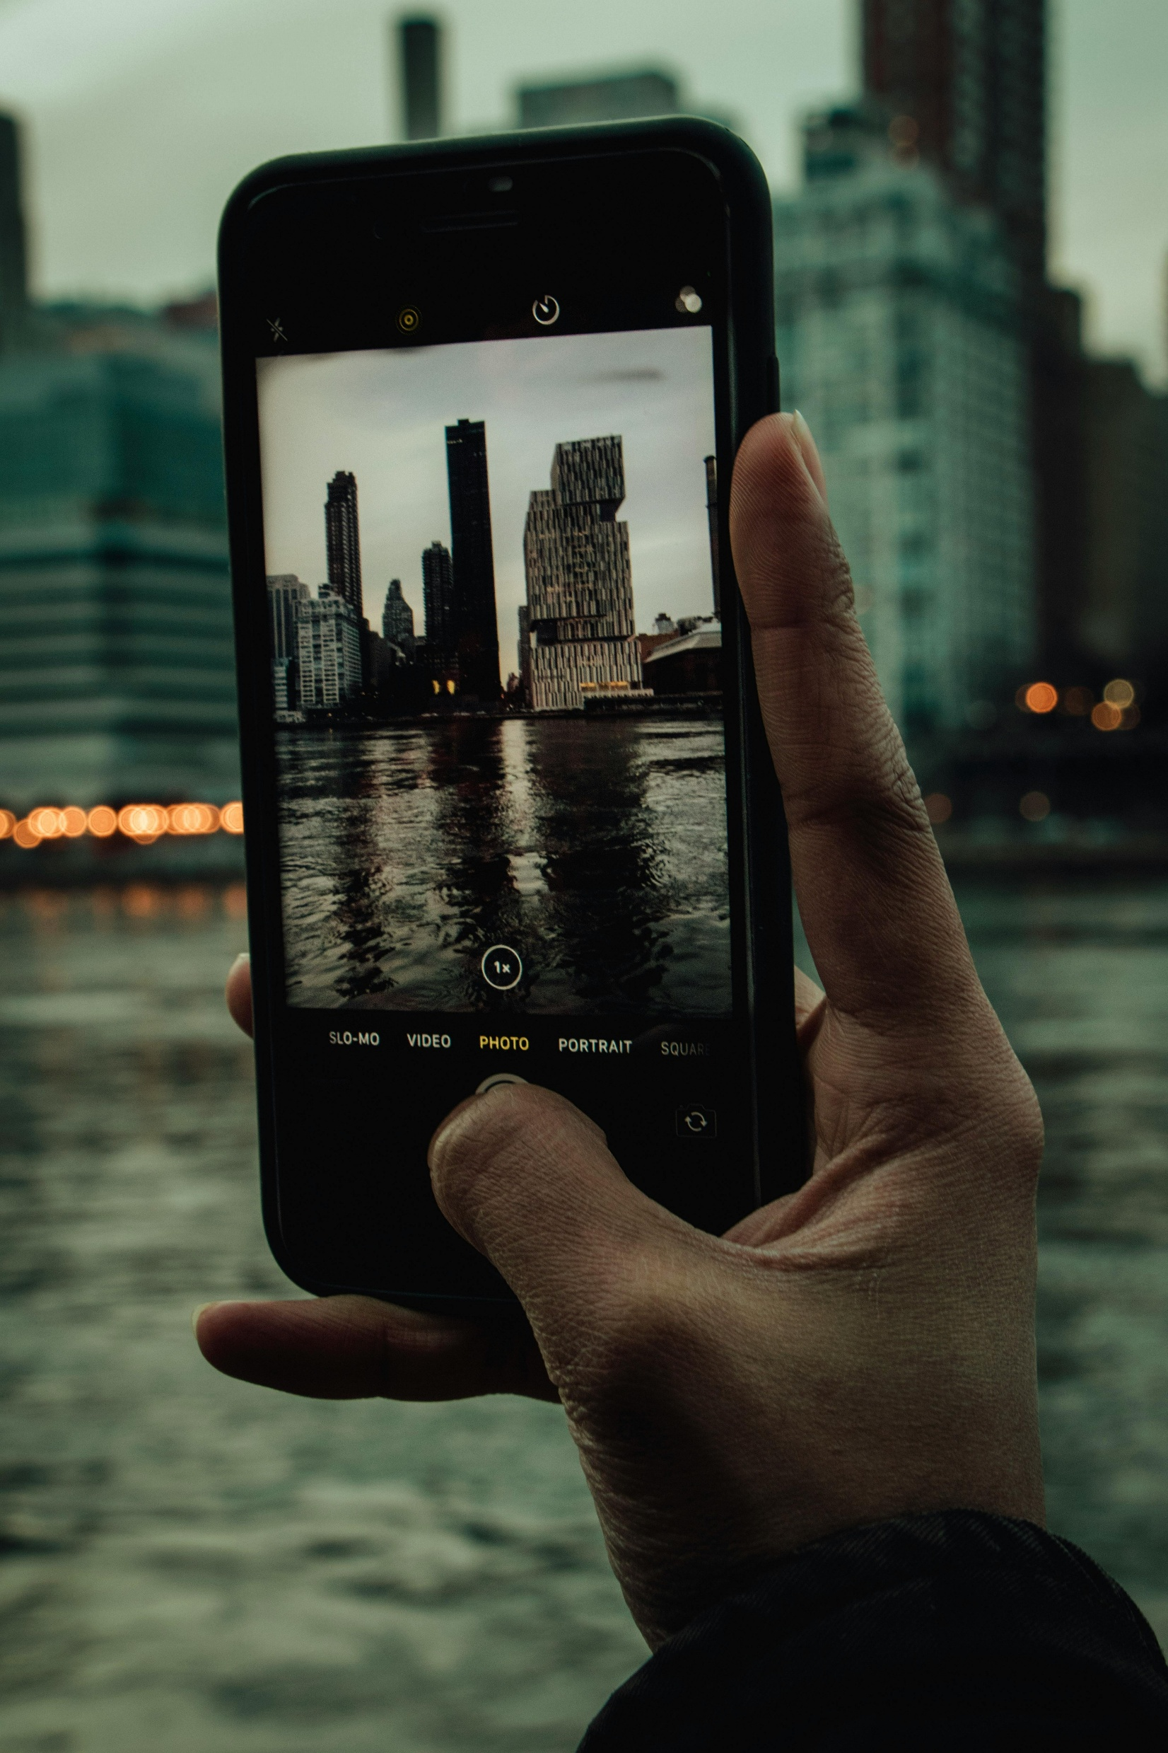


Turning Film and Literary Tourism
into Immersive Experiences
Implementation Clinic 01
Why Immersive Technologies Matter for Your Business
Learn how to create immersive film and literary tourism through practical workshops and hands-on clinics. Together, we explore key priority areas, tackle real challenges, discuss solutions, and explore practical approaches you can apply in real contexts.
January 2026
By Feltech Ireland

Slide 2

Implementation Clinic 1
Mapping Your Visitor Journey and Identifying Immersive Opportunities
Quick Tech and Content Audit
Try an AR Demo App

Slide 3

Bringing European Film & Literature to Life
Implementation Clinic Section
This section is designed to help you move from ideas to action by reflecting on how immersive experiences could be implemented within your business, place, or story.
Work through the exercises, activities and questions informally — on your own, with your team, or in a workshop setting. The focus is on exploring what’s possible, identifying practical opportunities, and deciding what makes sense for your resources, audience, and goals.

Slide 4
Mapping Your Visitor Journey and Identifying Immersive Opportunities
In this clinic you will explore how immersive storytelling could enhance your visitor experience.
You will complete three practical exercises:
Mapping the visitor journey
Identifying immersive touchpoints
Auditing available technology and content
1
Mapping Your Visitor Journey
Understanding the visitor journey helps identify the moments where storytelling and immersive elements can have the greatest impact.
Identify where visitors naturally pause, become curious, or ask questions. These moments are ideal opportunities to introduce immersive storytelling elements. Take a piece of paper and map out the current visitor journey for your tour or site. Mark points where visitors tend to be most excited or curious.
Now brainstorm one immersive element you could add at those points to amplify that excitement or satisfy the curiosity. For example: at a scenic lookout used in a film scene, maybe you provide a tablet with the film clip so they can compare; at a museum corner with a famous quote, you could use an audio recording of it being read dramatically. The key is to link story
Use the Editable Immersive Visitor Journey Map (with Touchpoints) Below
Step 1: Identify the stages of your visitor journey
Consider each stage of the visitor journey. Edit the below if needed.
Before the Visit (Discovery & Anticipation)
Arrival & First Impressions
Key Story Moments (Curiosity & Emotion Peaks)
Deep Engagement (Understanding the Story)
Reflection & Memory
After the Visit (Sharing & Connection)

Slide 5
Mapping Your Visitor Journey and Identifying Immersive Opportunities
1
Map the stages of your current visitor experience.
Step 2: Add & Name each Touchpoint (the little dots) on the Map
Now name and map (use a simple word if possible) on the digital and physical touchpoints on the journey where visitors are most engaged or asking questions (use conversational human and experience-led language, don’t be too technical)
Note: See next page for more help with this part.
xx
Digital Touchpoints
xxx
xx
xxx
xxx
xxx
xx
xxxe
xxx
xx
xxx
xxx
Before the Visit
(Discovery & Anticipation)
Arrival & First Impressions
Key Story Moments (Curiosity & Emotion Peaks)
Deep Engagement (Understanding the Story)
Memory & After the Visit (Sharing & Connection)
xxx
xxx
xxx
xxx
xxx
xxx
xxx
xxx
Physical Touchpoints

Slide 6
Mapping Your Visitor Journey and Identifying Immersive Opportunities
Identifying Moments of Curiosity
Step 2: Add & Name each Touchpoint (the little dots) on the Map
Where do visitors ask questions?
Where do they pause or take photos?
Where do they become emotionally engaged?
These moments often provide the best opportunities for immersive storytelling.
Now name and map (use a simple word if possible) on the digital and physical touchpoints on the journey where visitors are most engaged or asking questions (use conversational human and experience-led language, don’t be too technical)
Choose one or two moments in the visitor journey where immersive storytelling could enhance the experience. Examples:
• QR code linking to a film scene
• Audio narration of a story excerpt
• Augmented reality overlay
• Short dramatic reading
Note: See next page for more help with this part.
xx
Digital Touchpoints
xxx
xx
xxx
xxx
xxx
xx
xxxe
xxx
xx
xxx
xxx
Before the Visit
(Discovery & Anticipation)
Arrival & First Impressions
Key Story Moments (Curiosity & Emotion Peaks)
Deep Engagement (Understanding the Story)
Memory & After the Visit (Sharing & Connection)
xxx
xxx
xxx
xxx
xxx
xxx
xxx
xxx
Physical Touchpoints

Slide 7
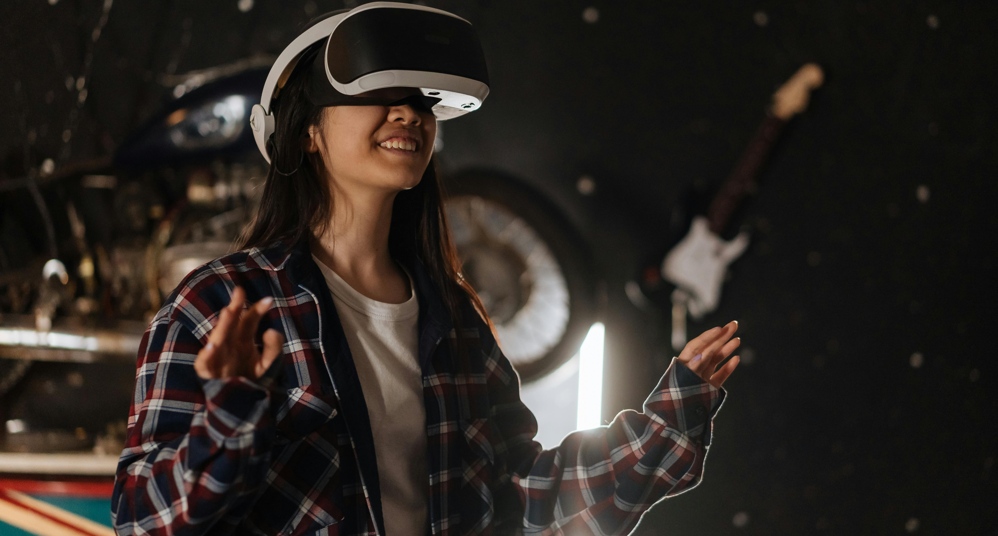

Stage 1: Before the Visit – Discovery & Anticipation
Visitor mindset: “What’s special about this place?” Immersive touchpoint: A short teaser video or audio clip triggered by a QR code on the website A quote from the film or book read aloud by a narrator Low-tech option: Audio clip on the website Story link: Sets emotional tone before arrival
Higher – Advanced Tech Options
Higher-tech immersive option: Interactive Web-Based Storyworld A browser-based immersive teaser where visitors explore characters, locations, or timelines before arriving (no app download). This could include short cinematic clips, branching story choices, or AI-driven narration that adapts to user interest. Advanced add-on: Personalised AI Story Preview Visitors answer 2–3 questions online (e.g. “film lover” or “history fan”) and receive a tailored teaser experience highlighting what they’ll enjoy most. Story value: Builds anticipation and emotional investment before arrival.

Slide 8
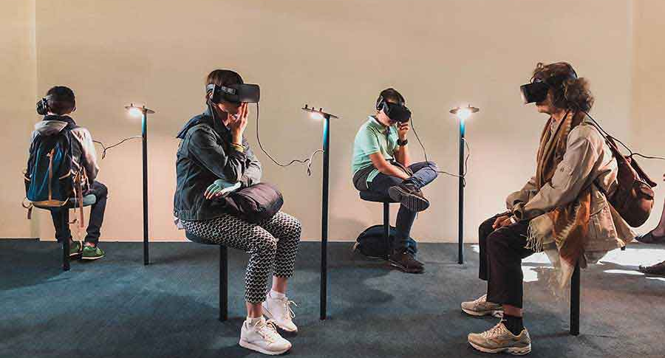
Stage 2: Arrival – First Impressions
Visitor mindset: “Where am I, and why does it matter?” Immersive touchpoint: AR welcome screen on a phone showing the location “then vs now” A short spoken introduction from a fictional character or filmmaker Low-tech option: QR code linking to a short intro video Story link: Grounds visitors in place and narrative
Higher – Advanced Tech Options
Higher-tech immersive option Location-Triggered AR Welcome Experience When visitors arrive, GPS or beacon-triggered AR automatically launches a welcome scene on their phone — a character, narrator, or filmmaker appears to introduce the place. Advanced add-on AR Spatial Audio Introduction Directional audio changes as visitors move through space, guiding them physically and narratively into the experience. Story value: Creates a cinematic “arrival moment” that immediately sets tone and identity.

Slide 9

You don’t need immersive tech everywhere.
One well-placed immersive touchpoint at a moment of curiosity or emotion
can transform the entire experience.
The goal is always the same:
Use technology to serve the story — not distract from it.
Stage 3: Key Story Moment – Curiosity Peak
(e.g. scenic lookout, street, room, landscape used in a film or book) Visitor mindset: “This feels important — what happened here?” Immersive touchpoint: Tablet or phone-based AR showing the original film scene Side-by-side comparison: real view + scene overlay Low-tech option: Still image + audio explanation Story link: Connects fiction directly to the real place
Higher – Advanced Tech Options
Higher-tech immersive option: Cinematic AR Scene Reconstruction High-fidelity AR recreates the original film scene or literary moment in situ — characters appear at real scale, dialogue plays, and visitors can move around the scene. Advanced add-on: Volumetric Video Characters Actors or narrators captured in 3D appear as hologram-like figures that speak directly to visitors. Story value: Transforms curiosity into awe by collapsing fiction and reality.

Slide 10

Stage 4: Deep Engagement – Understanding the Story
(e.g. museum corner, exhibition space, interior room) Visitor mindset: “I want to understand this more deeply.” Immersive touchpoint: Audio recording of a famous quote being read dramatically Short behind-the-scenes story from a writer, actor, or local voice Low-tech option: Headphones + audio player Story link: Adds emotion, voice, and meaning
Higher – Advanced Tech Options
Higher-tech immersive option: Multi-User VR or MR Experience Visitors step into a shared virtual or mixed-reality space where they explore story layers together — timelines, alternative endings, behind-the-scenes decisions, or character viewpoints. Advanced add-on: AI Story Companion An AI-driven guide responds to visitor questions in real time (“Why was this scene controversial?” “What was the author thinking here?”). Story value: Deepens understanding while maintaining agency and exploration.

Slide 11
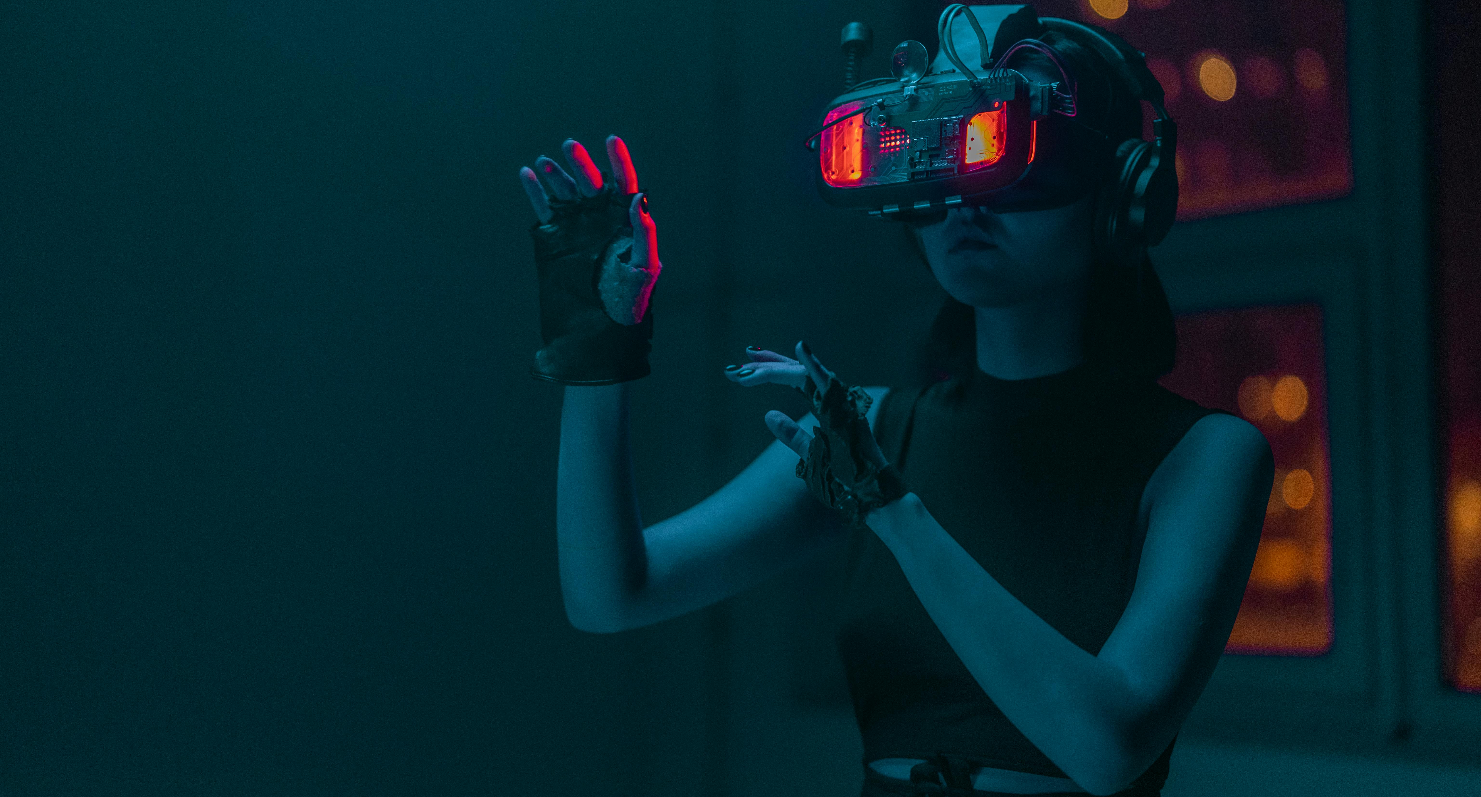

Stage 5: Reflection – Memory & Emotion
Visitor mindset: “How did this make me feel?” Immersive touchpoint: Digital guestbook or prompt: “Which scene stayed with you most?” Soundscape or music from the film/book world Low-tech option: Written reflection card + QR follow-up Story link: Encourages emotional connection and memory-making
Higher – Advanced Tech Options
Higher-tech immersive option: Emotion-Responsive Experience Using optional inputs (choice-based reflection, tone analysis, or interaction patterns), the system adapts music, visuals, or narrative endings to mirror how visitors felt. Advanced add-on: Digital Memory Capsule Visitors create a personalised digital keepsake (audio reflection, AR postcard, or short cinematic recap) sent to their email or phone. Story value: Turns emotion into a lasting, personal memory.

Slide 12

High-tech immersion isn’t about doing more — it’s about going deeper.
Advanced tools should only be used where they strengthen emotion, meaning, or connection to place.
Stage 6: After the Visit – Sharing & Connection
Visitor mindset: “I want to remember this or tell others.” Immersive touchpoint: Shareable AR photo moment Follow-up email with a hidden story, deleted scene, or bonus chapter Low-tech option: QR code to bonus content Story link: Extends the story beyond the site
Higher – Advanced Tech Options
Higher-tech immersive option: Persistent Digital Twin Experience Visitors unlock ongoing access to a digital version of the story world — new scenes released over time, seasonal content, or alternative perspectives. Advanced add-on: Social AR Story Moments Shareable AR scenes that place visitors inside the story world for social media, encouraging organic promotion. Story value: Extends the narrative beyond the site and builds long-term engagement.

Slide 13

2
Quick Technology and Content Audit
Many tourism businesses already have the tools needed to create simple immersive experiences. This exercise helps identify existing resources you can use immediately.
Assess what technology you already have access to.
Do you have an iPad or a projector lying around?
Do most visitors carry smartphones (almost certainly, yes)?
List what’s available, including digital content you already own (photos, videos, audio clips related to your story). Often you can start immersive experiences using existing tech – like uploading a 360° photo of your location to Facebook or Google so people can “virtually visit” online, or using simple QR codes. This audit will be handy in planning low-cost implementations.
List Devices and Match Content You Already Have and start There
Wi-Fi available on-site
1 laptop for admin and marketing
Several famous quotes from the book/film associated with the site
A short-written backstory used on the website
Action: add existing 2 short promo videos filmed on different social media (e.g., TikTok, You Tube, Instagram, Website, Linked In, Twitter etc.)
1 iPad at reception (used occasionally for bookings)
Action: Play an existing short looping video introducing the story and setting
Small portable projector (used for talks and events)
Action: Use it for an evening screening of a film scene or a literary reading
Visitors’ smartphones (almost all visitors carry one)
Action: QR codes linking to audio clips or behind-the-scenes stories
Existing 30+ high-quality photos of the location and surroundings
Action: Upload a 360° photo to Google Maps or Facebook for virtual visits
Have 1 audio interview with a local storyteller
Action: Create a “Listen here” moment at a key story location
No new equipment needed to get started
Most of the storytelling content already exists

Slide 14
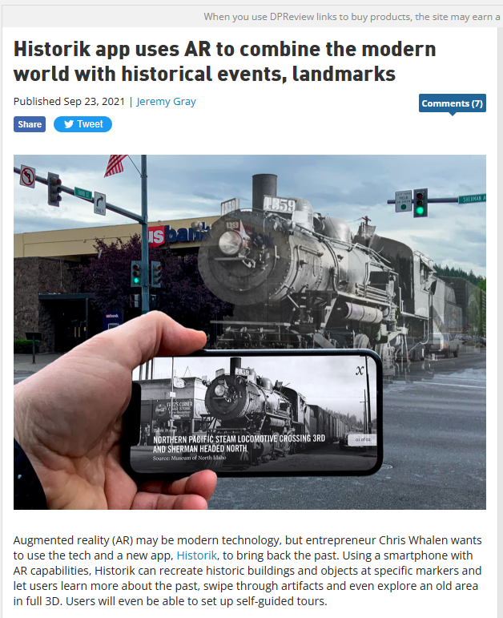

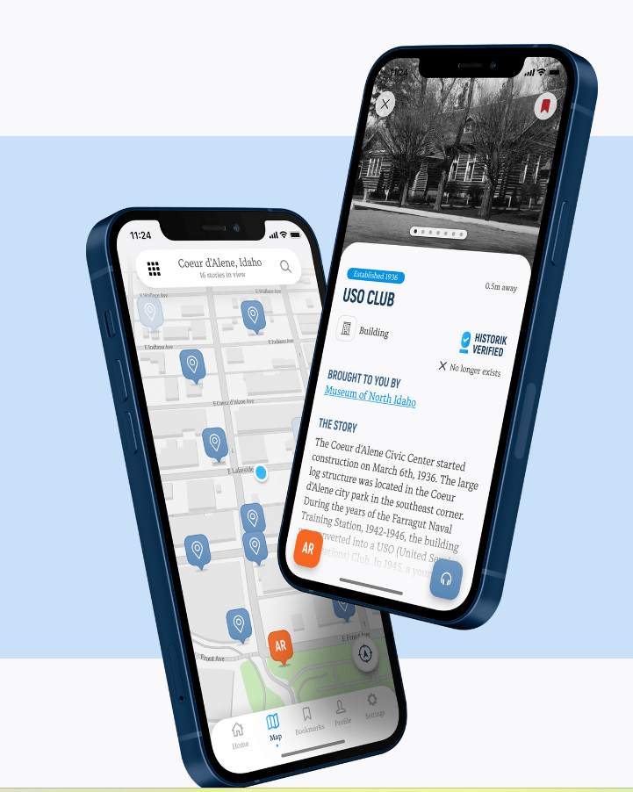
3
Testing Immersive Technologies
A hands-on way to grasp immersive tech is to try it yourself. Download a free AR app such as Google Arts & Culture (for virtual exhibits) or an app like Historik (which recreates historical scenes via AR) rockpaperreality.com.
Imagine how something similar could apply to your site. For instance, if you point your phone at a particular spot in your town, what digital content would wow a visitor (a historic photo overlay, an animation of a book character, etc.)?
Make a list of 2-3 ideas. Don’t worry yet about how to build it – just envision the possibilities.
Download App Historik
We leverage the power of geospatial data to bring North Idaho’s history to life. Swipe through historical markers to explore the region’s rich past—from hidden landmarks to well-known sites—all based on your location. Never unknowingly pass by history again. https://www.historik.com/

Slide 15
Case Study
Implementation: New Zealand’s Middle-earth & Beyond
Film Tourism and Immersive Storytelling: These examples help you visualise implementation.
To illustrate why embracing immersive storytelling can be so powerful, consider New Zealand’s success with film tourism.
After The Lord of the Rings hit the screens, New Zealand famously branded itself as the real-world Middle-earth. Guided by Tourism New Zealand’s marketing campaigns, fans from around the globe flocked to see Hobbiton and the stunning landscapes from the films.
The results were dramatic: in the five years after the first LOTR film, tourist numbers shot up by about 40%, and by 2006 arrivals had climbed from 1.7 to 2.4 million annually cathaypacific.comonlinemba.com. Many visitors cited the films as a key reason for choosing New Zealand. This influx brought substantial economic gains – all sparked by effectively leveraging a story.
Now, New Zealand didn’t stop at simply pointing out film locations – they created immersive experiences around them. Hobbiton isn’t just a movie set; it’s a guided experience where visitors feel like inhabitants of the Shire, complete with hobbit costumes and a mug of ale at the Green Dragon Inn. In Wellington, the Weta Workshop (the props/design studio for the films) offers interactive tours where you can see and even handle movie props, learning how the fantasy was made real. These are examples of layering immersive elements onto a film tourism draw: theatrical guides, hands-on exhibits, and detailed storytelling turn a passive sightseeing trip into an engaging journey.
The takeaway: You might not have a blockbuster movie filmed in your backyard, but the principle holds true on any scale. If you have a story (a film, TV show, famous book, legend, etc.) connected to your location, leveraging it can significantly boost interest. And by designing immersive ways for visitors to experience that story – be it through tech, interactive tours, or creative storytelling – you transform curious visitors into enthusiastic participants. The rest of this guide will show you how to do exactly that, step by step.
The Economic Impact of LOTR
Visit Middle Earth and see New Zealand through Frodo's eyes!
10 Day Lord of the Rings & Hobbit Holiday Package
Best Lord of the Rings filming locations in New Zealand

Slide 16
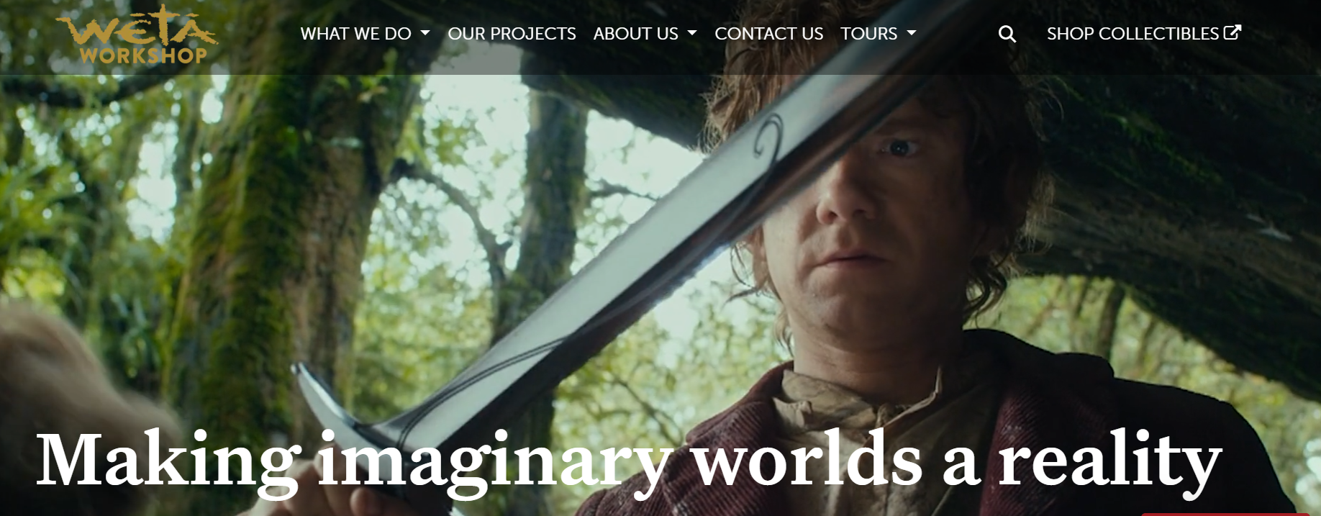
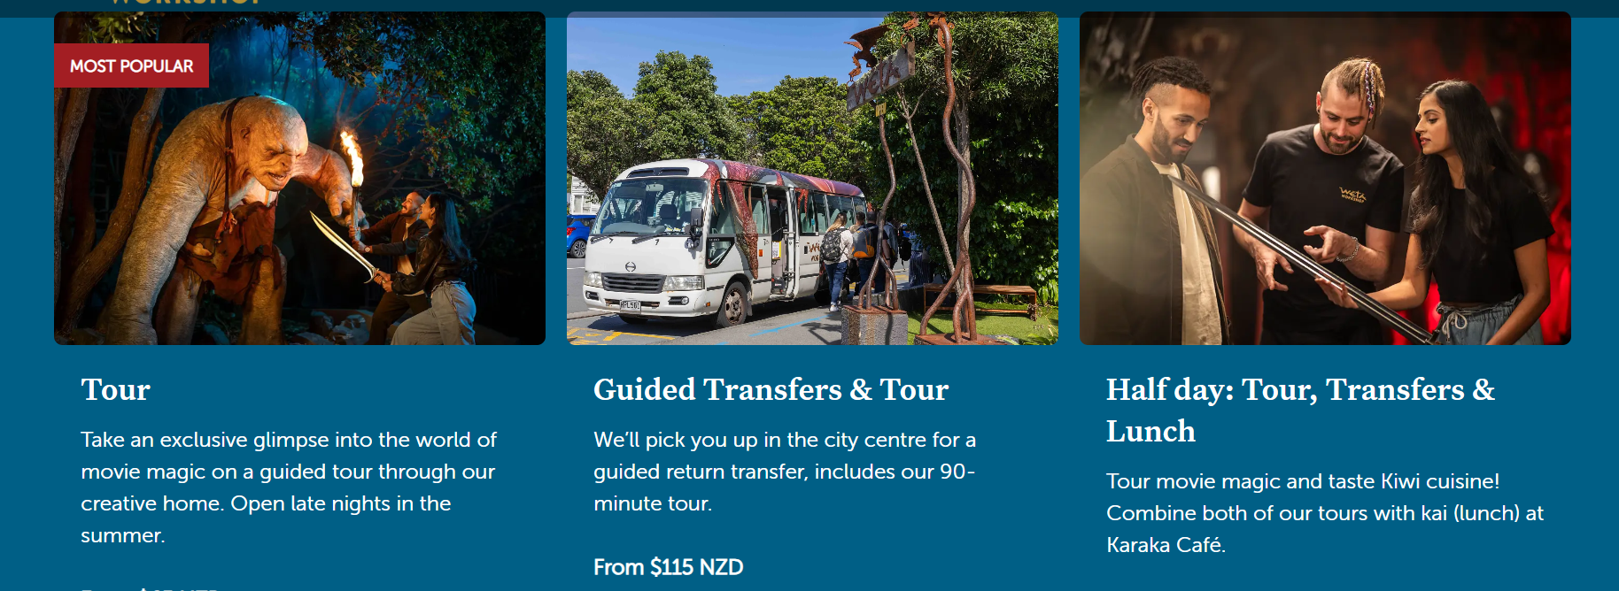
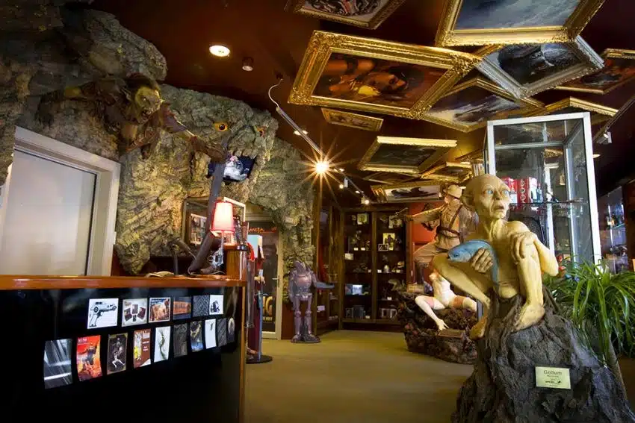
Weta Workshop, Wellington, NZ
https://www.wetaworkshop.com/

Slide 17
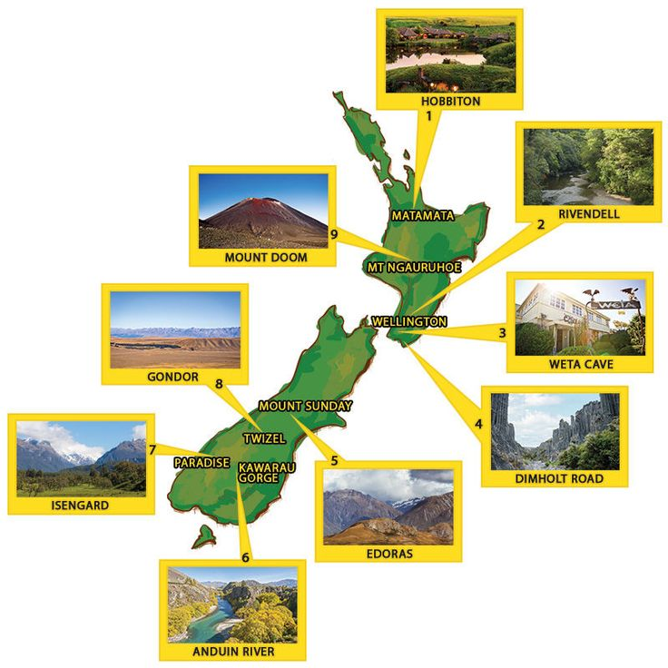
Visit Middle Earth and see New Zealand through Frodo's eyes!
Practical Implementation Tips
Start small
Test with one location
Use existing content
Measure visitor engagement

Slide 18
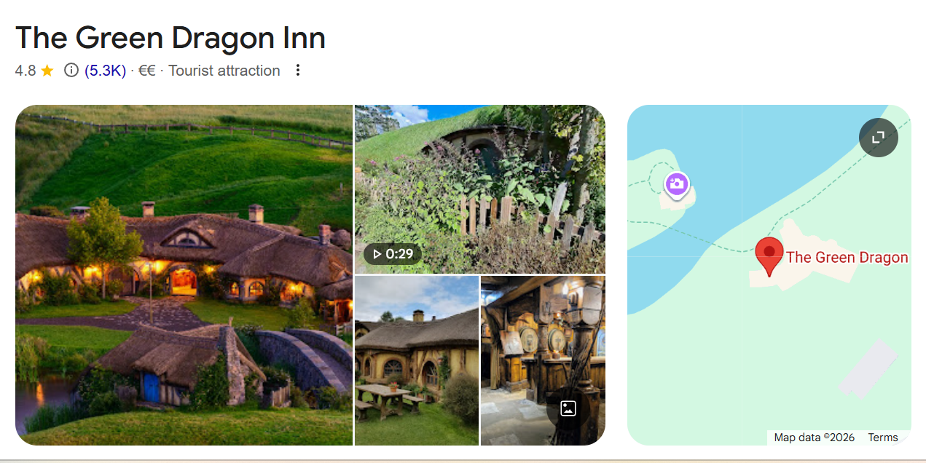
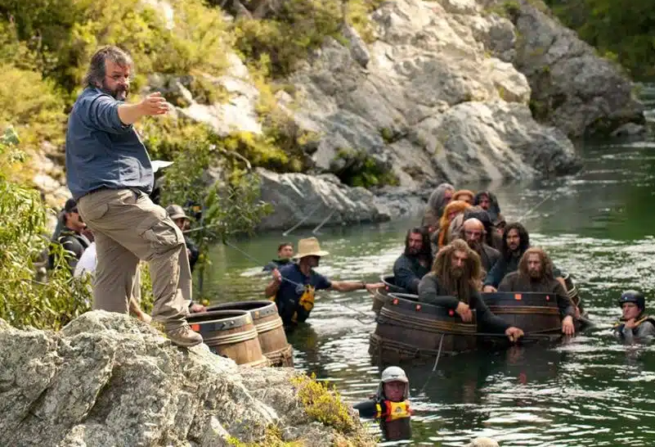
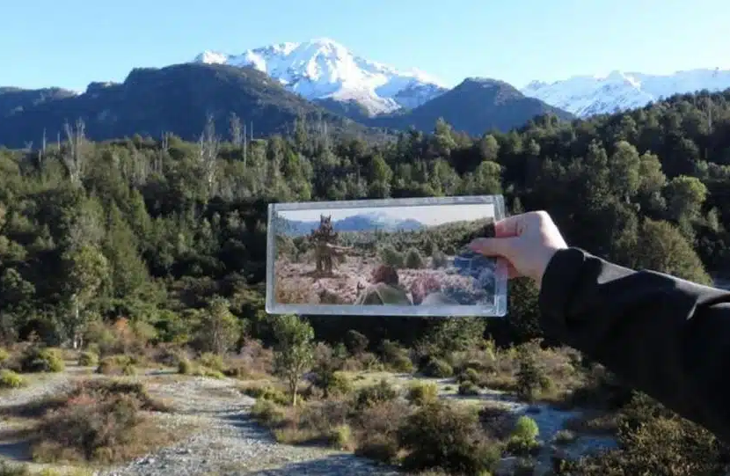
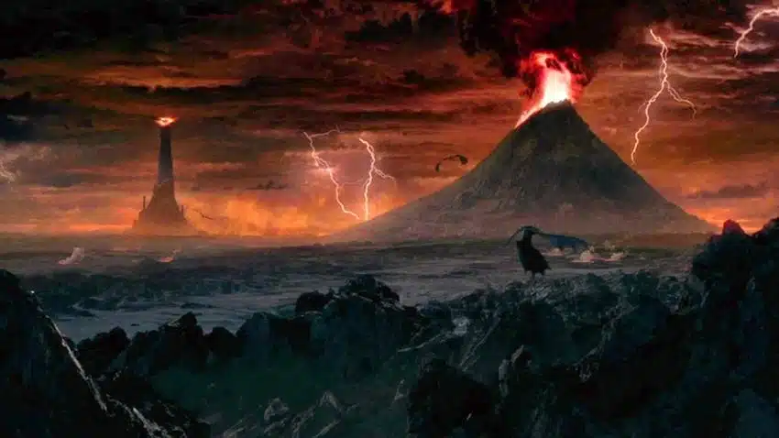
Green Dragon Inn, Matamata, NZ
https://www.hobbitontours.com/discover/the-green-dragon-inn/
Lord of the Rings: Filming Locations, NZ
https://www.moatrek.com/blog/best-lord-rings-filming-locations
Peter Jackson directing at the Pelorus River
Lord of the Rings Scenic Tour
Mt Doom scene from Lord of the Rings

Slide 19
Approaches & Solutions
If your exploration above identified some exciting ideas and some worries, that’s perfectly normal. Starting small and being strategic is the name of the game. Here are some approaches to consider:
Start with “Why” – always tie tech use to a purpose. Don’t use VR just because it’s trendy; use it because it helps tell your story better or solves a problem (like showing an inaccessible view). This ensures technology adds value rather than distracts. It is important to have a clear goal (e.g. “make visitors feel like characters in the story” or “explain complex history in a visual way”) this will guide your tech choices.
Leverage What You Have – You might not need custom software. There are many off-the-shelf apps and platforms for tourism. For instance, some companies offer AR tour apps where you can plug in your own content without coding. Even simple tools like QR codes can trigger audio or video on visitors’ phones – a low-cost form of AR. Using free or inexpensive platforms initially can be a smart way to test what works with your audience.
Combine Tech with Human Touch – One of the best approaches is using technology to enhance your personal or guided experience, not replace it. For example, a guide can carry a tablet to show AR visuals to the group, or you can give visitors an audio device that plays character voices at certain spots while you narrate live. This way, tech remains a tool in your storytelling toolbox, and you still engage with visitors directly.
Prototype and Iterate – Treat your first immersive tech addition as an experiment. It doesn’t have to be perfect. Maybe you create a short 2-minute VR video of a re-enacted scene and set up a single VR headset at your site for visitors to try. Gather feedback: Did people enjoy it? Was it easy to use? Use those insights to improve or decide on your next investment. Immersive tech is evolving, so a continuous improvement mindset will serve you well.
Mind Accessibility – When implementing tech, also plan alternatives for those who can’t or won’t use it. For instance, if you have an AR app, ensure there’s also a pamphlet or sign with similar information for visitors without smartphones. If a VR experience isn’t wheelchair accessible (due to space or hardware), consider having a 2D video version. This inclusive approach keeps the experience positive for all.

Slide 20
Develop Your Action Plan
Immediate next steps (0–6 months)
Pick one small immersive element that you can realistically implement soon – something that costs little and you’re curious about. It could be as simple as adding an audio storytelling segment (downloadable via QR code) at a point of interest, or collaborating with a local tech student to create one 3D model for AR. Implement it and observe how visitors respond.
Mid-term (6–24 months)
If the trial went well, plan a modest expansion. You might develop a dedicated mobile app or guided AR tour with multiple points, apply for a small grant to get a couple of VR headsets, or invest in training staff on delivering interactive performances (mixing tech and theater). At this stage, consider how the immersive feature can be marketed to attract more visitors – for example, promote it on social media with enticing visuals.
Long-term (2–5 years)
Envision a more integrated immersive experience across your entire offering. Perhaps you transform your site into a semi-virtual environment (holographic guides? interactive walls?) or you partner with tech providers to create a unique product (like an escape-room style adventure through the whole town). Keep an eye on tech trends – hardware is constantly improving (e.g. lightweight AR glasses could replace phone screens soon, making it easier for visitors to engage vsgt.si). By having already experimented in the short term, you’ll be ready to adopt bigger innovations when they become affordable and user-friendly.
without smartphones. If a VR experience isn’t wheelchair accessible (due to space or hardware), consider having a 2D video version. This inclusive approach keeps the experience positive for all.

Slide 21

www.uplifttourism.eu

